Slide 1
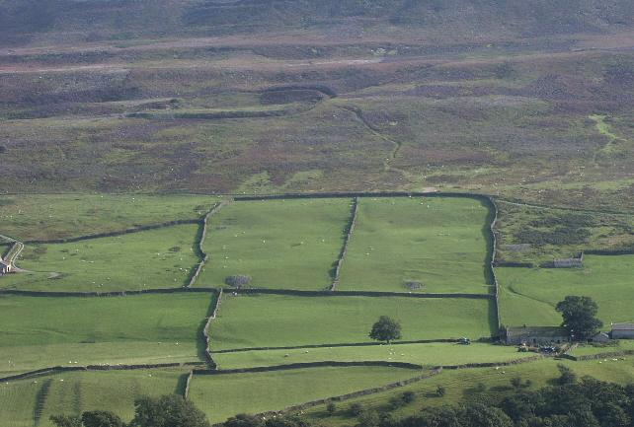
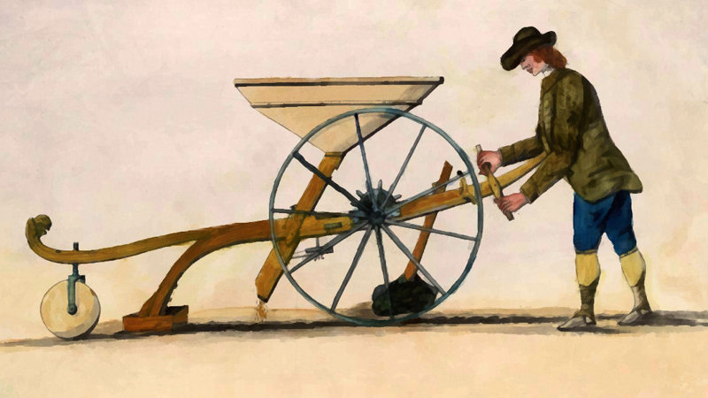
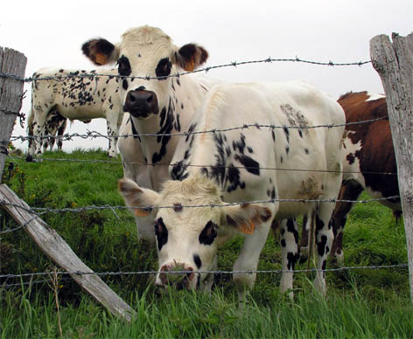
Start-up Task
List some of the changes that happened during the Agricultural Revolution in Britain.

Slide 3
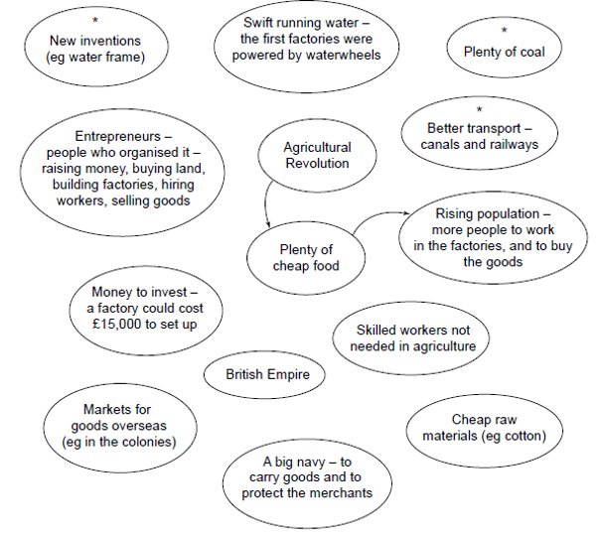

Slide 4
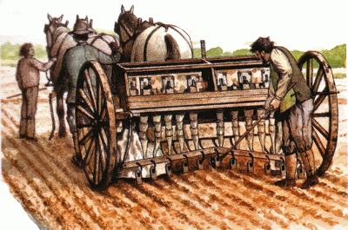
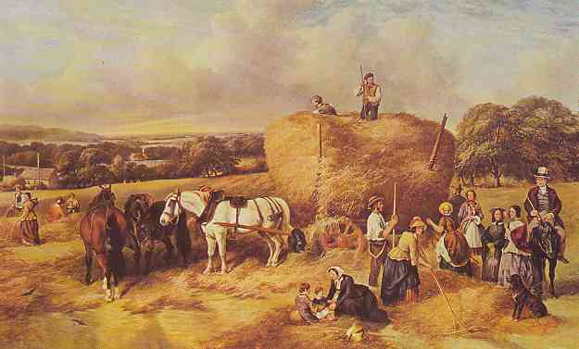
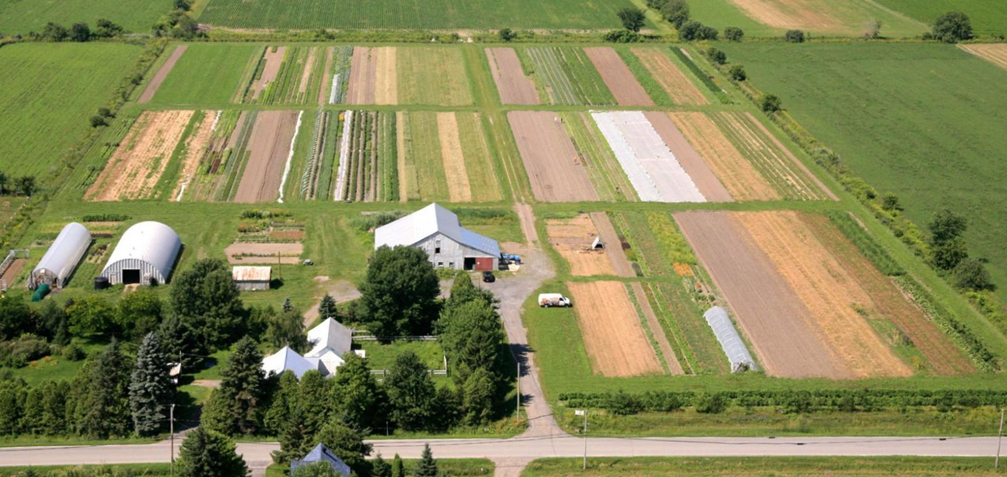
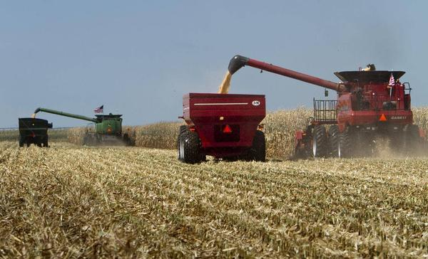
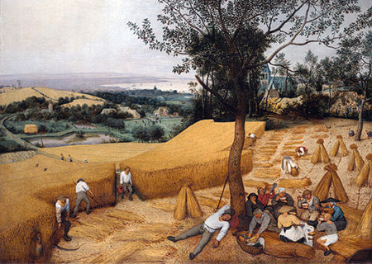
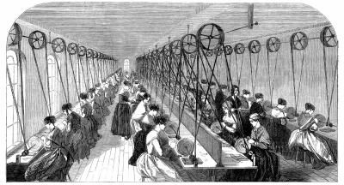
Agriculture: Then & Now

Slide 5
Learning Outcomes
By the end of this lesson, I can…
Compare and contrast farming in the 1800s with farming today

Slide 6
Think/Pair/Share
List (in point-form) some of the issues that farmers in B.C. have to deal with each year.
What can hurt their crops?

Slide 7
#FarmLife

Slide 8
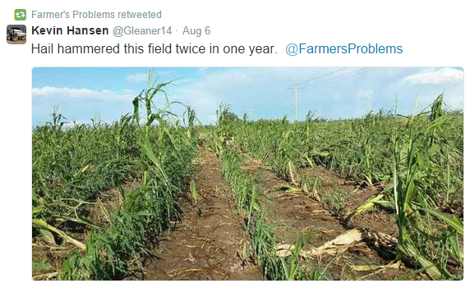

Slide 9
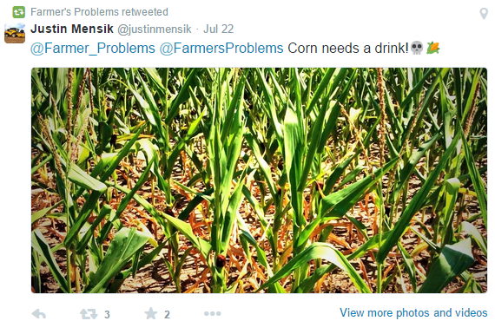

Slide 10
Farming Cartoon Assignment
Create a split-screen cartoon comparing what farms looked like in 19th Century England and what they look like now in Canada.
Think about:
Number of farm workers
Clothing of farm workers
Machines/Technology used
Crops
Animals
Water

Slide 13
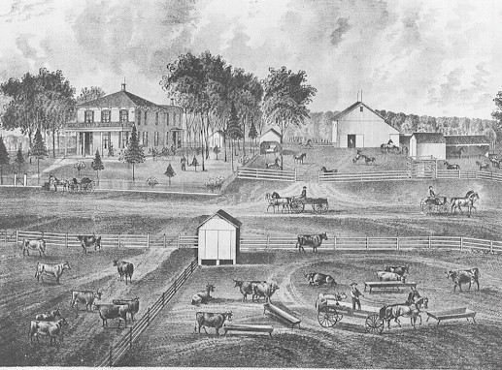

Slide 14
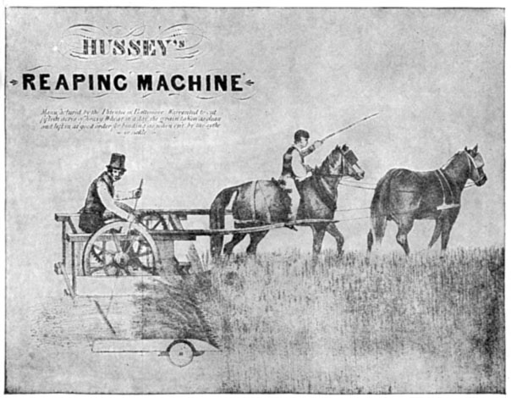

Slide 16
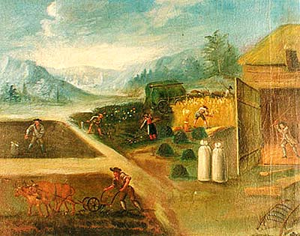

Slide 17
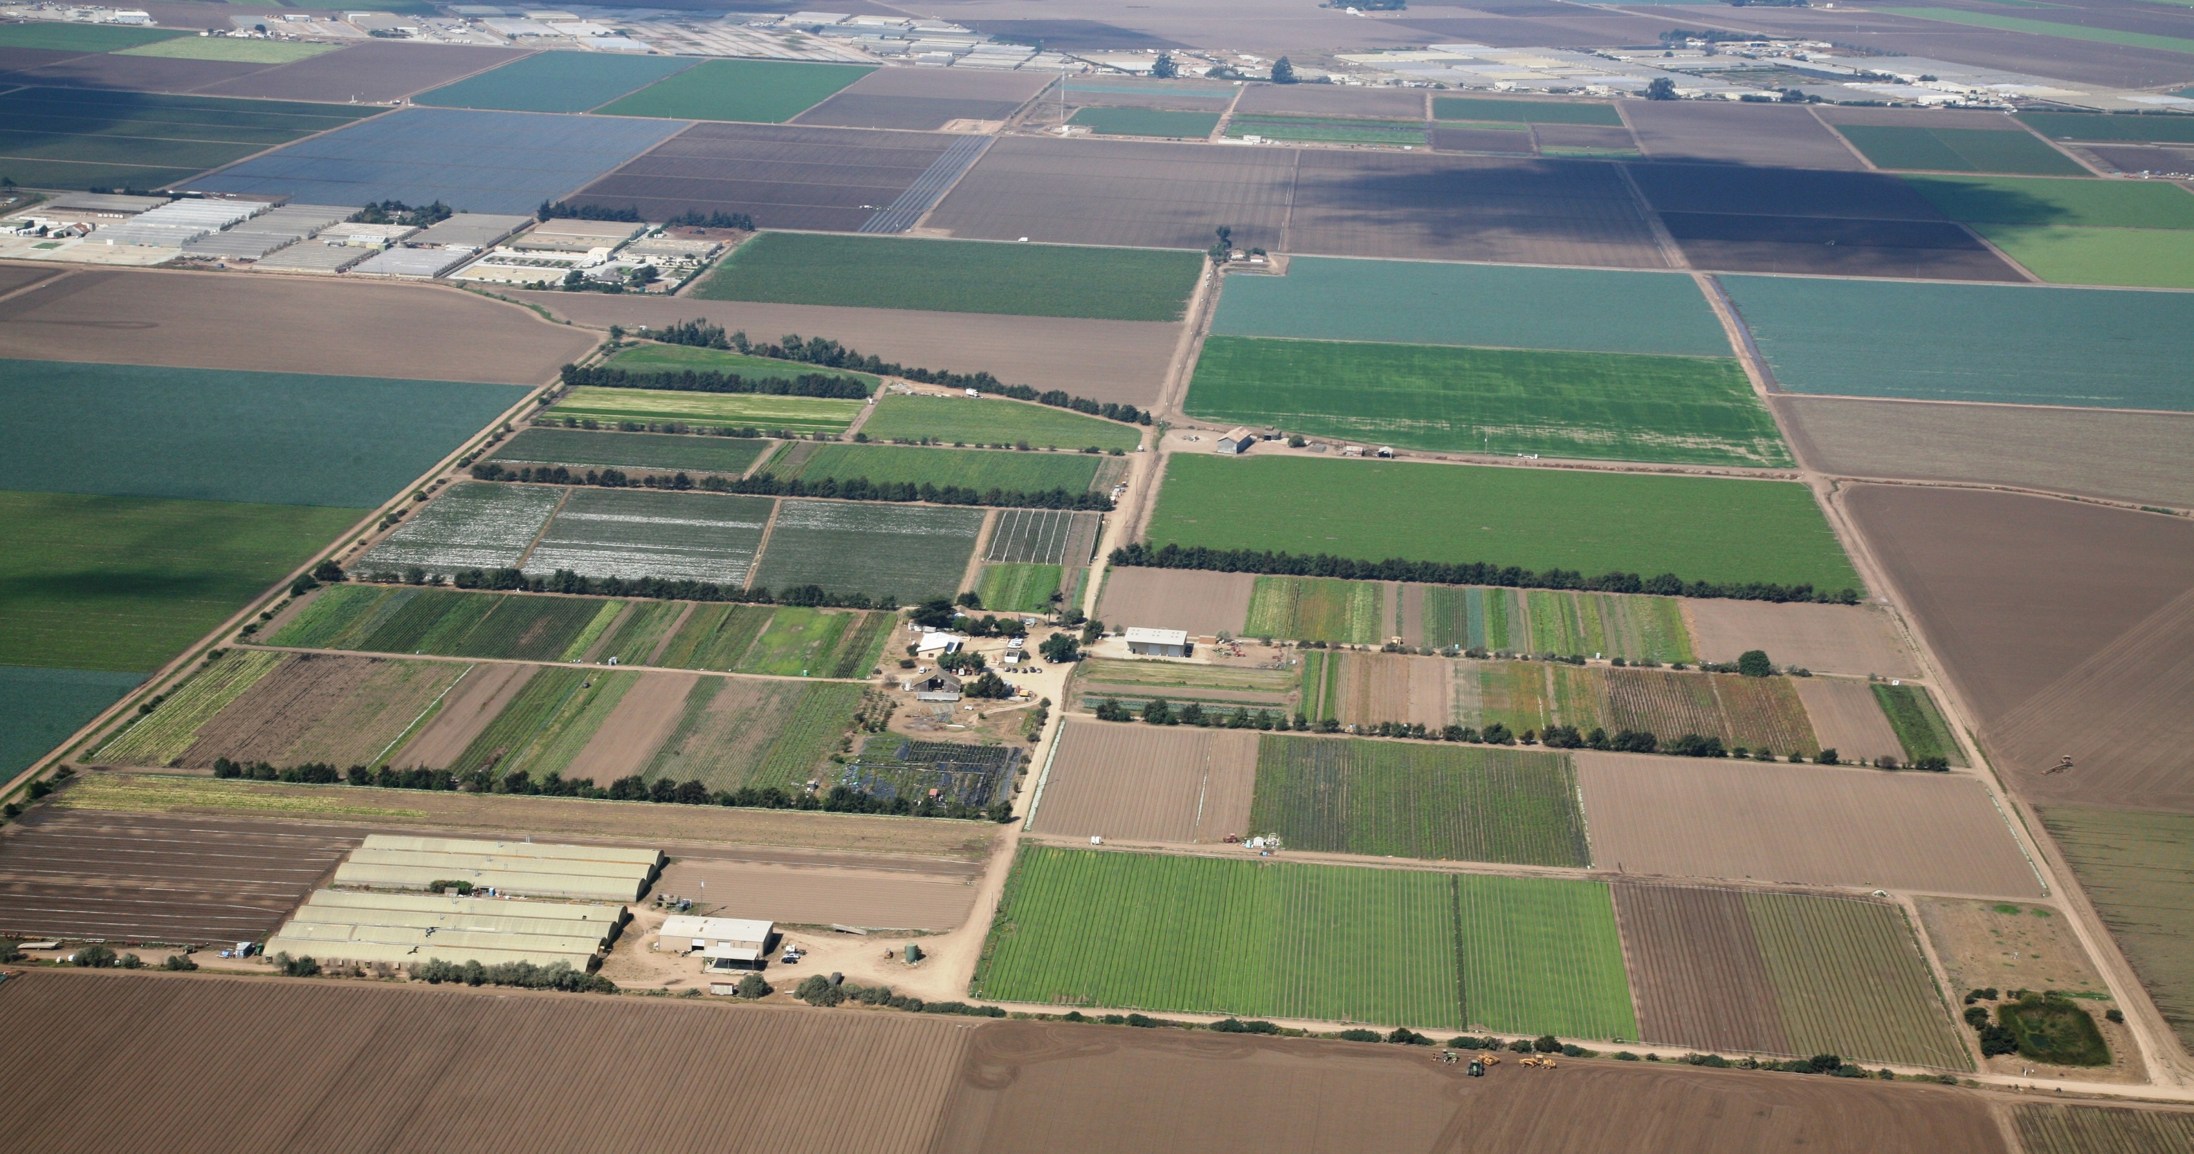
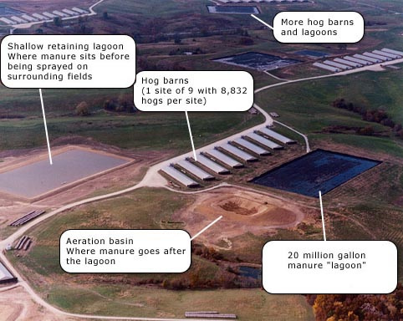

Slide 19
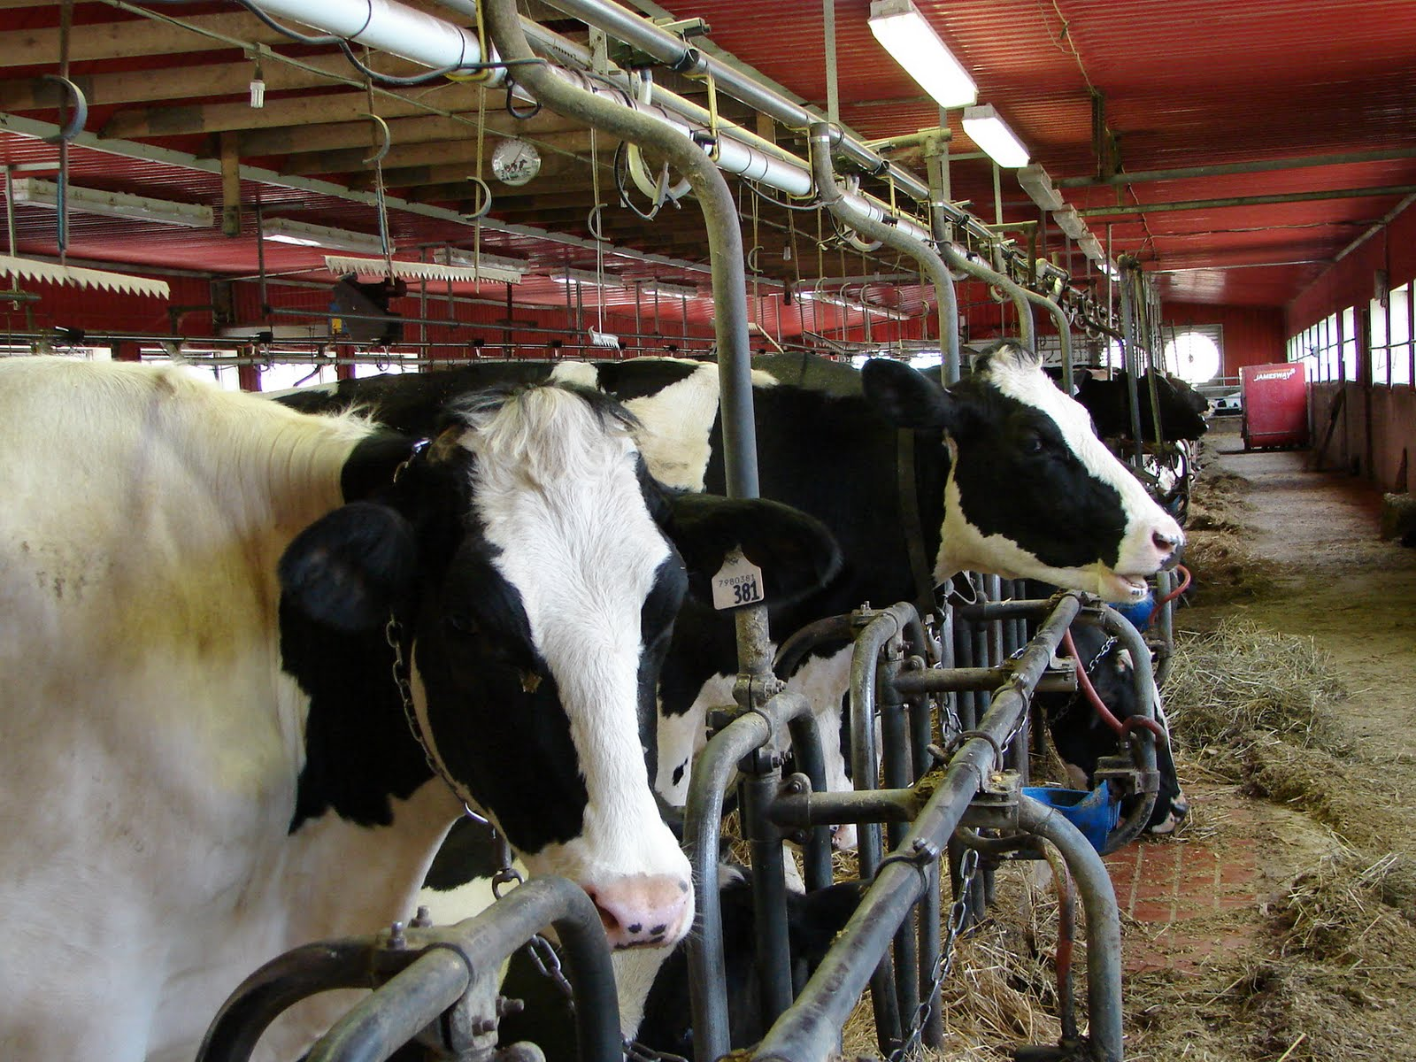

Slide 21
Farming Cartoon Assignment
Create a split-screen cartoon comparing what farms looked like in 19th Century England and what they look like now in Canada.
Think about:
Number of farm workers
Clothing of farm workers
Machines/Technology used
Crops
Animals
Water

Slide 22
Farming Cartoon Assignment
Create a split-screen cartoon comparing what farms looked like in 19th Century England and what they look like now in Canada.
The 1800s
Today

Slide 23
Extensions
The Basics of Our Food System
https://www.youtube.com/watch?v=04T23houM4s

