Slide 1
Assessment in Social Studies 9

Slide 2
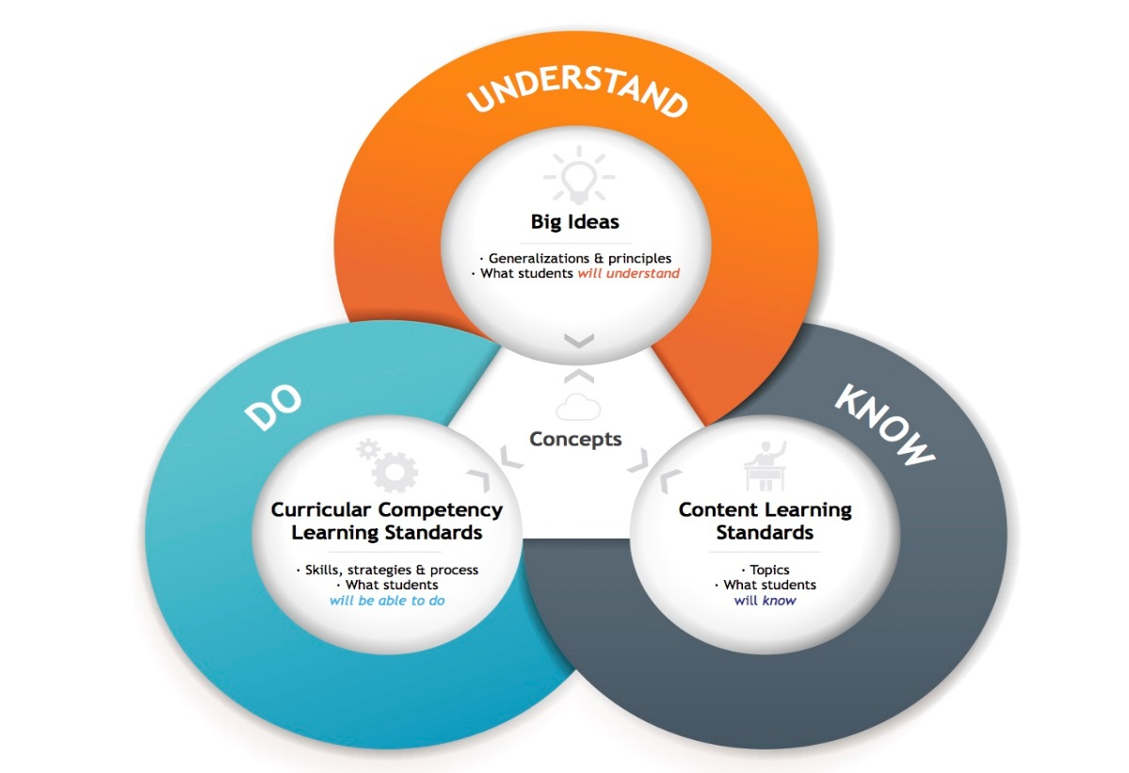
3 “BIG” Categories
Big Ideas (What you UNDERSTAND)
Content (What you KNOW)
Competencies (What you can DO)

Slide 3
Big Ideas
5% of final mark
Will be assessed in the final culminating questions (written questions) at the end of this course. You will use evidence (what you have learned) to answer them.

Slide 4
Content (C)
25% of class mark
Will usually be assessed through quizzes or tests (sometimes assignments), throughout the semester.

Slide 5
Competencies
75% of class mark
Communication (30%) CM
Thinking (30%)
Critical CLT
Creative CRT
Personal & Social Responsibility (15%)
Positive Personal and Cultural Identity PCI
Personal Awareness & Responsibility PAR
Social Responsibility SR

Slide 6
You will be assigned a mark from 1-4
4 | I am confident I have mastered this (Fully Meeting learning outcomes)
3 | I have a good understanding of this (Meeting learning outcomes)
2 | I have a basic understanding of this (Minimally Meeting learning outcomes)
1 | I am still just learning this (Not Yet Meeting learning outcomes)
You will also assess YOUR OWN progress with these sheets throughout the course, checking of 1, 2, 3, or 4 for certain learning outcomes.

Slide 7
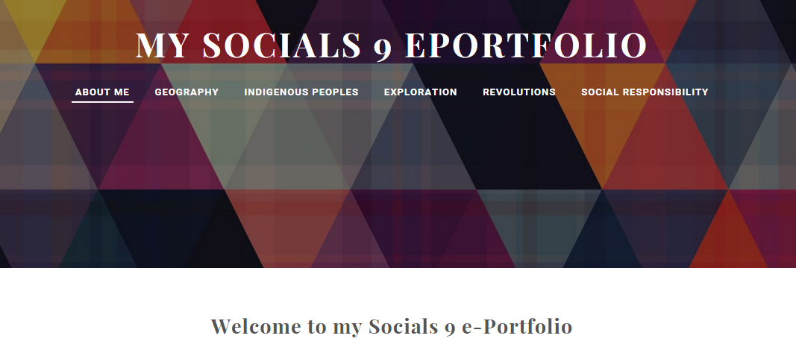
ePortfolio
10% of final mark
Contains EVIDENCE of learning, and REFLECTIONS
Sample: http://sampless9eportfolio.weebly.com/

