Slide 1
Check-in
Something you did on the weekend
OR
Something you are looking forward to
OR
Something you are grateful for

Slide 2
Debrief: Confederation Simulation
Thoughts or comments
What went well?
Challenges?
What we could improve for next time?

Slide 3
Writing in Role
Step 5: Write a one-page summary report of the conference to your colleagues back in your home colony. Use the following questions as a guide:
What significant items did you achieve for your colony?
What items did you have to concede for your colony?
What changes to your original outlook did you make and why?

Slide 4
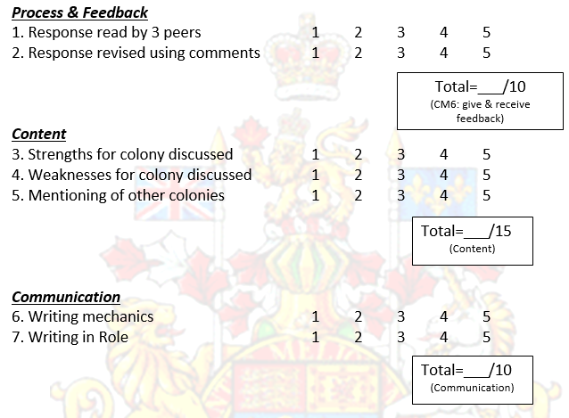
Writing in Role: Criteria

Slide 9
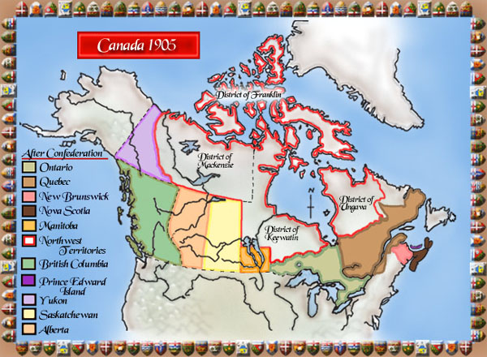

Slide 10
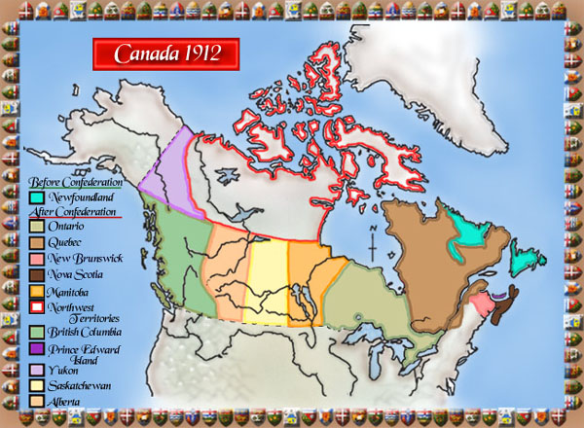

Slide 11
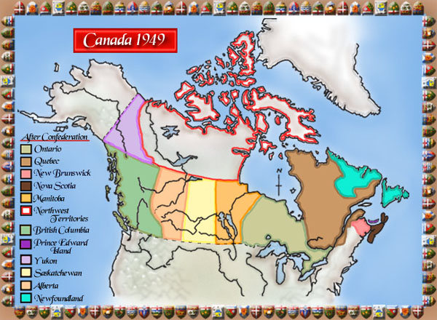

Slide 13
The BNA Act, 1867
Read p. 85-88, and answer the following questions:
What is a constitution? (in your own words!)
Look at the excerpt from the BNA Act (86-87): summarize how our divisions of power (from the conference we had) are similar/different.
In what key way did Canada’s approach to achieving nationhood differ from that of the United States?
Would you say that the new Dominion of Canada was truly independent? Explain your answer.

