Slide 1
Documentary
Before Viewing: Review
Why do you think that murder rates are so much higher in the United States than they are in Canada?

Slide 2
Documentary
Before Viewing: Review
Child Poverty
How does child poverty in BC compare with the rest of Canada?
BC has the LOWEST % of children living in poverty
BC is right in the middle
BC has the HIGHEST % of children living in poverty
a)
b)
c)

Slide 3
Documentary
Before Viewing: Review
Child Poverty
How does child poverty in BC compare with the rest of Canada?
BC has the HIGHEST % of children living in poverty
c)

Slide 4
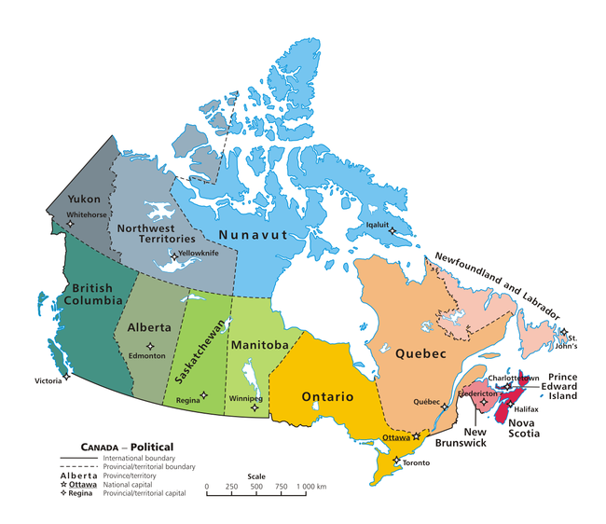
Documentary
Before Viewing: Review
Which province do you think has the highest murder rates in Canada?

Slide 5
Documentary
Before Viewing: Review

Slide 6
Documentary
Before Viewing: Review
Do you know anyone who owns a gun or rifle?
a) I don’t know anyone who owns a gun.
b) I know one person who owns at least one gun.
c) I know between 2-10 people who own at least one gun.
d) I know 11 or more people who own at least one gun.

Slide 7
Documentary
Before Viewing: Review
a) All the time, even when we’re home.
b) Only if we’re away from the house.
c) Only at night.
d) We never lock the front door.
Do you and your family lock the front door of your house?

Slide 8
Documentary
Your TASK:
** Next week you will be completing an activity and writing a paragraph about this documentary, so it is IMPORTANT that you:
WATCH IT
and
ANSWER THE COMPREHENSION QUESTIONS

