Slide 1
What did we even learn last class?

Slide 2
Your Task:
Imagine that you are a factory owner in 18th century Britain.
Write a letter from this point of view, explaining to a friend why you think child labour is important to the economy, and why it would not be a good idea to improve working conditions.
You have 15-20 minutes
Textbook pages 144-147 might help you

Slide 3
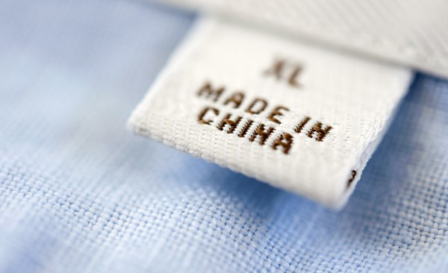
Activity:
Check the tag on your partner’s t-shirt/jacket/sweater
On your sticky note, write which country your shirt was made in
When I call your group up, put the sticky note above the appropriate country in a line
Indonesia USA

Slide 4
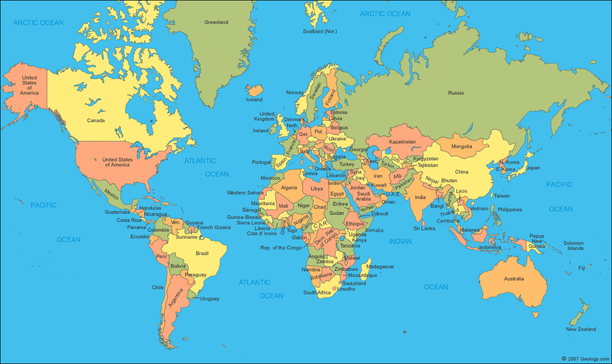

Slide 5
Response Journal
Write a response (full sentences) answering some of these questions. Feel free to add in any of your thoughts/experiences/feelings.
What did you notice about the map and graph we made?
What surprised you?
Where were most of the items made? Did you notice any patterns?
Why do you think the factories were in these locations?
What kind of conditions do you think the people who produced the items work in?

Slide 6
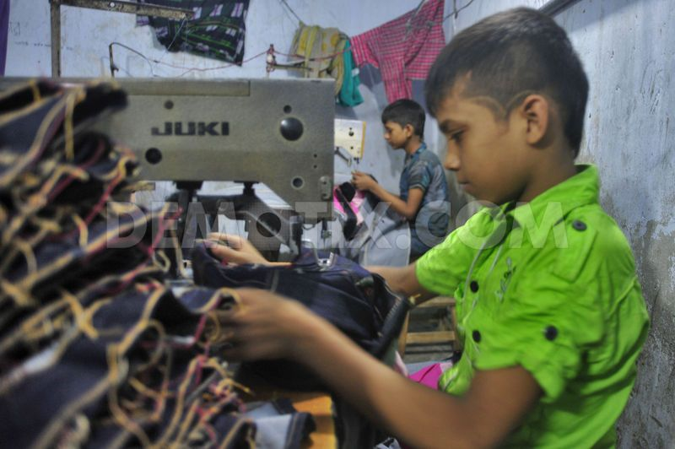
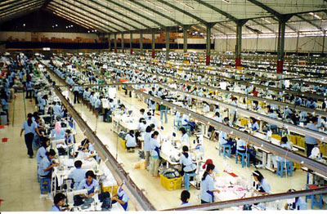
Child Labour & Sweatshops Today

Slide 7
Start-up Task
Respond to this question on the handout provided:
What do you know about sweatshops? What are they and where do you think they exist? Do you think that child labour is common today?

Slide 8
What is a Sweatshop?
Violates labour laws / has socially unacceptable working conditions
Often have
Poor working conditions
Unfair wages
Unreasonable hours
Child labour
Lack of worker benefits
In developing countries, an estimated 250 million children ages 5-14 are forced to work
Products that commonly come from sweatshops:
Shoes
Clothing
Toys

Slide 9
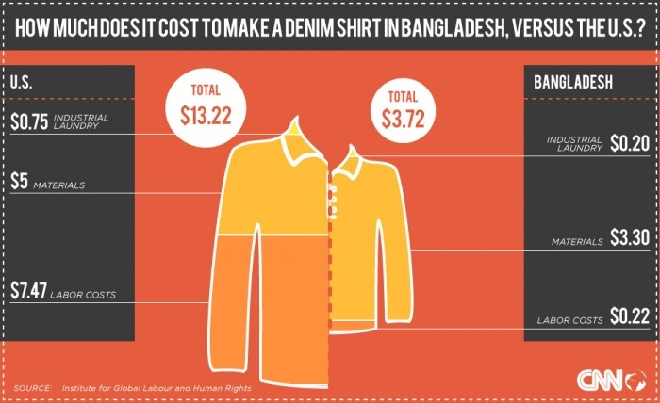

Slide 10
In a factory in China that makes Levi jeans, women sew for 12 hours a day for less than 12 cents an hour, with only 2 days off each month. Also, they receive no healthcare and no compensation for injury.

Slide 11
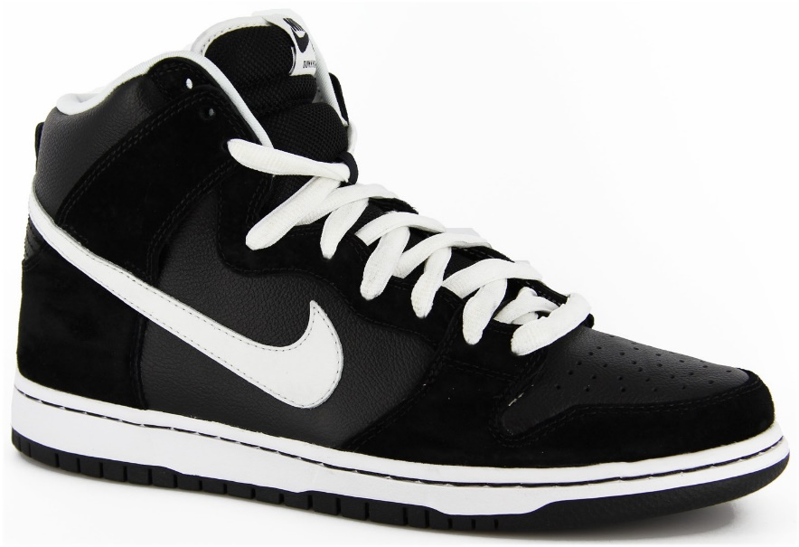
In a factory in Vietnam that makes Nike shoes, employees work for 65 hours each week, for less than $10 a week. Most of these employees suffer from respiratory problems caused by breathing in chemical fumes at work.

Slide 12
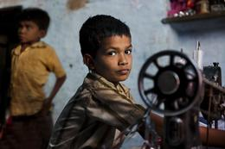
In a factory in India, boys work 22 hour shifts sewing beads onto scarves, and are beaten if they make even a tiny mistake.

Slide 13
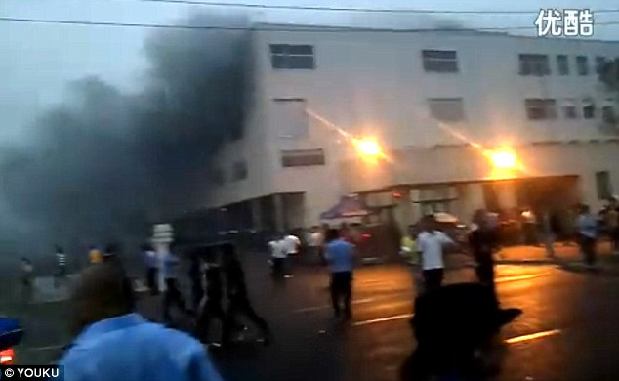
Factories in China which make ipads and iphones for Apple employ impoverished teenagers for about 25 cents an hour, with forced overtime, in dangerous working conditions. As a result, many workers have committed suicide, fights have broken out, and in one instance, an explosion killed two workers.

Slide 14
In a factory in China which makes Christmas ornaments for Wal-Mart, employees work 95 hours a week without the proper safety equipment to protect them from the various paints, paint thinners, and solvents they were exposed to. Workers developed sores and rashes as a result, but received no medical treatment or compensation.

Slide 16
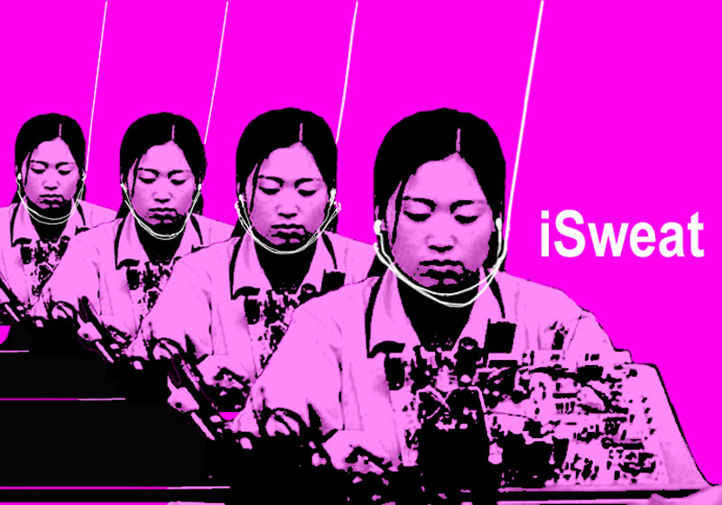

Slide 17
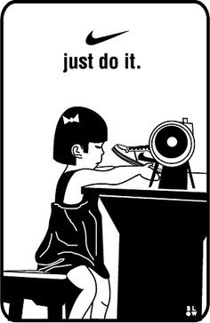
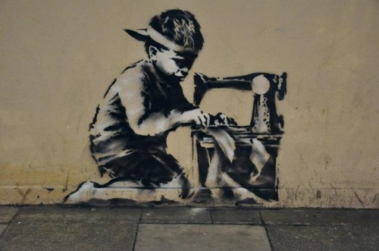

Slide 20
https://www.youtube.com/watch?v=wzq31hpGZOI

Slide 24
Task: For/Against Chart
Read the statement
Decide if it is for or against sweatshops. Write for or against in the next column
In column three, respond to the statement (Do you agree/disagree? Why or why not?)

Slide 25
Opinion:
This side:
Sweatshops are not as evil as many think.
This side:
Sweatshops should be outlawed worldwide

Slide 26
Opinion:
This side:
Outsourcing damages a country’s economy
This side:
Outsourcing is necessary in today’s economic world

Slide 27
Opinion:
This side:
Child labour is completely unacceptable
This side:
Child labour is saving many families

Slide 28
Your Task
Answer questions 4 & 5 on your handout

Slide 29
Extension
https://www.youtube.com/watch?v=M5uYCWVfuPQ

