Slide 1
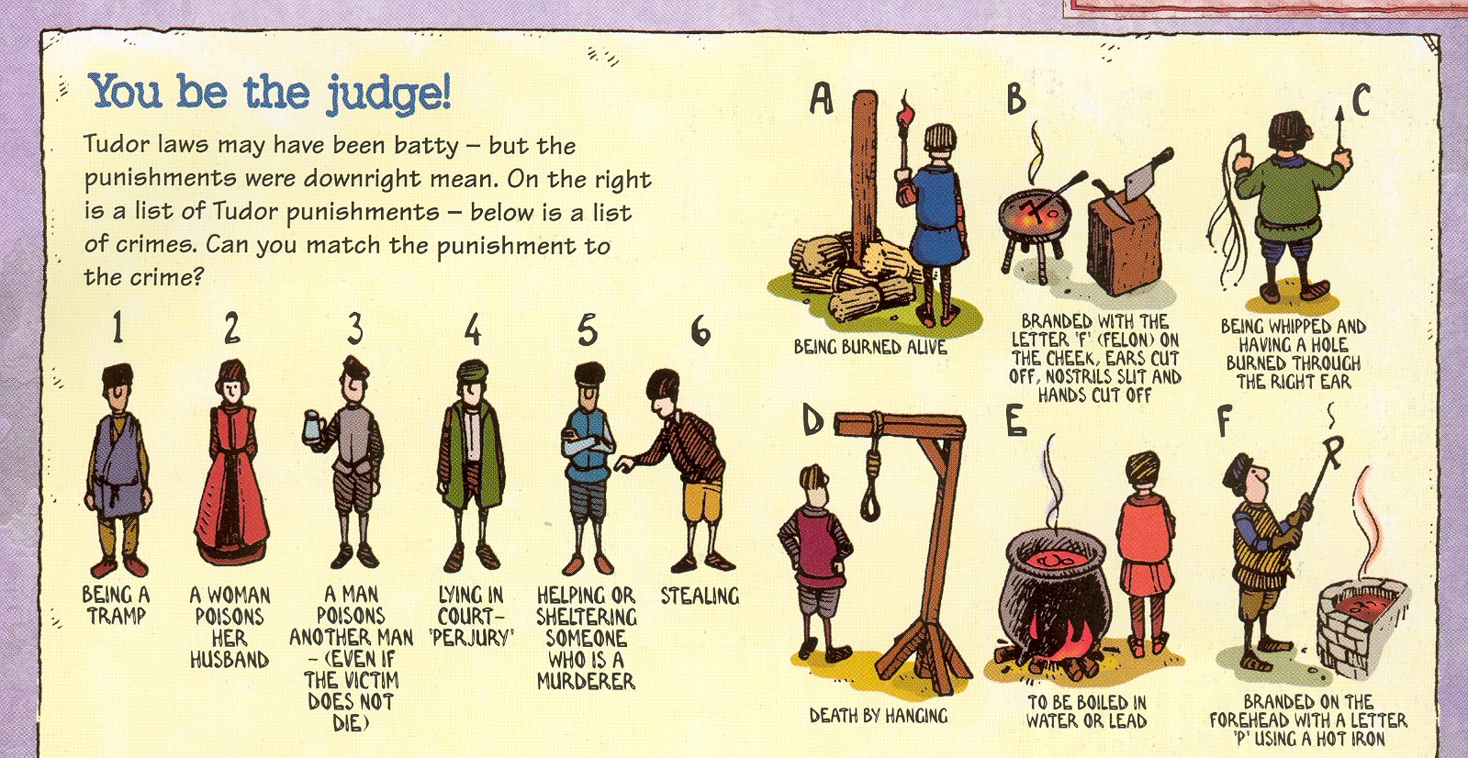
Start-up Task: Match the crime (#) with the punishment (letter)

Slide 2
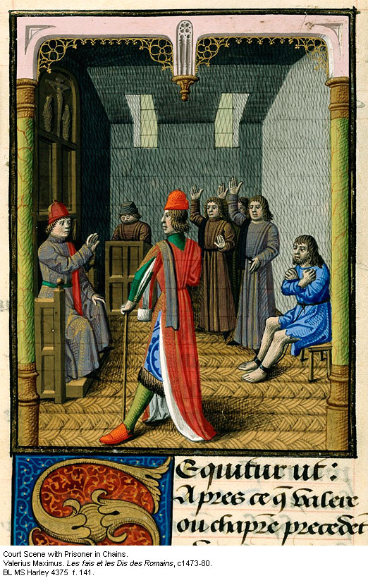
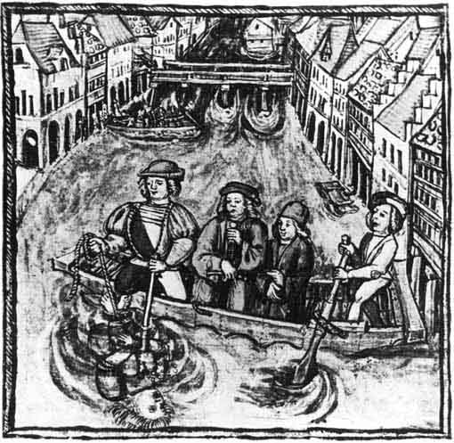
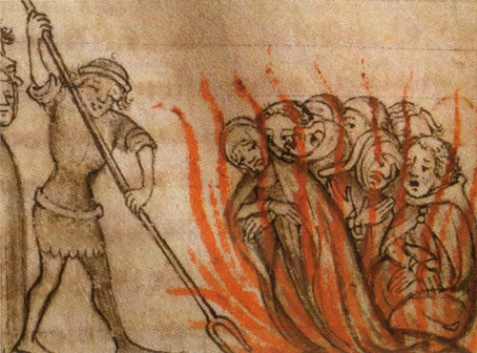
Medieval Crime & Law

Slide 3
Learning Outcomes:
By the end of this lesson I can:
To describe what crime, punishment, and law was like in Medieval Europe

Slide 4
What methods are used in Canada for keeping law and order today?

Slide 5
Some Key Definitions:
Crime: an act that breaks a law
Defendant: a person accused of wrongdoing
Justice: fair treatment
Law: rule(s) established by authority or custom
Punishment: a penalty for an offence

Slide 6
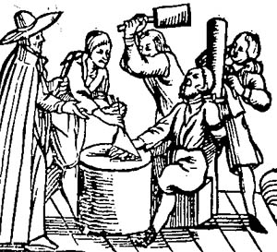
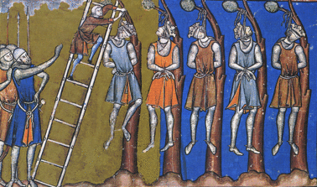
Law and order was very harsh in Medieval England. It was believed that people would only learn how to behave properly if they feared what would happen to them if they broke the law. Even the ‘smallest’ offences had serious punishments.

Slide 7
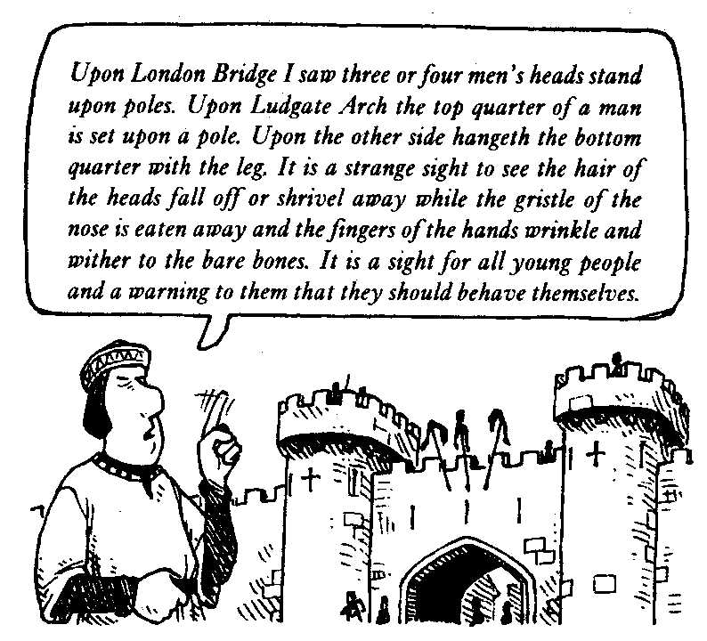

Slide 8
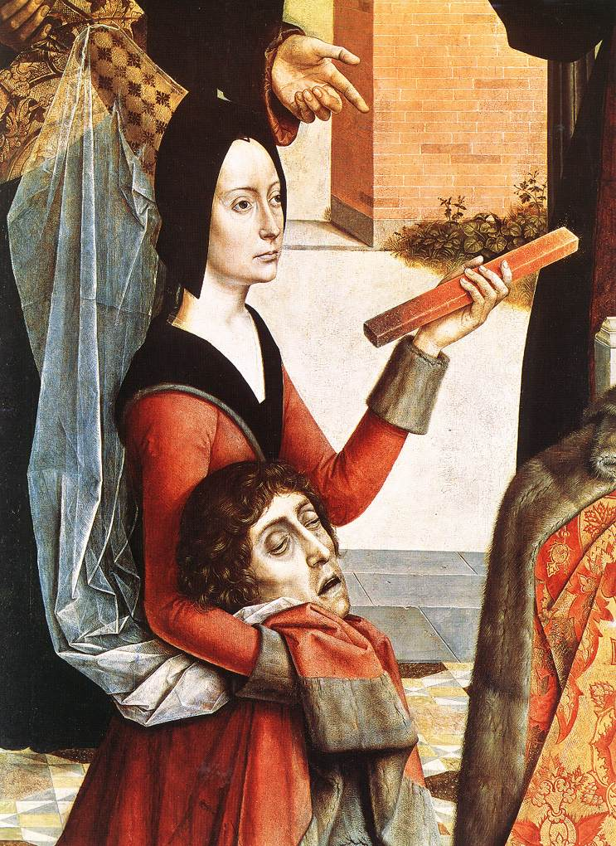
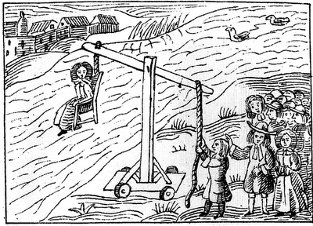
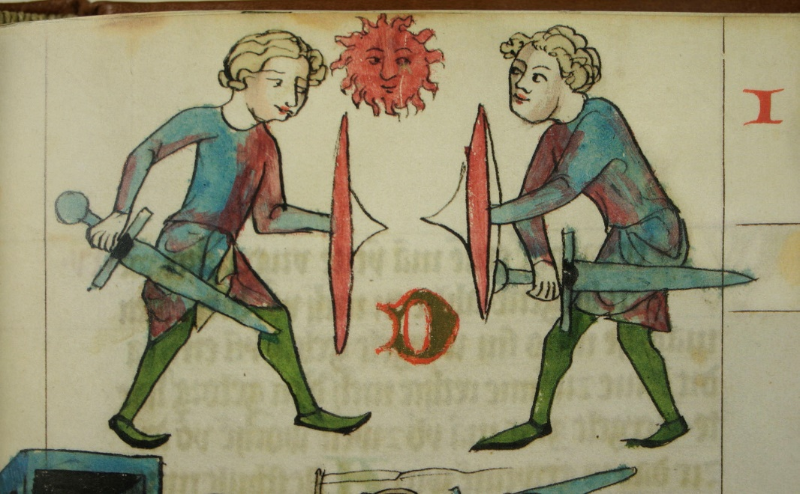
Trial by Ordeal
Horrible Histories video (19:14)

Slide 9
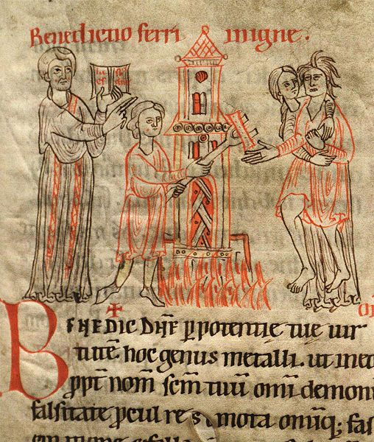
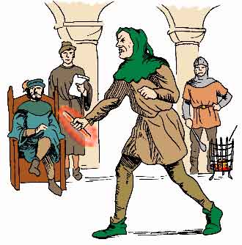
Ordeal by fire
Accused holds red hot iron bar
Walk 3-5 paces holding it
Hand is bandaged and left for a certain number of days
If it is healing = innocent if it is not = guilty

Slide 10
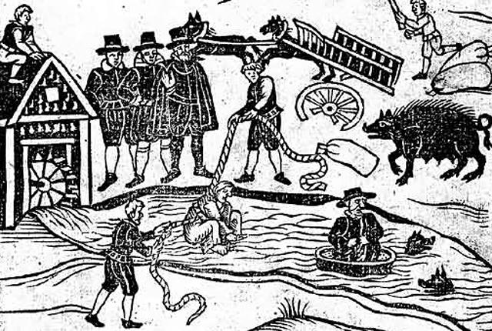
Ordeal by water
The accused person is tied up
They are thrown into water
Float = guilty Sink = innocent (but dead)

Slide 11
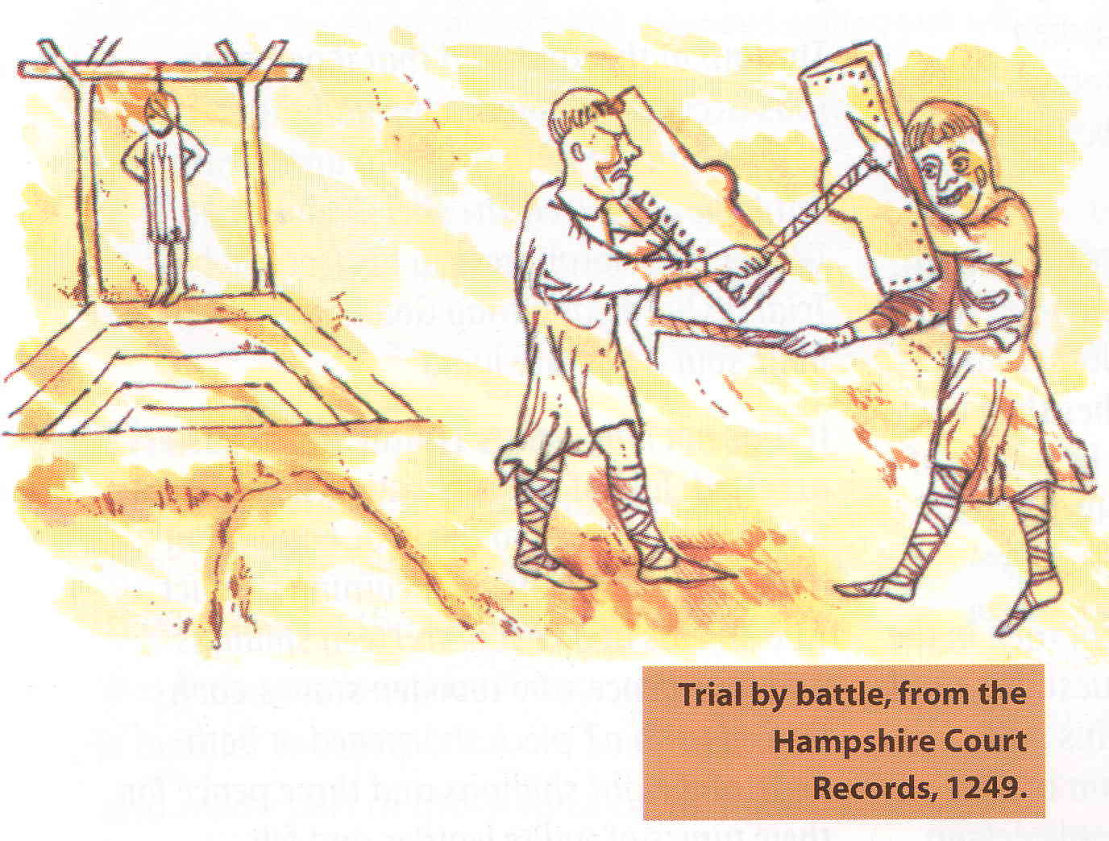
Ordeal by combat
This was used by noblemen who had been accused of something.
Accused fights the Accuser
Whoever wins = right
Whoever lost was usually dead at the end of the fight
S Yelland KHS

Slide 12
Trial by Ordeal
Why? God would save those who were innocent…

Slide 14
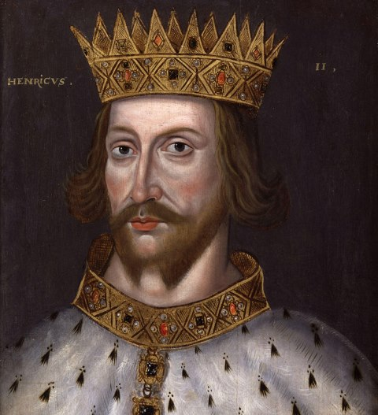
Changes to law
By the time of Henry II (1154), the system of law in England had been improved:
Brought in trial by jury
No more trial by ordeal
Sent judges to different towns throughout country to try cases

Slide 15
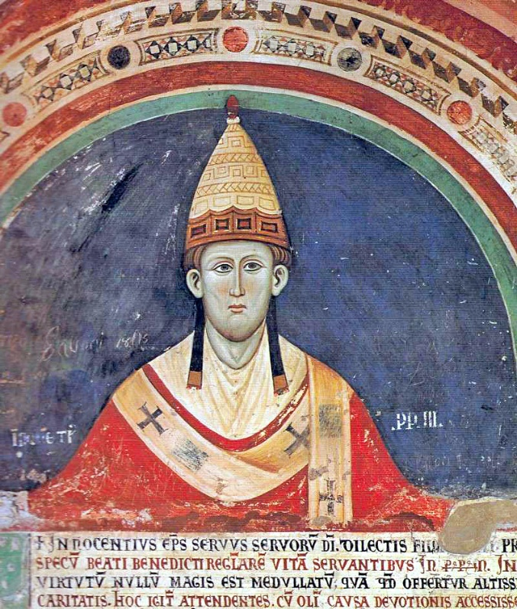
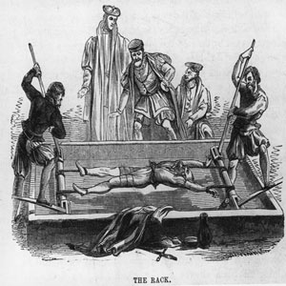
In 1215, the Pope decided that priests in England must not help with ordeals. As a result, ordeals were replaced by trials by juries.
After 1275, a law was introduced which allowed people to be tortured if they refused to go to trial before a jury.

Slide 17
Medieval Courts
Read your textbook pages _______, about the different types of courts:
Royal Court
Church Court
Manor Court
Answer the question on your handout about the different types of courts.

Slide 18
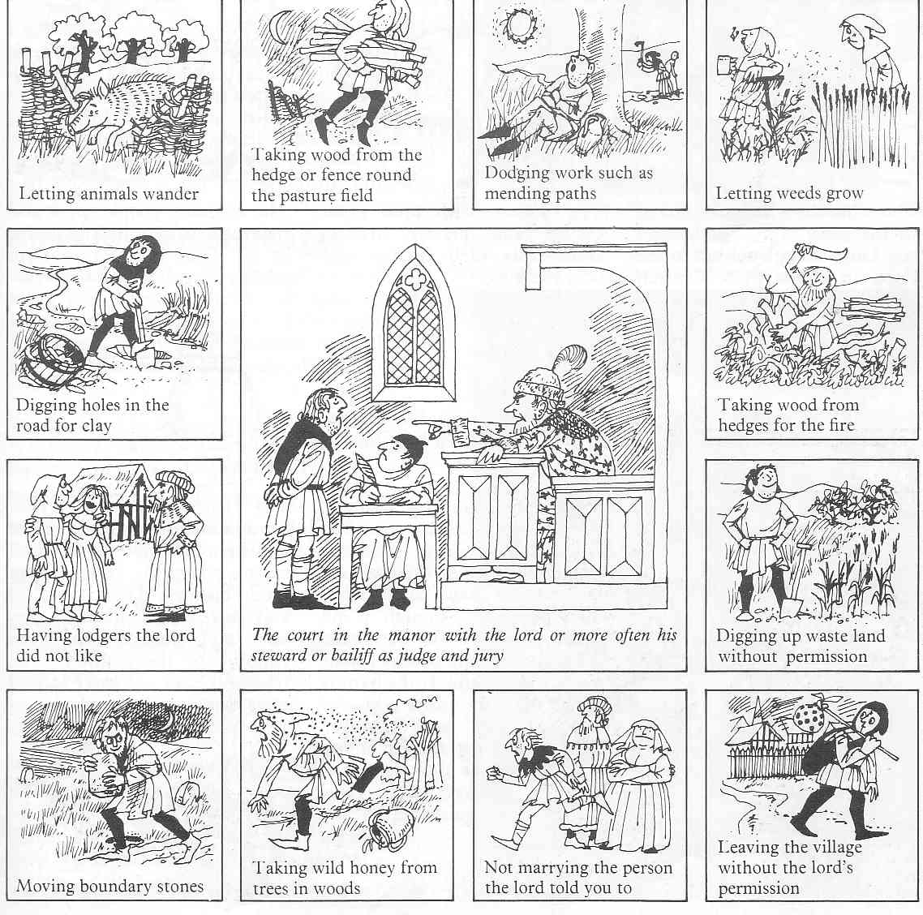

Slide 19
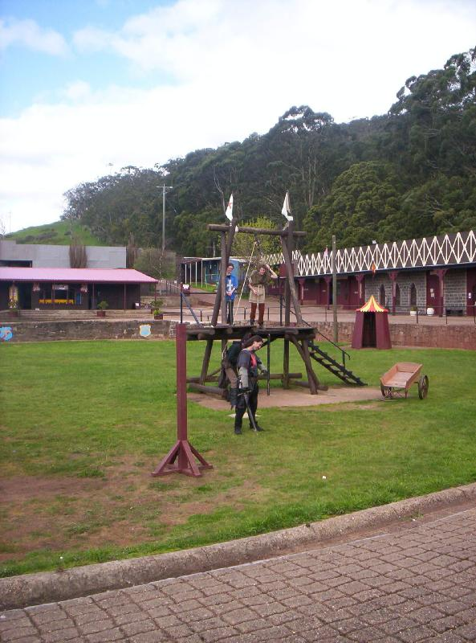
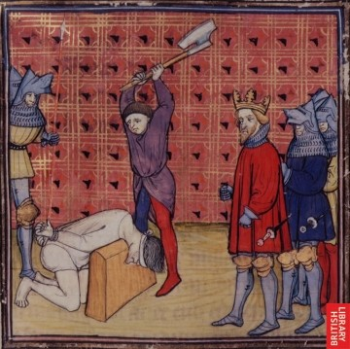
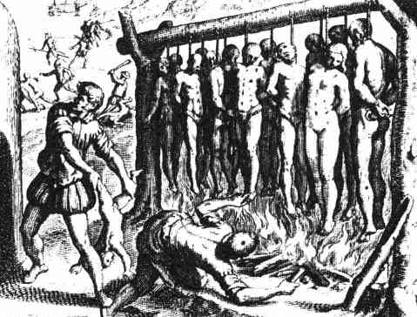
Punishments: Execution
Nobles and rich people were beheaded for serious crimes
Usually Men were hung for crimes like murder
Women were burned to death for crimes like murder

Slide 20
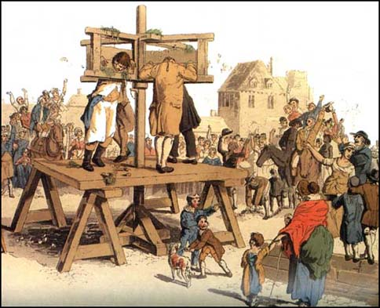
Punishments: pillories
The Pillories (arms and head)
was a type of punishment for crimes not thought to be severe.
Once the accused was in the stocks the crowd threw vegetables and fruit that were rotten, mud, dead rodents especially rats, excrement and stones.

Slide 21
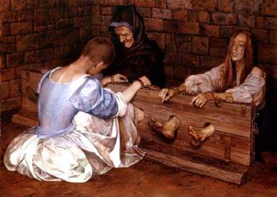
Punishments: the stocks
The Stocks (legs and arms) were also a punishment for mild crimes. Some villages had Pillories, some had stocks and some had both
The stocks were also
used in prison cells

Slide 22
Crimes for stocks & pillories
Robbery and Perjury – 24 hours
Trader cheating customers – 12 hours
Drunkenness – 6 hours
Swearing – 1 hour
These are the words, that are called swearing: thief, murderer, liar, ba-----d, arsonist, son of a bitch, whore, prostitute, witch.

Slide 23
Punishments: burglary
Punishments were designed to stop
people doing the same thing again.
A pickpocket would have his hand cut
off
A rapist would have his genitals cut
off

Slide 24
Punishments
Read through the “Medieval Punishments” handout
Fill in the chart with 5 different crimes and punishments
Decide if you think they are fair/unfair and explain why

Slide 25
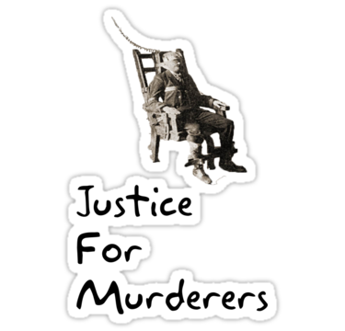
Reflection Question
Do you think that it is right to have a death penalty?
(i.e. should be ever be able to execute people for their crimes?)
Explain your answer in a paragraph (at least 5 sentences) by considering both sides of the argument.

