Slide 1
Europe’s Age of Exploration
Video: https://www.youtube.com/watch?v=ksYSCWpFKBo

Slide 2
Seeking A Passage to the East
Trade in silk, spices and teas was big business in Europe.
The Ottoman Empire controlled most of the trade routes and were not always friendly to foreigners.
Finding passage by sea became very important.

Slide 3
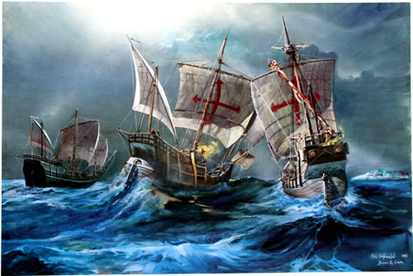
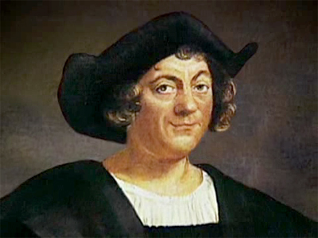
Christopher Columbus
“In 1492 Columbus sailed the ocean blue.”

Slide 4
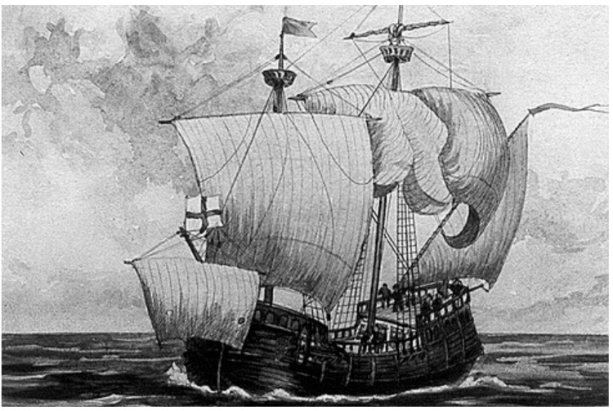
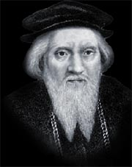
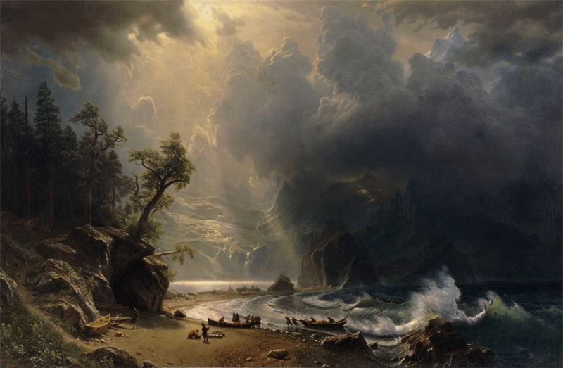
John Cabot (Giovanni Cabotto)
An Italian sailor hired by King Henry VII and given a Letters Patent to acquire new territory.
Was convinced that the North Sea had a passage to Asia.

Slide 5
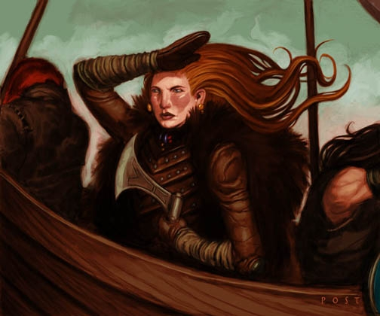
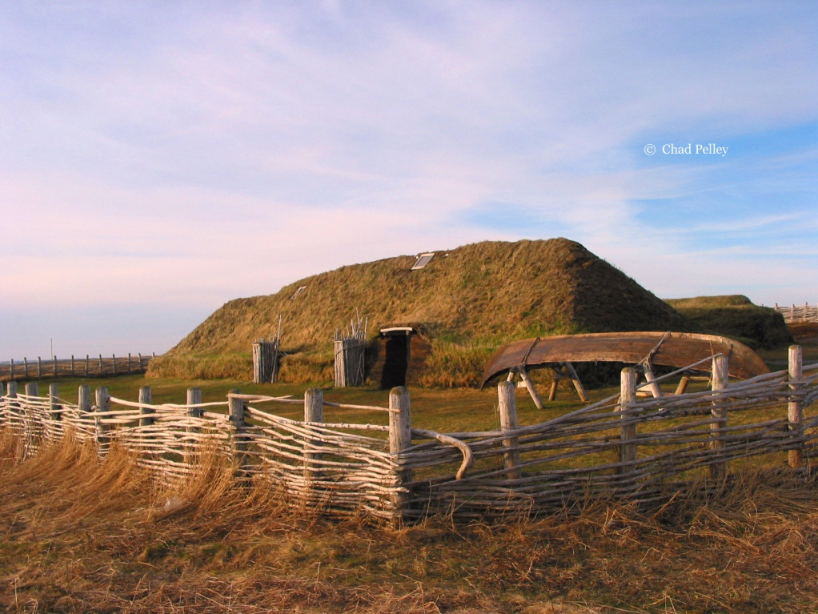
Mighty Vikings
Erik Thorvalson (Erik the Red) – Discovered Greenland during his exile.
Leif Erikson – Believed to be the 1st European to land in North America (year 1000), landed in Labrador and Newfoundland.
Freydis Eriksdotter – Female explorer set up a colony in L’Anse aux Meadows.

Slide 6
Vocabulary
Colonize: to settle and control new lands eg. England colonized North America.
Imperialism: Political policy to control a region or nation.
Monopoly: complete control of a good or service.
Heathen: anyone non-Christian
Infidel: a “non-believer”, not Christian

