Slide 1
Review Task:
What happened at the Battle of Hastings in 1066?
What is it that tells us the story of the battle?

Slide 2
https://www.youtube.com/watch?v=qI8jsVE0qEQ

Slide 3
Animated Bayeux Tapestry
https://www.youtube.com/watch?v=LtGoBZ4D4_E

Slide 4
Your Task:
Why was the Battle of Hastings significant?

Slide 5
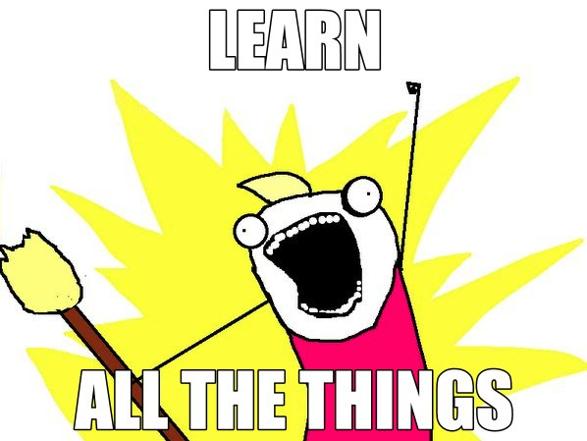
Learning Outcomes
To explain why William introduced the Feudal System to England.
To describe how the Feudal system worked.

Slide 6
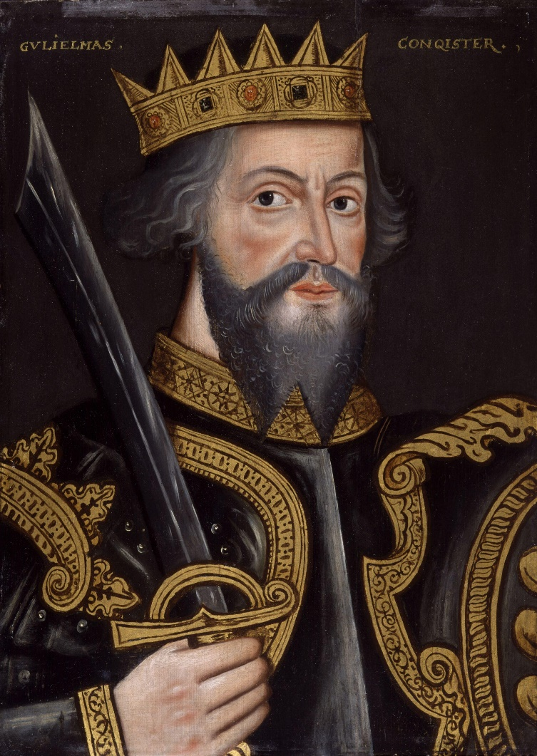
What sorts of problems did William face once he was crowned king of England?
I CANNOT TRUST THE SAXON LORDS TO CONTROL THE COUNTRY FOR ME.
I NEED TO COLLECT TAXES BUT I DON’T KNOW WHO OWNS WHAT.
IF I DON’T STOP THE REBELS IN THE NORTH THEY WILL SUPPORT A VIKING REBELLION.

Slide 7
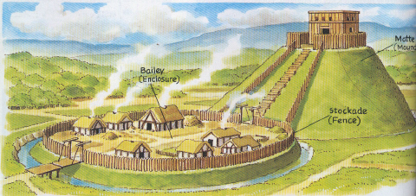
William built castles all around England to help him control the land and its people.
William also introduced a new social system into England. It was called the Feudal System.

Slide 8
The Feudal System: Based on the 3 F’s
Fief (land)
Fealty (loyalty)
Faith (religion)

Slide 10
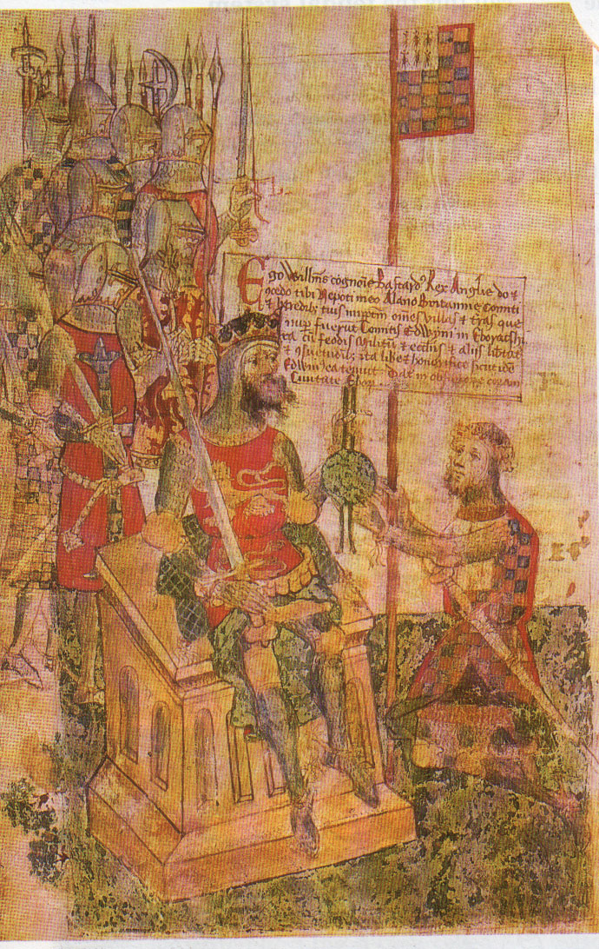
The Feudal Contract
The agreement between:
King and noble
Noble and vassal
Vassal and peasants
Sealed the relationship (I give, you get) with an
oath of allegiance

Slide 11
Jigsaw Activity:
PART 1
Fold your piece of paper in half
In groups of 4 (your choice) work together to read through the textbook and find information about your assigned person (king, noble, knight, peasant)…
Point form notes & an image in ONE of the four sections
** Do a good job, because you will be sharing your info with others…***

Slide 12
Jigsaw Activity:
PART 2
Form groups of 4 where each of you has a different section of information
Take turns SHARING your info with the other students, so they can add it to their sheet.

Slide 13
KING
Noble A
Noble B
Vassal A
Vassal B
Peasant
A’s
Peasant
B’s

Slide 15
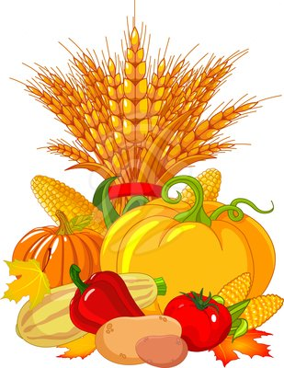
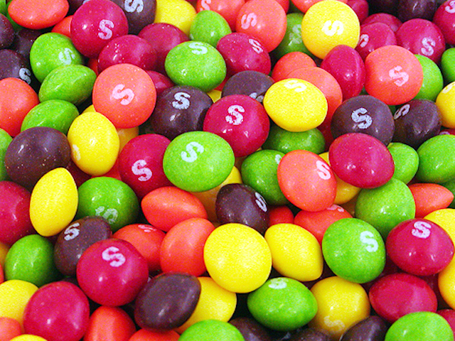
=
The candy that you have in your cup represents this year’s harvest. Peasants: you have worked very hard to produce all of this food.

Slide 16
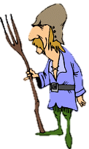
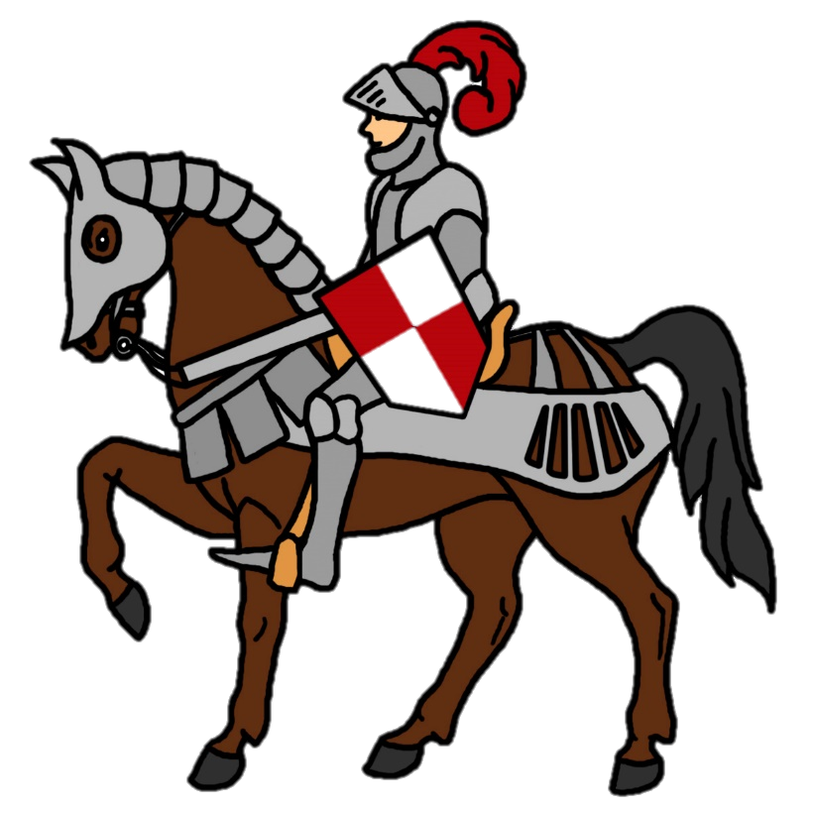
Peasants: you must pay for your protection… Vassals/knights you may confiscate SIX candies from each of your peasants.
6

Slide 17
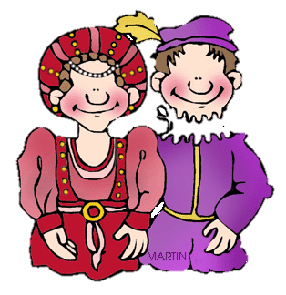
Vassals/knights: from each peasant’s payment, you may keep one candy, and must give your lord (noble) five. Pay your noble FIVE candies for each peasant that you have.
5
(x number of peasants you have)

Slide 18
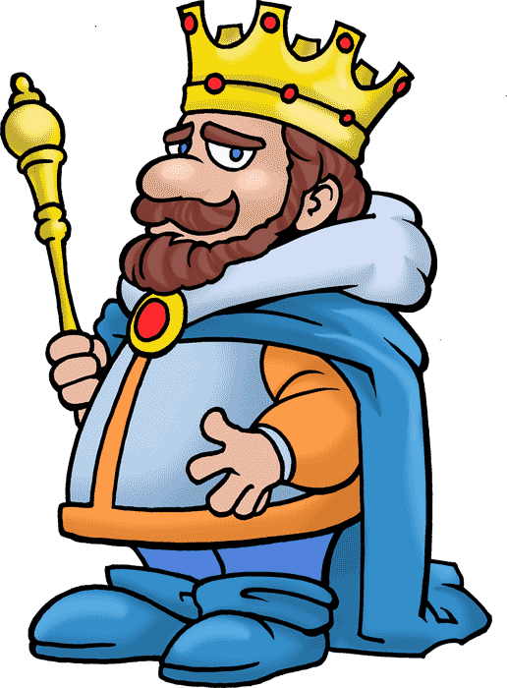
Nobles from each vassal/knight’s payment, you may keep two candies, and must give your lord (the King) three. Pay the King THREE candies for each peasant that is on your side.
3
(x number of peasants on your side “A” or “B”)

Slide 19
How many candies did you end up with?

Slide 20
Discussion Questions:
How did the Feudal System Simulation make you feel?
If you were a peasant, what was unfair?
If you were the vassals/nobles/king:
Did you feel bad for the peasants?
Would you support them if they revolted?

Slide 21
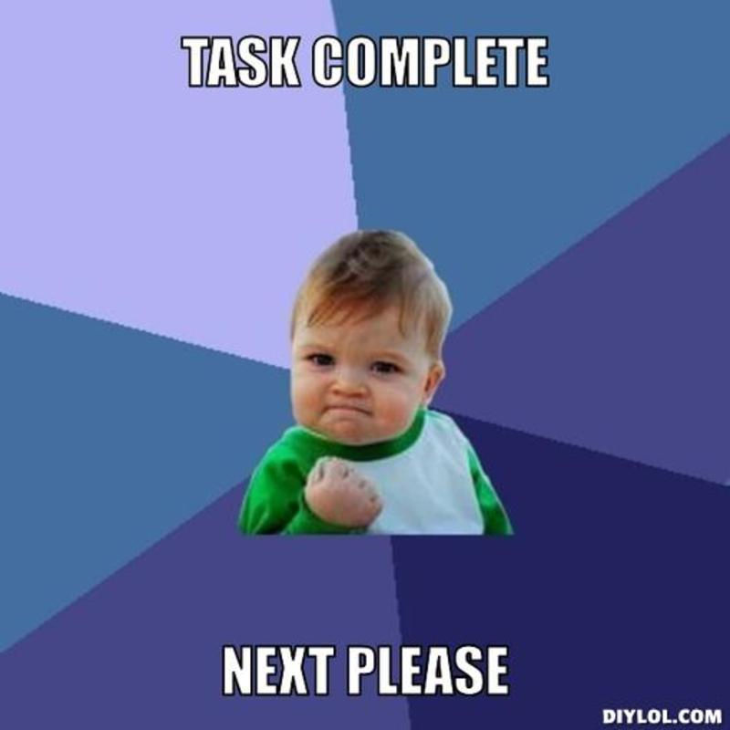
Your Task:
Complete the Feudal System graphic organizer and questions
Use textbook pages 44-47

Slide 22
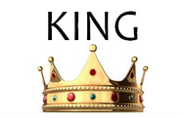
Can you work out who would have said these statements?
I like the system because it means I can control the country.

Slide 23
Can you work out who would have said these statements?
I do not like the system because I want to move to the next village but I am not allowed to.

Slide 24
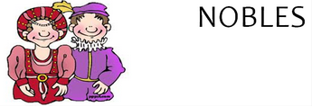
Can you work out who would have said these statements?
I like the system because I only owe allegiance to the king.

Slide 25
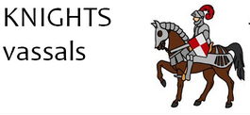
Can you work out who would have said these statements?
I like the system because I have been given large amounts of land.

Slide 26
Can you work out who would have said these statements?
I like the system because I have many peasants working on my land.

Slide 27
Can you work out who would have said these statements?
I am not keen on the system because I have to fight for my local noble.

Slide 28
Reflection Journal
If you had to choose to be someone in the Feudal System:
Who would you MOST want to be, and why?
Who would you LEAST like to be, and why?

Slide 29
Group Activity
In pairs or groups (3-4), make a list of the positive and negative effects of the Feudal System on society.
Positive Effects
Negative Effects

