Slide 1
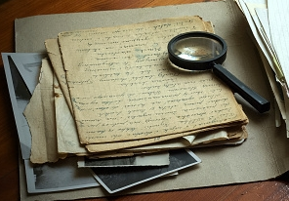
Historical Significance
Artifact Assignment

Slide 2
Results in change
It may be significant if it…
What changes does the artifact reflect?
Individual’s life?
Society?
Values/beliefs?

Slide 3
Deep consequences (at the time & over time)
It may be significant if it has…
How is this artifact related to deep consequences or impacts of individuals/groups at the time
What are the deep consequences/impacts that have endured a long time?

Slide 4
Revealing
It may be significant if it is…
Shed light on enduring/emerging issues in history or our current society
Which broad issues in society does this artifact relate to?

Slide 5
Constructed & Varied (we make it, and it changes)
Historical significance is…
It might only be important to certain people at certain times.
Is the artifact historically significant today? Does it have the same meaning as it would have at the time?

Slide 6
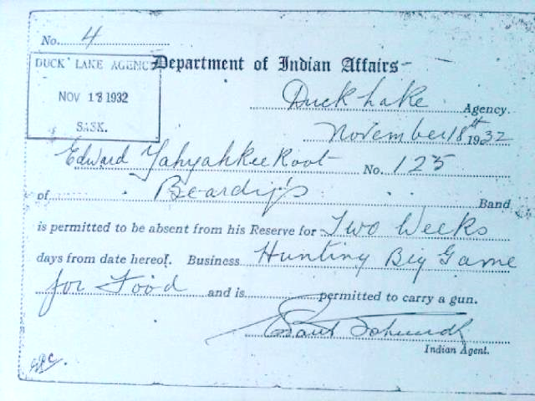
Artifact: Reserve Pass
Results in change?
Deep Consequences
Revealing
Change in Perspectives? (past vs. present)

Slide 7
Artifact: Reserve Pass
Results in change?
Does it reflect any changes:
For individuals
In society?
In values/beliefs?

Slide 8
Artifact: Reserve Pass
Deep consequences?
What consequences did this artifact have for people then?
How were they impacted? (+/-)
Are there still consequences from this in people or society today? (long-term)

Slide 9
Artifact: Reserve Pass
Revealing?
Does the artifact shed light on any major issues that happened in history, or any issues that our society is currently facing?
(i.e. environment, poverty, racism, etc.)

Slide 10
Artifact: Reserve Pass
Changes in Perspectives
What would be some different perspectives on this artifact at that time? (e.g. Aboriginal, Indian agent, government, etc.)
Does it hold the same meaning today? Why/why not?

