Slide 1
World War II: The Canadian Homefront

Slide 2
How did the traditional role of women change during WW2?
Official women’s branches of army, air force, navy:
Canadian Women’s Army Corps
Women’s Royal Canadian Naval Service
RCAF Women’s Division

Slide 3
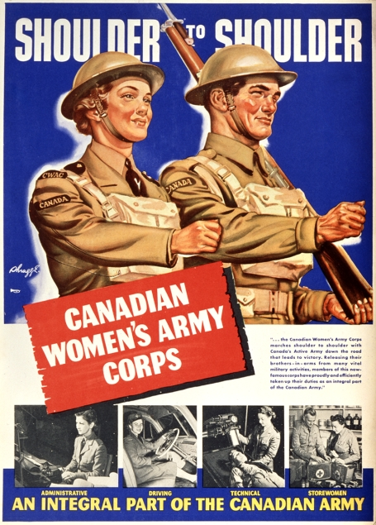
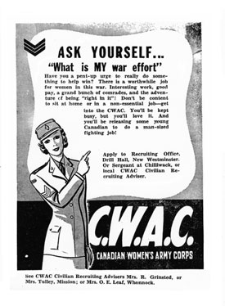

Slide 4
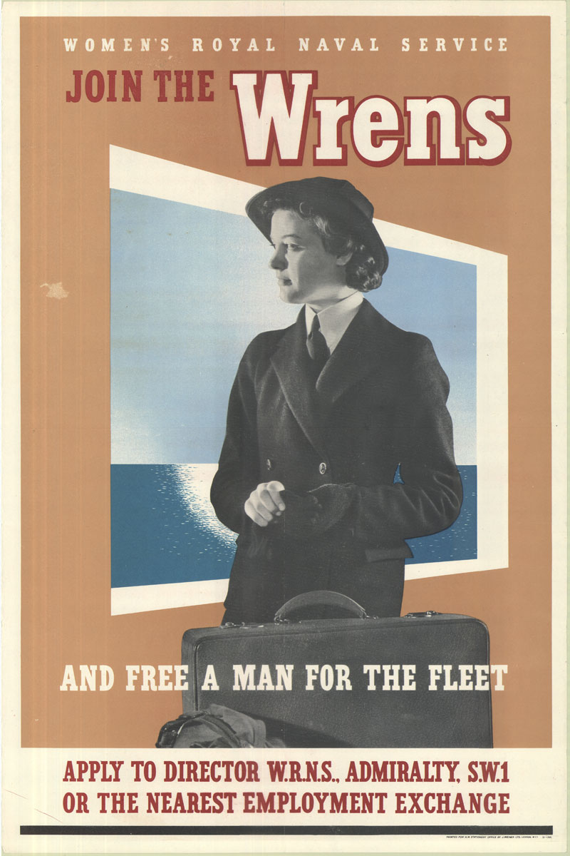
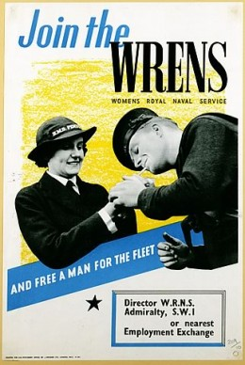

Slide 5
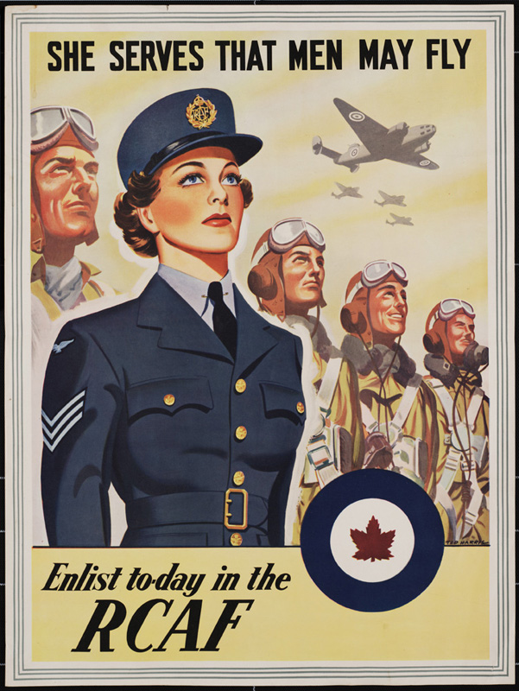

Slide 6
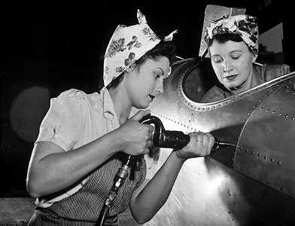
How did the traditional role of women change during WW2?
More women entered the workforce
(1 million by 1944)
Women became spies, saboteurs, etc.
https://www.youtube.com/watch?v=kR_ccKxeums

Slide 7
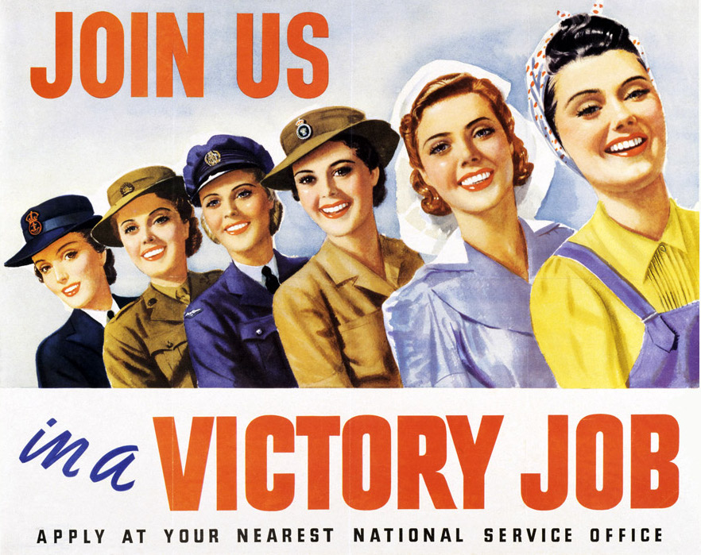

Slide 8
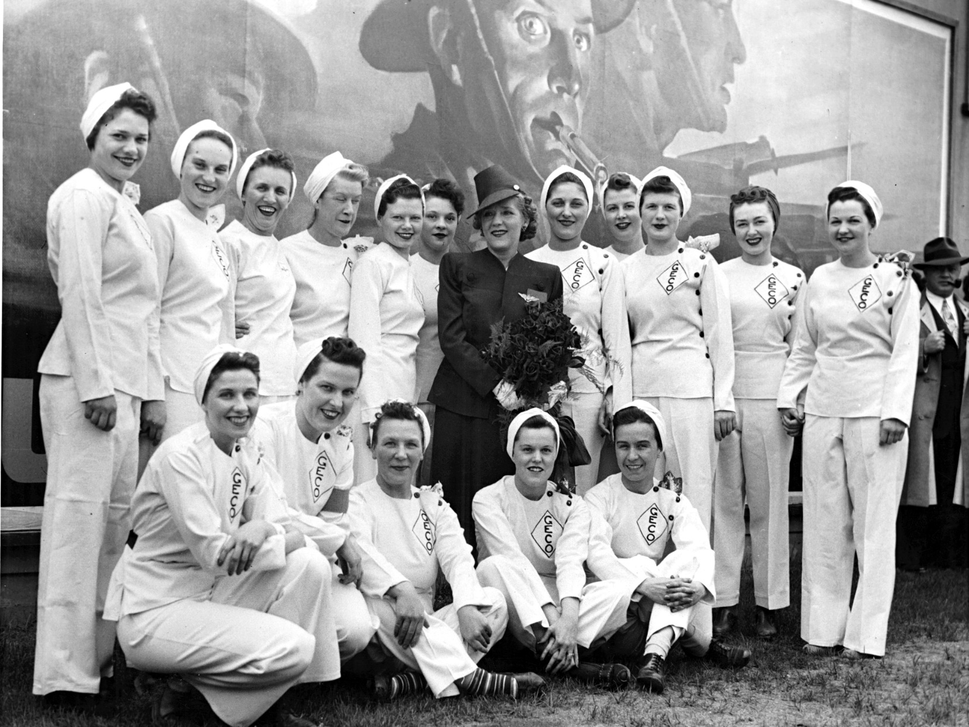
Women workers at a munitions factory in Canada, 1943

Slide 9
Women still faced inequality…
Paid less for same work
No childcare provisions or tax breaks when war ended
Expected to give their jobs to returning soldiers

Slide 10
TOTAL WAR
The complete concentration of a nation’s industries on the war effort
Example: Canada created bombs, bullets, ships, aircrafts, armoured cars…. Also had training facilities like BCATP, Camp X

Slide 11
How was Gov’t involved in the war effort?
Introduced rationing
Created a War Supply Board
Increased taxes
Sold war bonds to pay for war effort
Censored information

Slide 12
British Commonwealth Air Training Plan (BCATP)
230 facilities across Canada
Trained pilots and other crew members for Britain, Canada, Australian, New Zealand
Trained ~1/2 pilots, navigators, bomb aimers, air gunners, wireless operators, and flight engineers
Why do you think that they chose Canada?

Slide 13
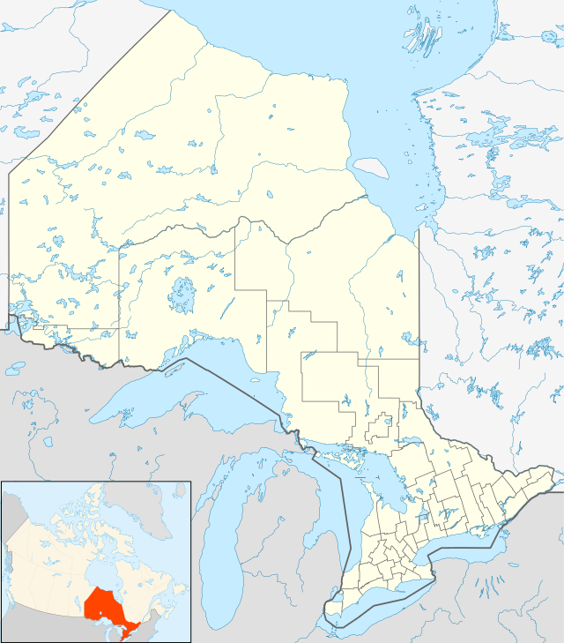
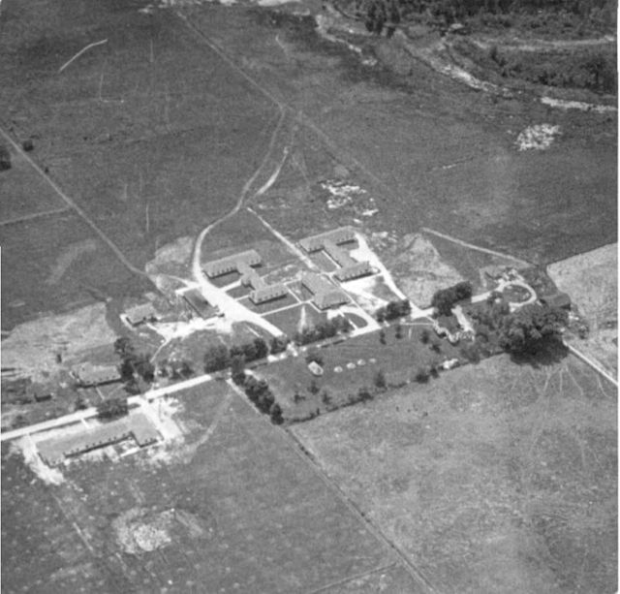
CAMP X
Top secret training facility for foreign intelligence gathering
Over 500 Canadian, British, and American spies were trained

Slide 14
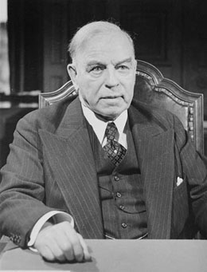
1942-1944 Conscription Crisis
King had promised in 1939 that he WOULD NOT introduce conscription
1940: implemented National Resource Mobilization Act- all men had to help with war effort

Slide 15
1942-1944 Conscription Crisis
1942: need for troops overseas
Held a vote on issue
Majority supported (not French Canadians)
Send 13,000 men overseas, only 2,000 saw front lines

