Slide 1
Human geography

Slide 2
Part 1: Demography

Slide 3
What is demography?
The statistical study of human populations

Slide 4
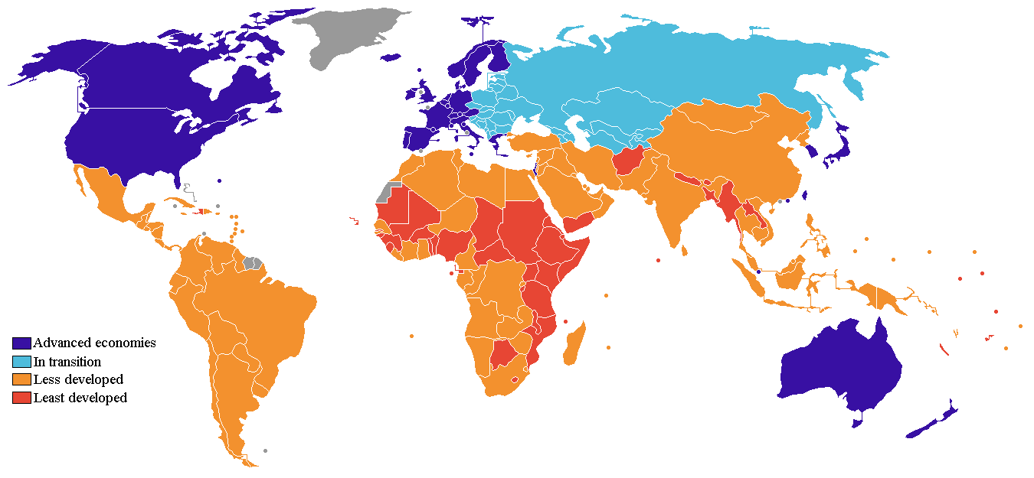
The UN estimates that over 90% of future population growth will occur in developing countries

Slide 5
Ancient demographers thought population growth was beneficial because:
Allowed for stronger military
Provided better security
Helped create a bigger empire
Offset deaths caused by famine & war

Slide 6
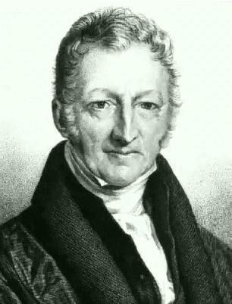
Thomas malthus
Believed that the rate of food production would not be able to keep up with the rapid growth of population
Thought that because of this, everyone’s quality of life would eventually be destroyed

Slide 7
Demography & Gov’T
Governments need to know
How many people there are
Where people live
What they do for a living
How they spend their money
WHY?
Helps the government make decisions about planning and spending, as well as to combat problems like poverty and illiteracy

Slide 8
Rate of natural increase
Although it is important to know a country’s population… it is more telling to know the speed at which the population is increasing or decreasing
To calculate this, we subtract the death rate from the birth rate
In Canada, our rate of natural increase is 0.6%

Slide 9
Natural increase vs. population growth
Canada:
Rate of natural increase = 0.6%
Population growth rate = 0.9%
only births and deaths
includes the number of people leaving and entering a country
Canada is currently experiencing low birth rates, and depends on immigrants in order to continue on its population growth rate of 0.9%

Slide 10
Canada’s current estimated doubling time is about 78 years.

Slide 11
Part 2: Where do people live?

Slide 12
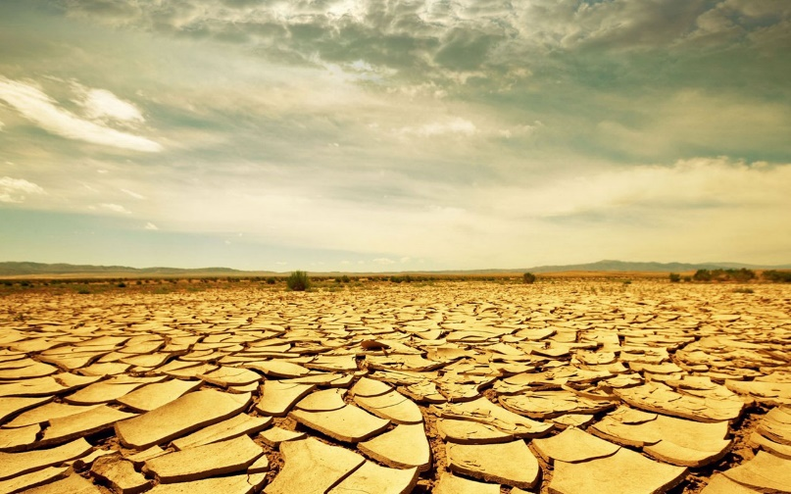
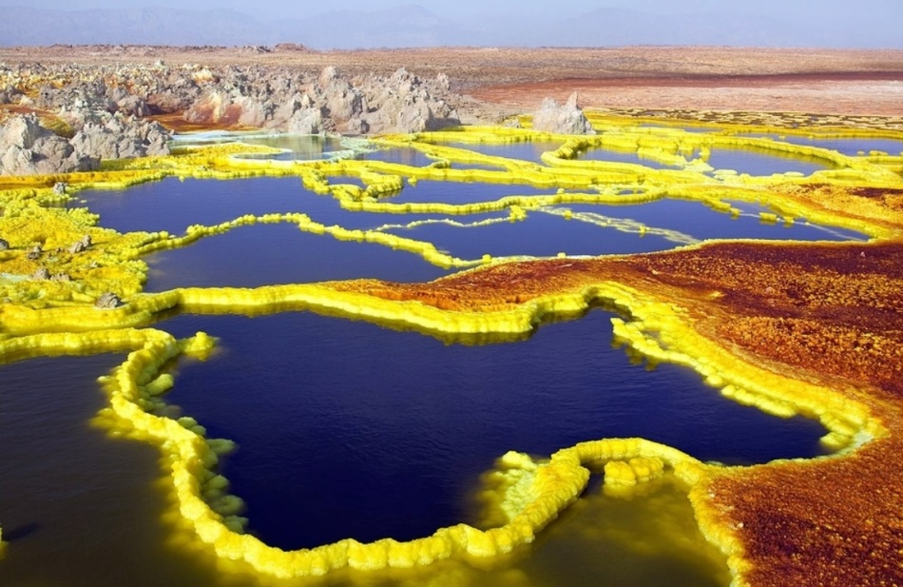
Inhospitable land
Not easily accessed (transport/communication)
Climate (too dry/cold, etc.)
Landscape (too mountainous)
Vegetation (not enough)
Available resources

Slide 13
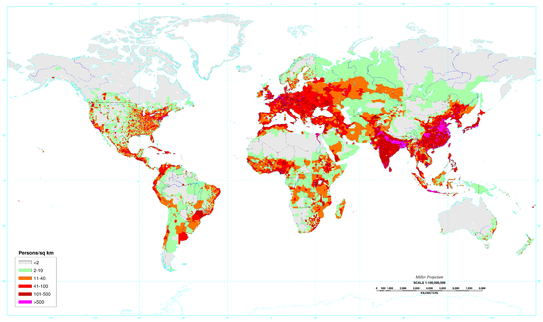

Slide 14
World population
~ 7 billion total
Characteristics of distribution:
High concentrations in small areas
Over half lives on only 5% of the land
Many areas of the world are too inhospitable to support life

Slide 15
Carrying capacity
The level at which a land can no longer support its people.
Related to nutritional density
How much nutrition in calories can be produced from the land

Slide 16
Part 3: demographic tools

Slide 17
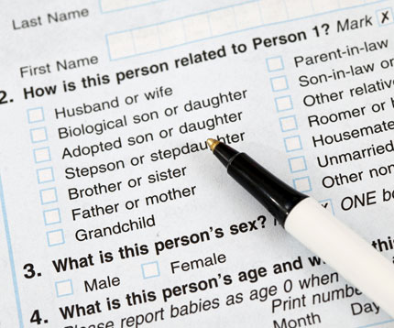
The census
Occurs in Canada every 5 years
Provides demographic & social data that informs government decisions
Need a regular census to maintain accurate records

Slide 18
The census: inaccuracies
Could result from people who:
Do not have permanent address
Live on the streets
Choose to avoid the census
Births or deaths may go unrecorded
Cycle: Countries with inaccurate records often suffer from illiteracy and poverty.
Inaccurate records mean it’s hard to combat those problems, so the levels of them rise… and lead to more inaccurate records!

Slide 19
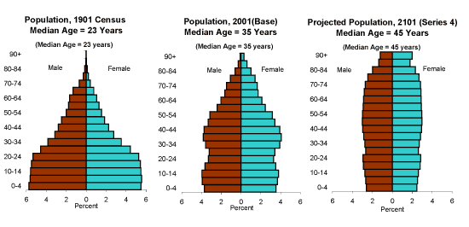
Population pyramids
A graph that shows the age and sex structure of a population

Slide 20
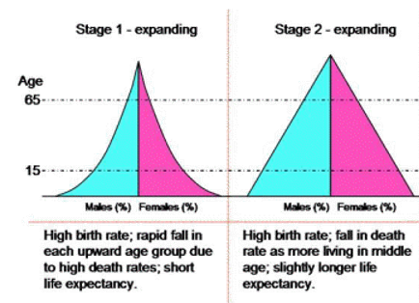
Population pyramids
Expanding
Shape = Wide base
High birth and death rates

Slide 21
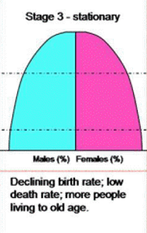
Population pyramids
Stable
Shape = Equal sized base and upper section
Balanced birth and death rates

Slide 22
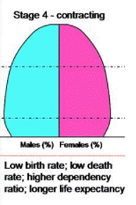
Population pyramids
Contracting
Shape = Wide upper section
Low birth and death rates

Slide 23
Population pyramids

Slide 24
Dependency ratio
The size of the population that is being supported by the working-age group
A HIGH dependency ratio means that there is a higher financial burden on those of working-age

Slide 25
Canada’s population
Population growth = 0.9%
Natural increase = 0.6%
65+ years = 12.8% (will continue to rise)
An aging population means that government needs to spend more on health care.
Also means we will accept more immigrants because we need more young skilled workers.

Slide 26
