Slide 1
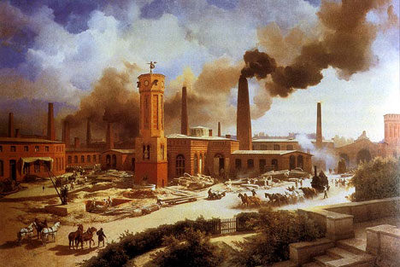
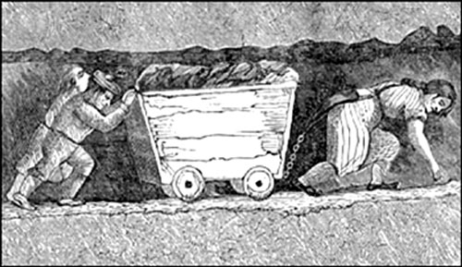
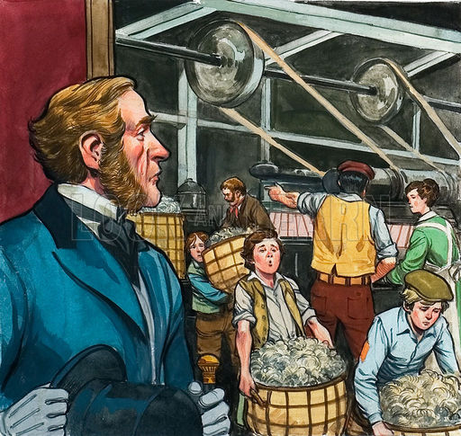
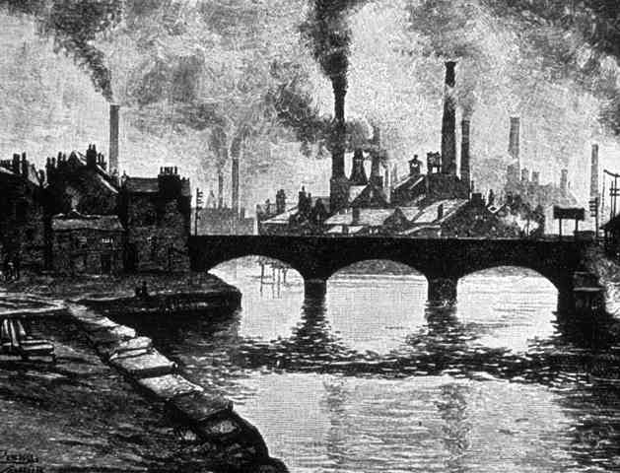
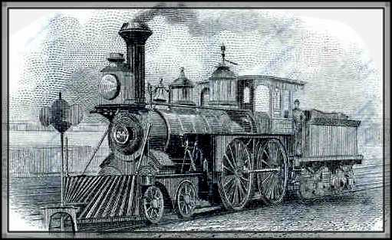
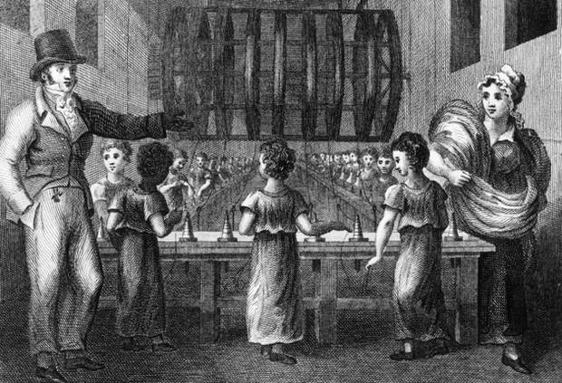
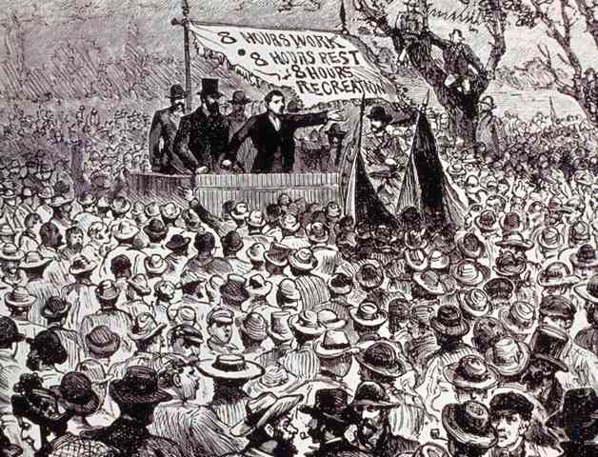
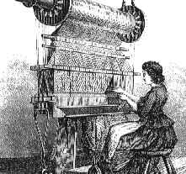
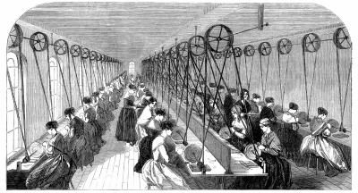
The Industrial Revolution
1750-1850s

Slide 2
Learning Outcomes
By the end of this lesson, I can…
Define industrialization/industrialized
List some of the changes (positive and negative) that occurred because of the Industrial Revolution

Slide 3
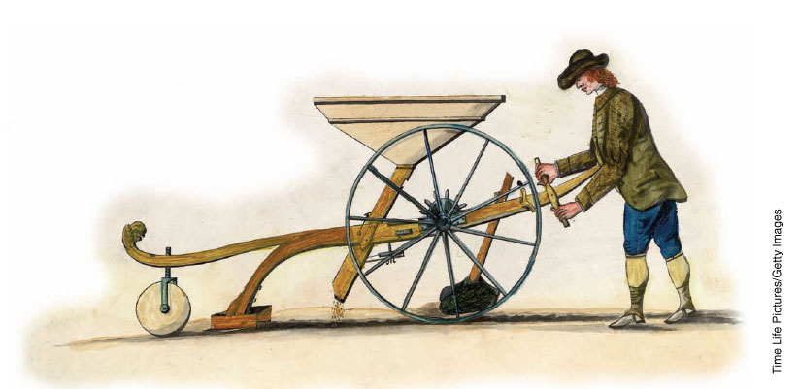
After 1700, the ways of growing food, and manufacturing and transporting goods changed completely in Great Britain.
It was such a huge change that it was labelled a revolution, called the Industrial Revolution.

Slide 4
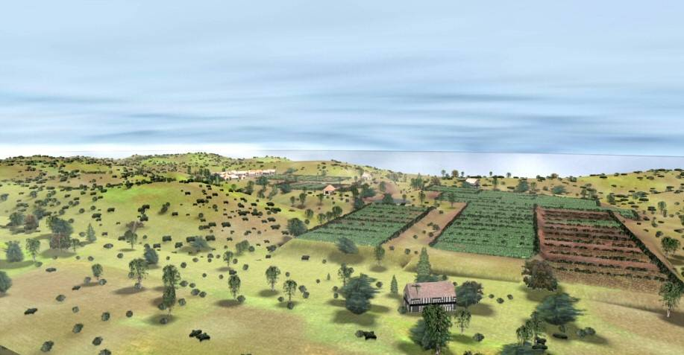
Industrialized
Definition:
An economy based on industry*, not agriculture
(Industry = processing of raw materials and making goods in factories)

Slide 5
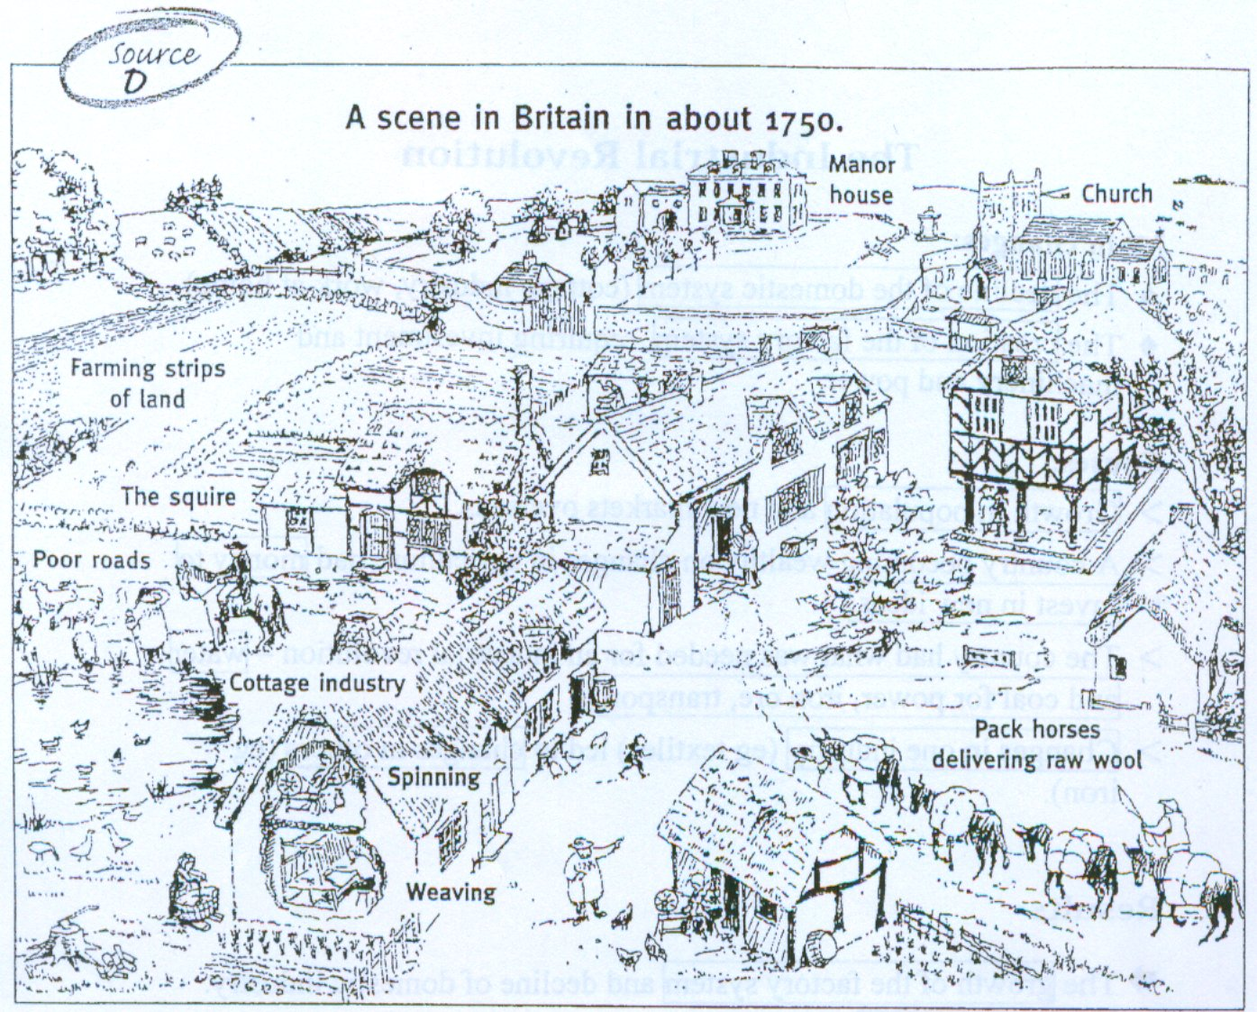

Slide 6
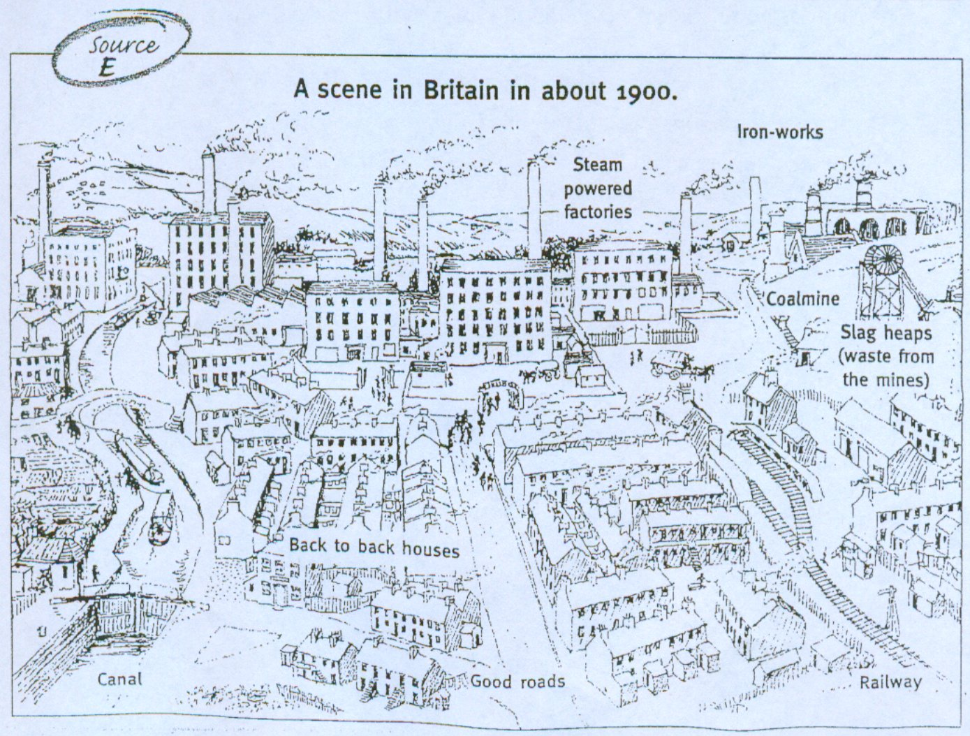

Slide 8
Changes:
New ways of farming
Increased population
Towns and cities grew (urbanization)
Employment in factories
Economy grew
Many became wealthy
Bad working conditions
Dirty, crowded cities
Child labour
Workers struggle for rights

Slide 9
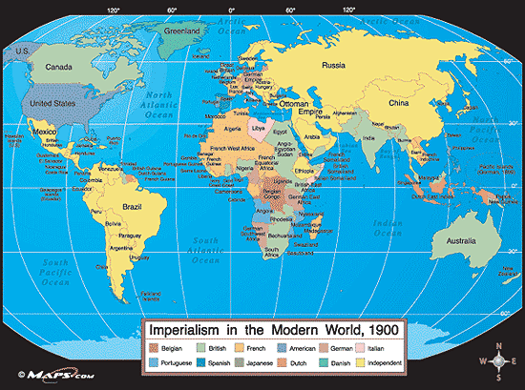
The Industrial Revolution
Spread to other countries
Economy became more global

Slide 10
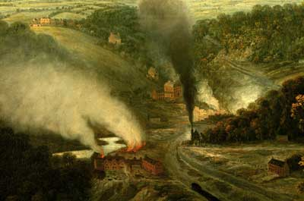
The Industrial Revolution
Changed the way that humans interacted with nature
The exploitation of the earth’s resources would greatly improve the material well-being of humanity…

Slide 11
Task: Need/Want
In small groups (2-4)
Imagine that you are living in Britain in the 1700s.
Place the items at the top of your sheet in either the NEEDS or WANTS column.

Slide 12
The belief that it is good for people to spend a lot of money on goods and services

Slide 13
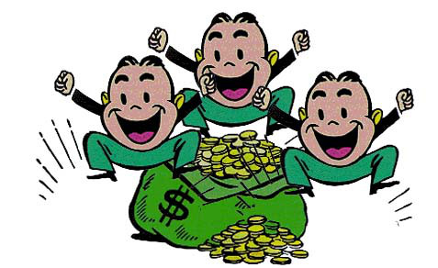
Materialism
A desire for wealth and material possessions with little interest in ethical or spiritual matters

Slide 14
Extensions:
What is consumerism? (1:43)
Logo Quiz (ppt)
The Story of Stuff (21:30)

Slide 15
Your ticket out the door…
Hand me your completed questions/notes from today

Slide 16
Factors that Contributed to The Industrial Revolution

Slide 17
Learning Outcomes
By the end of this lesson, I can…
Explain which factors are needed for industrialization to occur
Explain the causes of the Industrial Revolution
Describe how these causes are connected

Slide 19
Think/Pair/Share
What kinds of things would need to be present (factors) in order for a country to become industrialized?

Slide 20
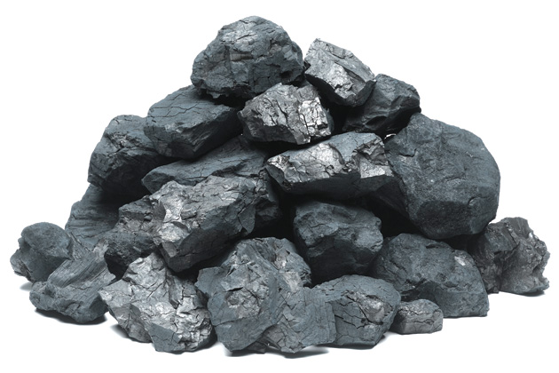
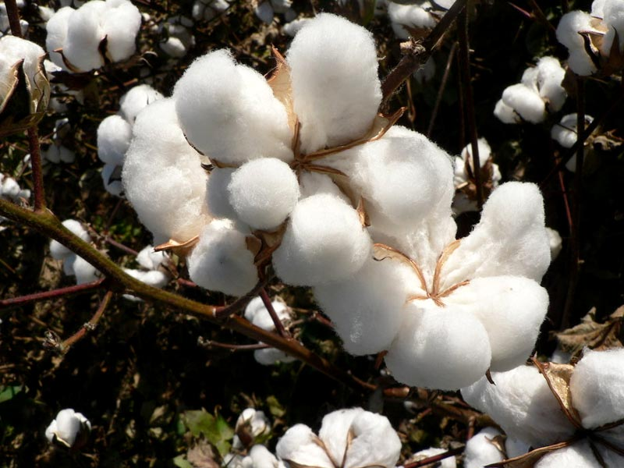
Factors leading to industrialization…
You need the basic materials to be able to produce goods to sell…
You need
RAW MATERIALS

Slide 21
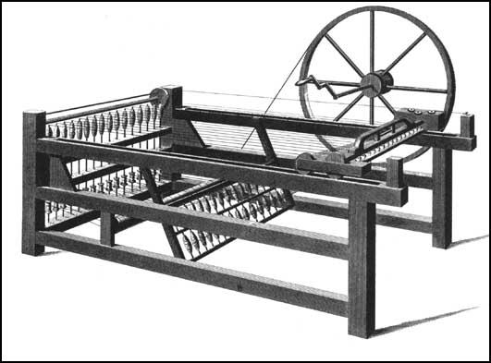
Factors leading to industrialization…
You need to be able to do things faster or in different ways
You need
NEW TECHNOLOGY
and
INVENTIONS

Slide 22
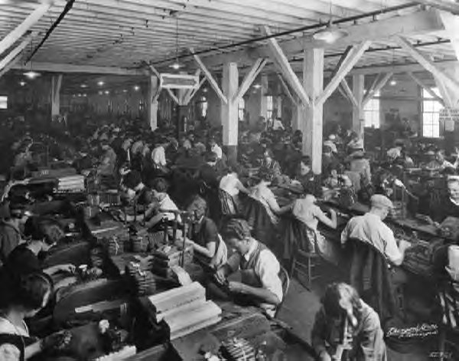
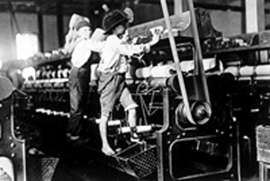
Factors leading to industrialization…
You need people to work in factories…
You need a
LABOUR SUPPLY

Slide 23
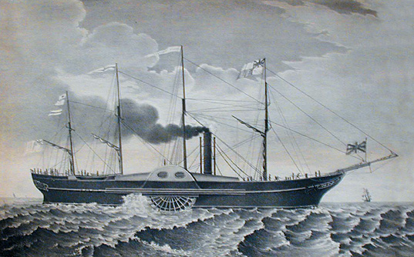
Factors leading to industrialization…
You need an efficient way to move goods or raw materials from one place to another…
You need
TRANSPORTATION

Slide 24
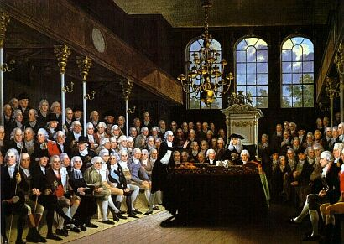
Factors leading to industrialization…
You need laws that help business and industry…
You need
GOVERNMENT SUPPORT

Slide 25
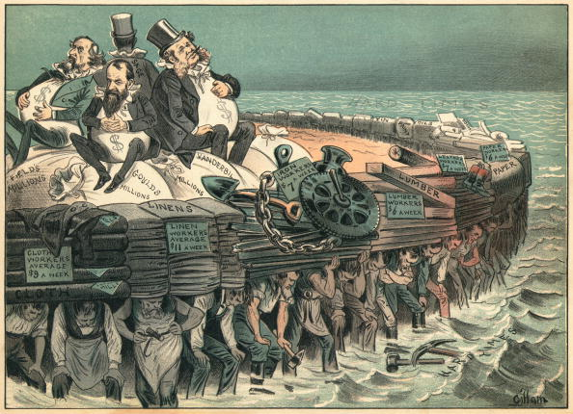
Factors leading to industrialization…
You need money to invest in business, factories, etc…
You need
CAPITAL

Slide 26
Task
Read “Why Britain?”
Discuss questions at the bottom
Complete “Causes” connections and questions
Hand in, or complete for homework

Slide 27
Extensions:
Kids React: Old Computer https://www.youtube.com/watch?v=PF7EpEnglgk
Kids React: Rotary Phone https://www.youtube.com/watch?v=XkuirEweZvM
Kids React: Gameboy https://www.youtube.com/watch?v=0pCp8g-VjOs

