Slide 1
Start-up Task
What is the purpose of a workers’ union?

Slide 2
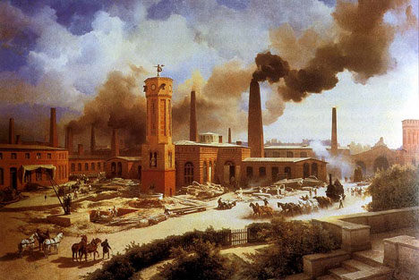
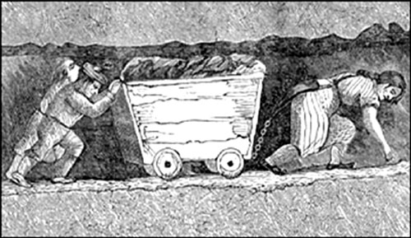
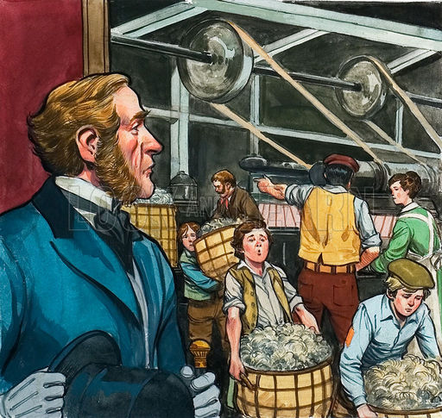
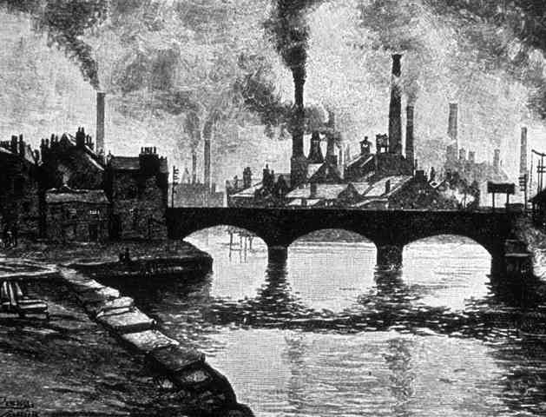
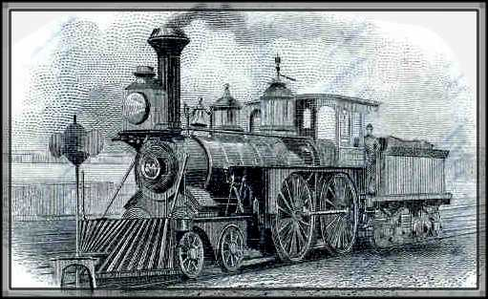
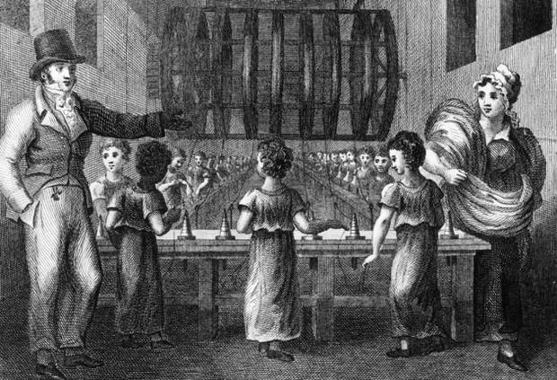
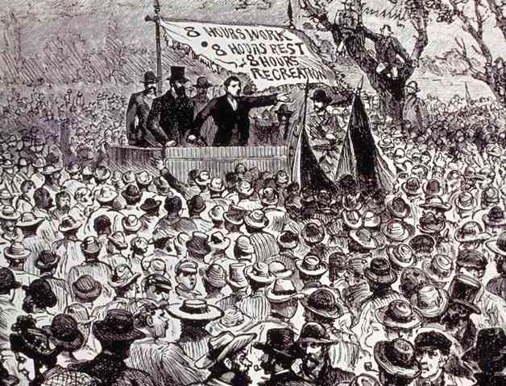
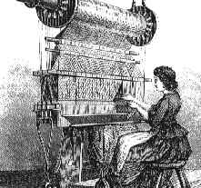
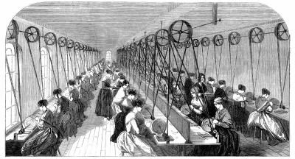
The Industrial Revolution
1750-1850s

Slide 3
Learning Outcomes
By the end of this lesson, I can…
Explain what laissez-faire policy is and compare it to our economy today
Assess the impact of laissez-faire policy
Critically analyze propaganda

Slide 4
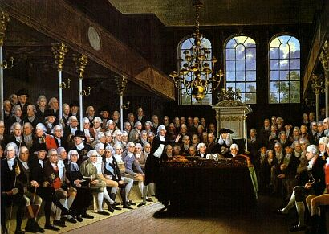
Factors leading to industrialization…
You need laws that help business and industry…
You need
GOVERNMENT SUPPORT

Slide 5
Pro-Business Government
More middle class entrepreneurs in gov’t
Tories = rich landowners Whigs = middle-class business people

Slide 6
Laissez-faire policy
Few government regulations for business
People are free to pursue profit
Wealthy and productive economy
Beneficial to all of society
Reality
Owners want to keep wages low to make profit.
Few benefits to workers.

Slide 7
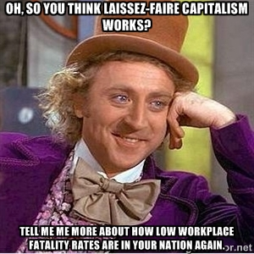

Slide 8
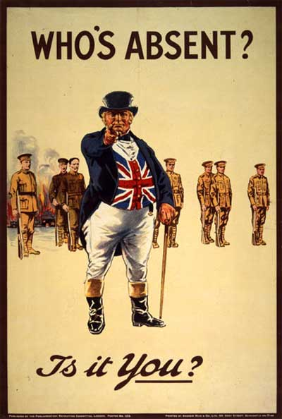
What is propaganda?
Information used to influence an audience and further an agenda
i.e. carefully selected information to make you think, feel, or believe something

Slide 9
Pro-Capitalism, Anti-Union Ads
Write down notes/comments/questions on your handout

Slide 10
Pro-capitalism https://www.youtube.com/watch?v=ZNrMk2qn8sY (2m)

Slide 11
Anti-Union Ad
https://www.youtube.com/watch?v=MKYvPEqMTZ8

Slide 12
Pro-Union “Employee Free Choice” Ads
Write down notes/comments/questions on your handout

Slide 16
Task
Complete the questions on your handout
Write in full sentences
If you finish… work/chill quietly

