Slide 1
Silent Reading
“Reading forces you to be quiet in a world that no longer makes places for that” – John Green

Slide 2
Media & Technology
Unit:
KEY Question:
How do media and technology impact our lives and the world?

Slide 3
Video
Did you know?
https://www.youtube.com/watch?v=XrJjfDUzD7M

Slide 4
Definitions
Media
Technology
The main means of mass communication (e.g. TV, radio, newspapers, internet)
Things created by humans to make life easier, or to solve a problem

Slide 5
Write:
Media/tech survey
Complete the media and technology surveys.
Read the statement, and check either “I agree,” or “I disagree”
I AGREE | I DISAGREE
✓
 | ✓
✓

Slide 6
Journal writing
Goal = Write for 10 minutes
Choose one, or several of the survey statements, and explain why you agree or disagree.
Complete sentences
On topic
Capitals & punctuation

Slide 7
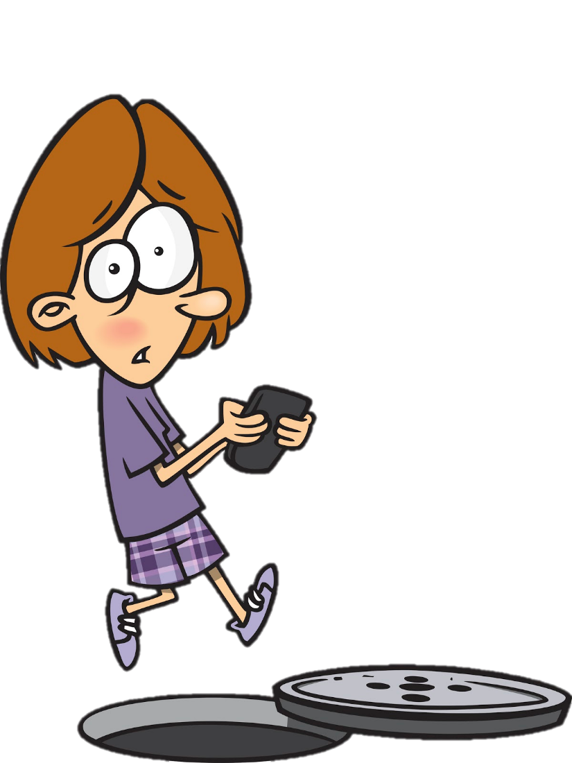
By jim toomey
Comic Strip
Sherman’s lagoon
Have you ever been distracted while texting or talking on a cellphone? Have you observed anyone else being distracted?

Slide 8
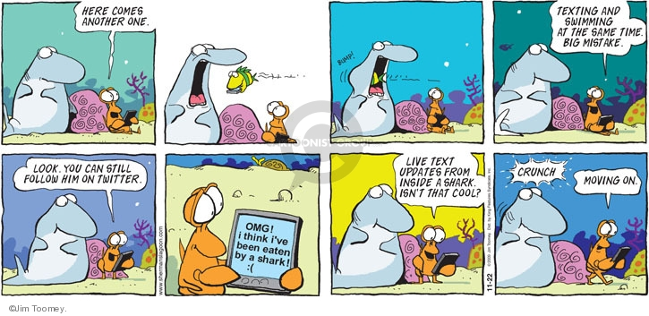
By jim toomey
Comic Strip
Sherman’s lagoon

Slide 9
What do you think is the message in this comic strip?
Comic Strip

Slide 10
satire
Comic Strip
= using humour to criticize something in the hope of bringing about change
Do you think that using humour is a good way to make people pay attention to a problem? Why?

Slide 11
By Dan Jaffe
Poem
THE FORECAST
A bit
Some
Quite a lot
A lot!
How much do you rely on media and technology in your daily life?

Slide 12
By Dan Jaffe
Poem
THE FORECAST
What are some of the PROS and CONS about relying on technology?
PROS (good) | CONS (bad)
1. | 1.
2. | 2.
3. | 3.
4. | 4.

Slide 13
By Dan Jaffe
Poem
THE FORECAST
Perhaps our age has driven us indoors.
We sprawl in the semi-darkness, dreaming sometimes
Of a vague world spinning in the wind.
But we have snapped our locks, pulled down our shades,
Taken all precautions. We shall not be disturbed.
If the earth shakes, it will be on a screen;
And if the prairie wind spills down our streets
And covers us with leaves, the weatherman will tell us.

Slide 14
By Dan Jaffe
Poem
THE FORECAST
Do you agree with Dan Jaffe’s view of “our age”? Why or why not?

Slide 15
Videos
Technology of yesterday
Rotary Phone https://www.youtube.com/watch?v=XkuirEweZvM
Old Computers https://www.youtube.com/watch?v=PF7EpEnglgk

