Slide 1
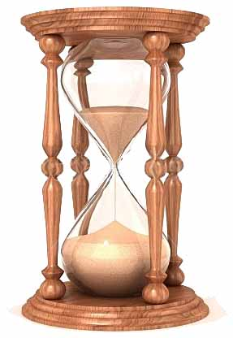
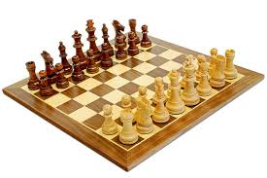
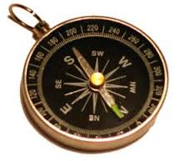
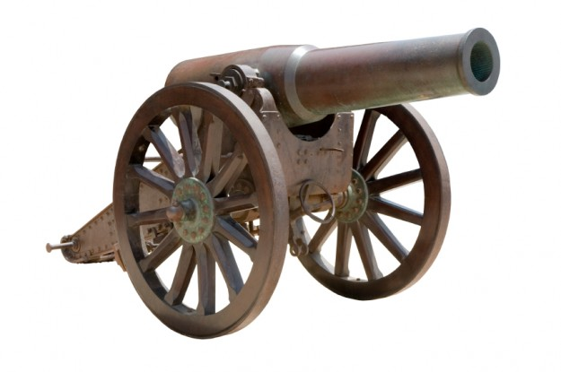
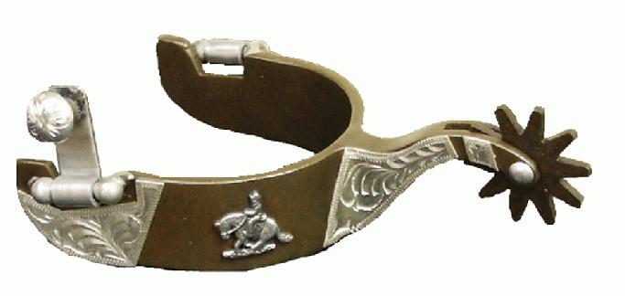
What do all of these objects have in common?

Slide 2
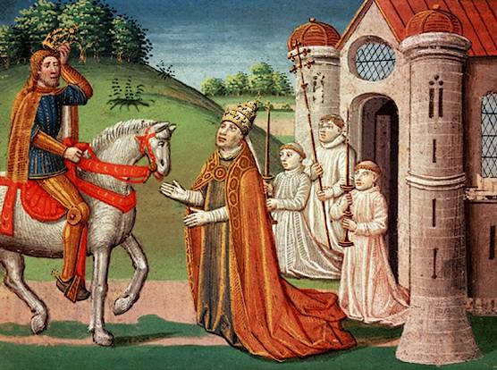
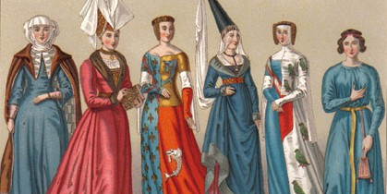
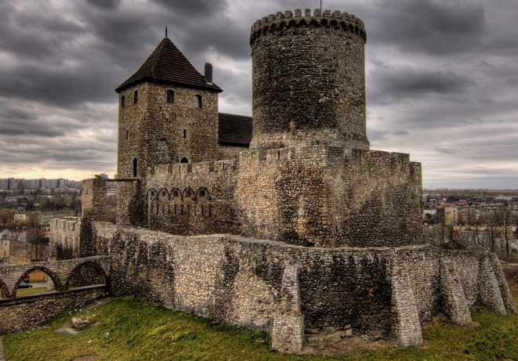
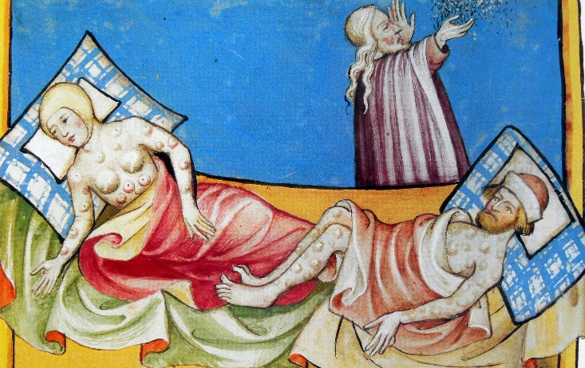
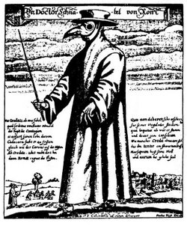
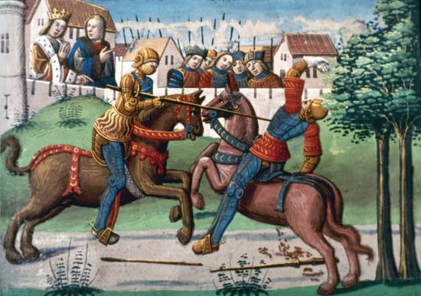
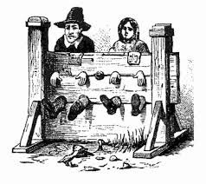
Europe’s Middle Ages
High Middle Ages (1066-1300), Late Middle Ages (1301-1500)

Slide 3
The Middle Ages
Also called the Medieval Period “Medieval”= Latin for “Middle Ages”
You have studied the EARLY Middle Ages
We will look at the HIGH and LATE Middle Ages

Slide 4
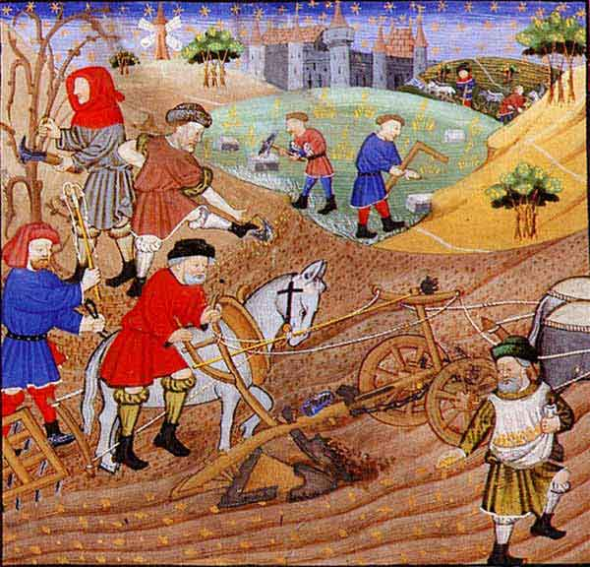
The High Middle Ages (1066-1300)
Population
Power of Catholic Church
Agriculture
Key Events:
Norman conquest of Britain
Development of feudalism
Development of knighthood and chivalry
The Crusades
The Magna Carta

Slide 5
Which topic to do with Medieval Europe interests you the most?
Ticket out the Door:
Answer this question on a piece of paper. Put your name on it and hand it to me on your way out the door

