Slide 1
Jeopardy Review Game
https://www.superteachertools.net/jeopardyx/jeopardy-review-game.php?gamefile=1416798204#.VHKqZfnF-So

Slide 2
paragraph
Goal:
Write a 5+ sentence paragraph that answers the question.
What was the impact of the crusades?
We need to know what the crusades were.
Impact = what effect did they have, what changed?
Were there new items, ideas, etc. that changed the way people lived or thought?
Long-term impact =

Slide 3
paragraph
Goal:
Write a 5+ sentence paragraph that answers the question.
What was the impact of the crusades?
Read pages 64-65 “Long Term Consequences” in your textbook.
Make a point form list of the impacts while you read

Slide 4
Topic Sentence
Supporting Sentences
Concluding Sentence
Tells what your paragraph will be about.
Add details about the topic.
Closes your paragraph by concluding what you have said: “summing it up”

Slide 5
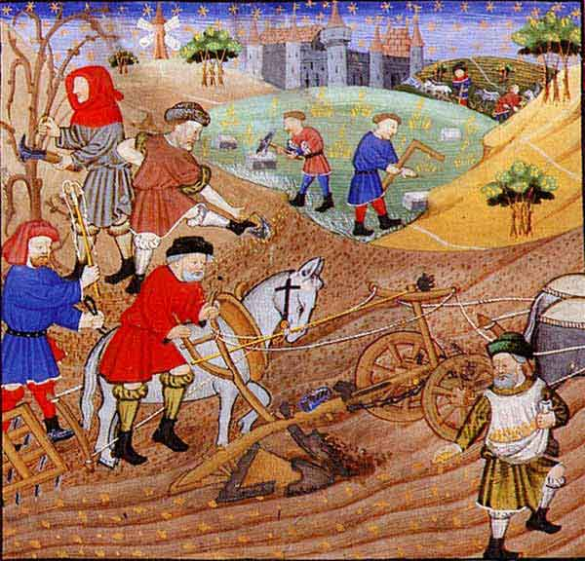
The High Middle Ages (1066-1300)
Population
Power of Catholic Church
Agriculture
Key Events:
Norman conquest of Britain
Development of feudalism
Development of knighthood and chivalry
The Crusades
The Magna Carta

Slide 6
HAVE A GREAT DAY!!

