Slide 1
The immigration issue
Immigration has been an issue throughout Canada’s history (and still is today!)
What are some controversies surrounding immigration policy? (past or present)
What are some possible concerns that might be voiced by new arrivals to Canada? (past or present)

Slide 3
1 minute:
On your own, or with a partner, come up with as many questions as you can about this photograph.

Slide 4
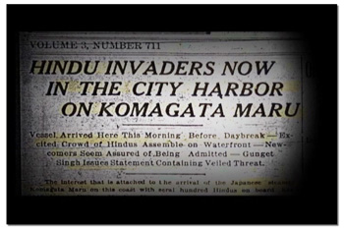
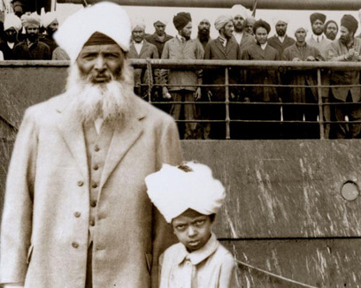
The Komagata Maru Incident
Steamship from India
Arrived in Vancouver’s harbour May 23, 1914
Denied access to Canada
Reflects deliberate exclusionary immigration policies of Cdn gov’t
Idea that Canada should remain “White Man’s Country”

Slide 6
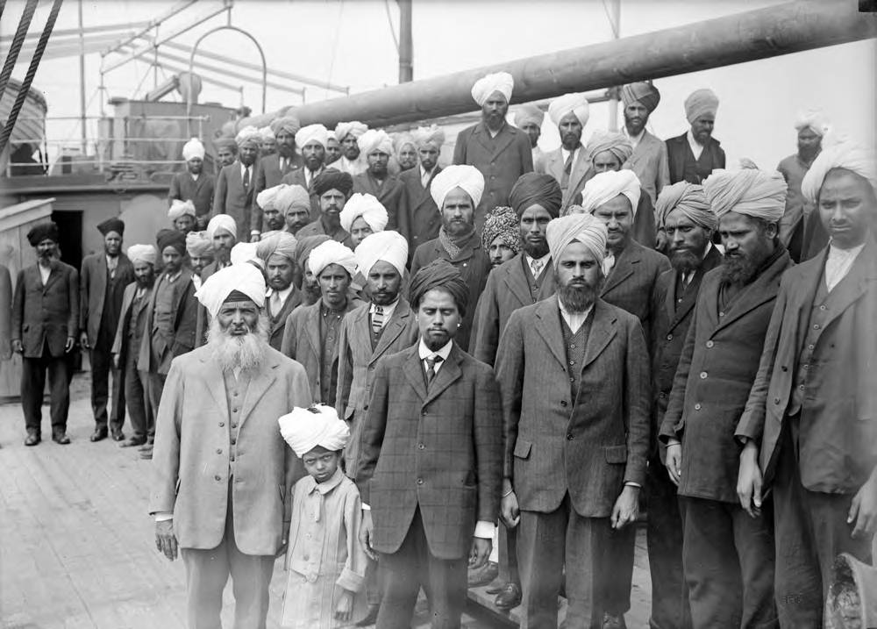
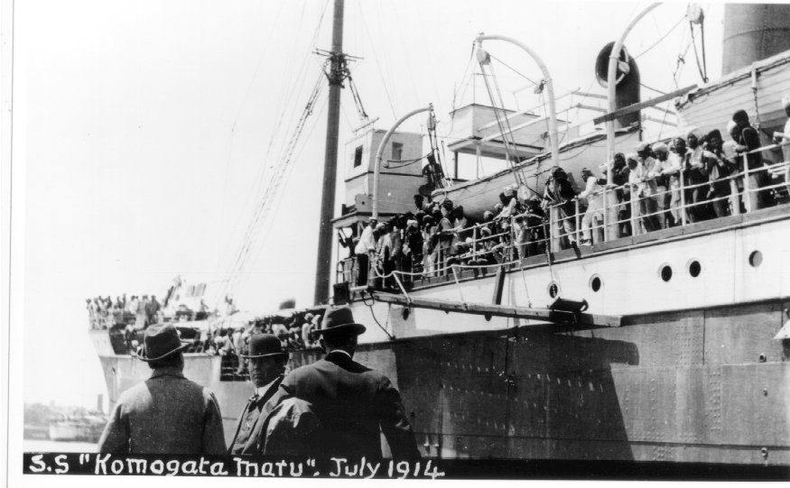
Why did this happen?
What motivated the individuals and groups to make the decisions they did?
We need to understand their attitudes and worldviews to be able to answer that…

Slide 7
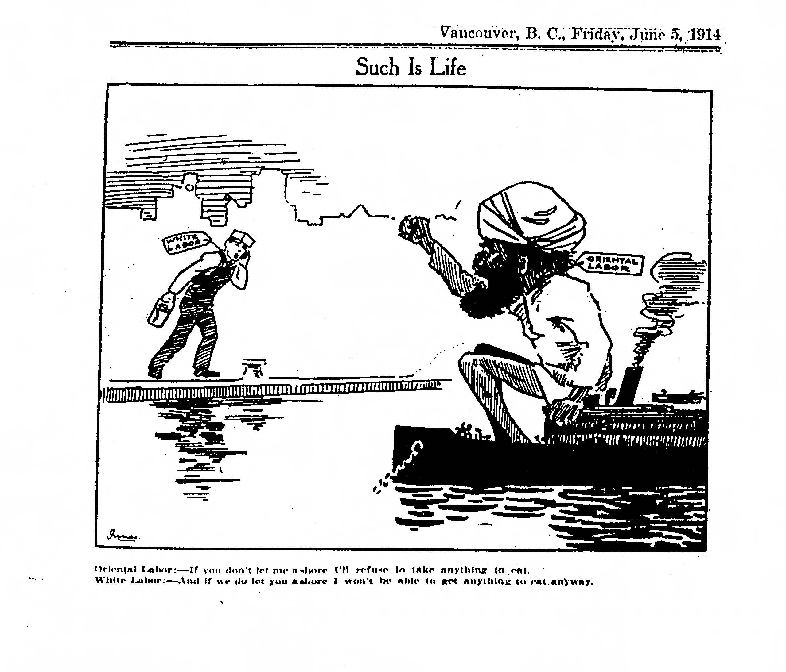

Slide 8
Primary Source Analysis
Reading within a Document: Making Inferences

Slide 9
In small groups:
Based on our observations and inferences, record some words that you think summarize the author’s attitude

Slide 10
Place Your words on this spectrum:
Strongly Supportive (FOR)
Strongly Opposed (AGAINST)

Slide 11
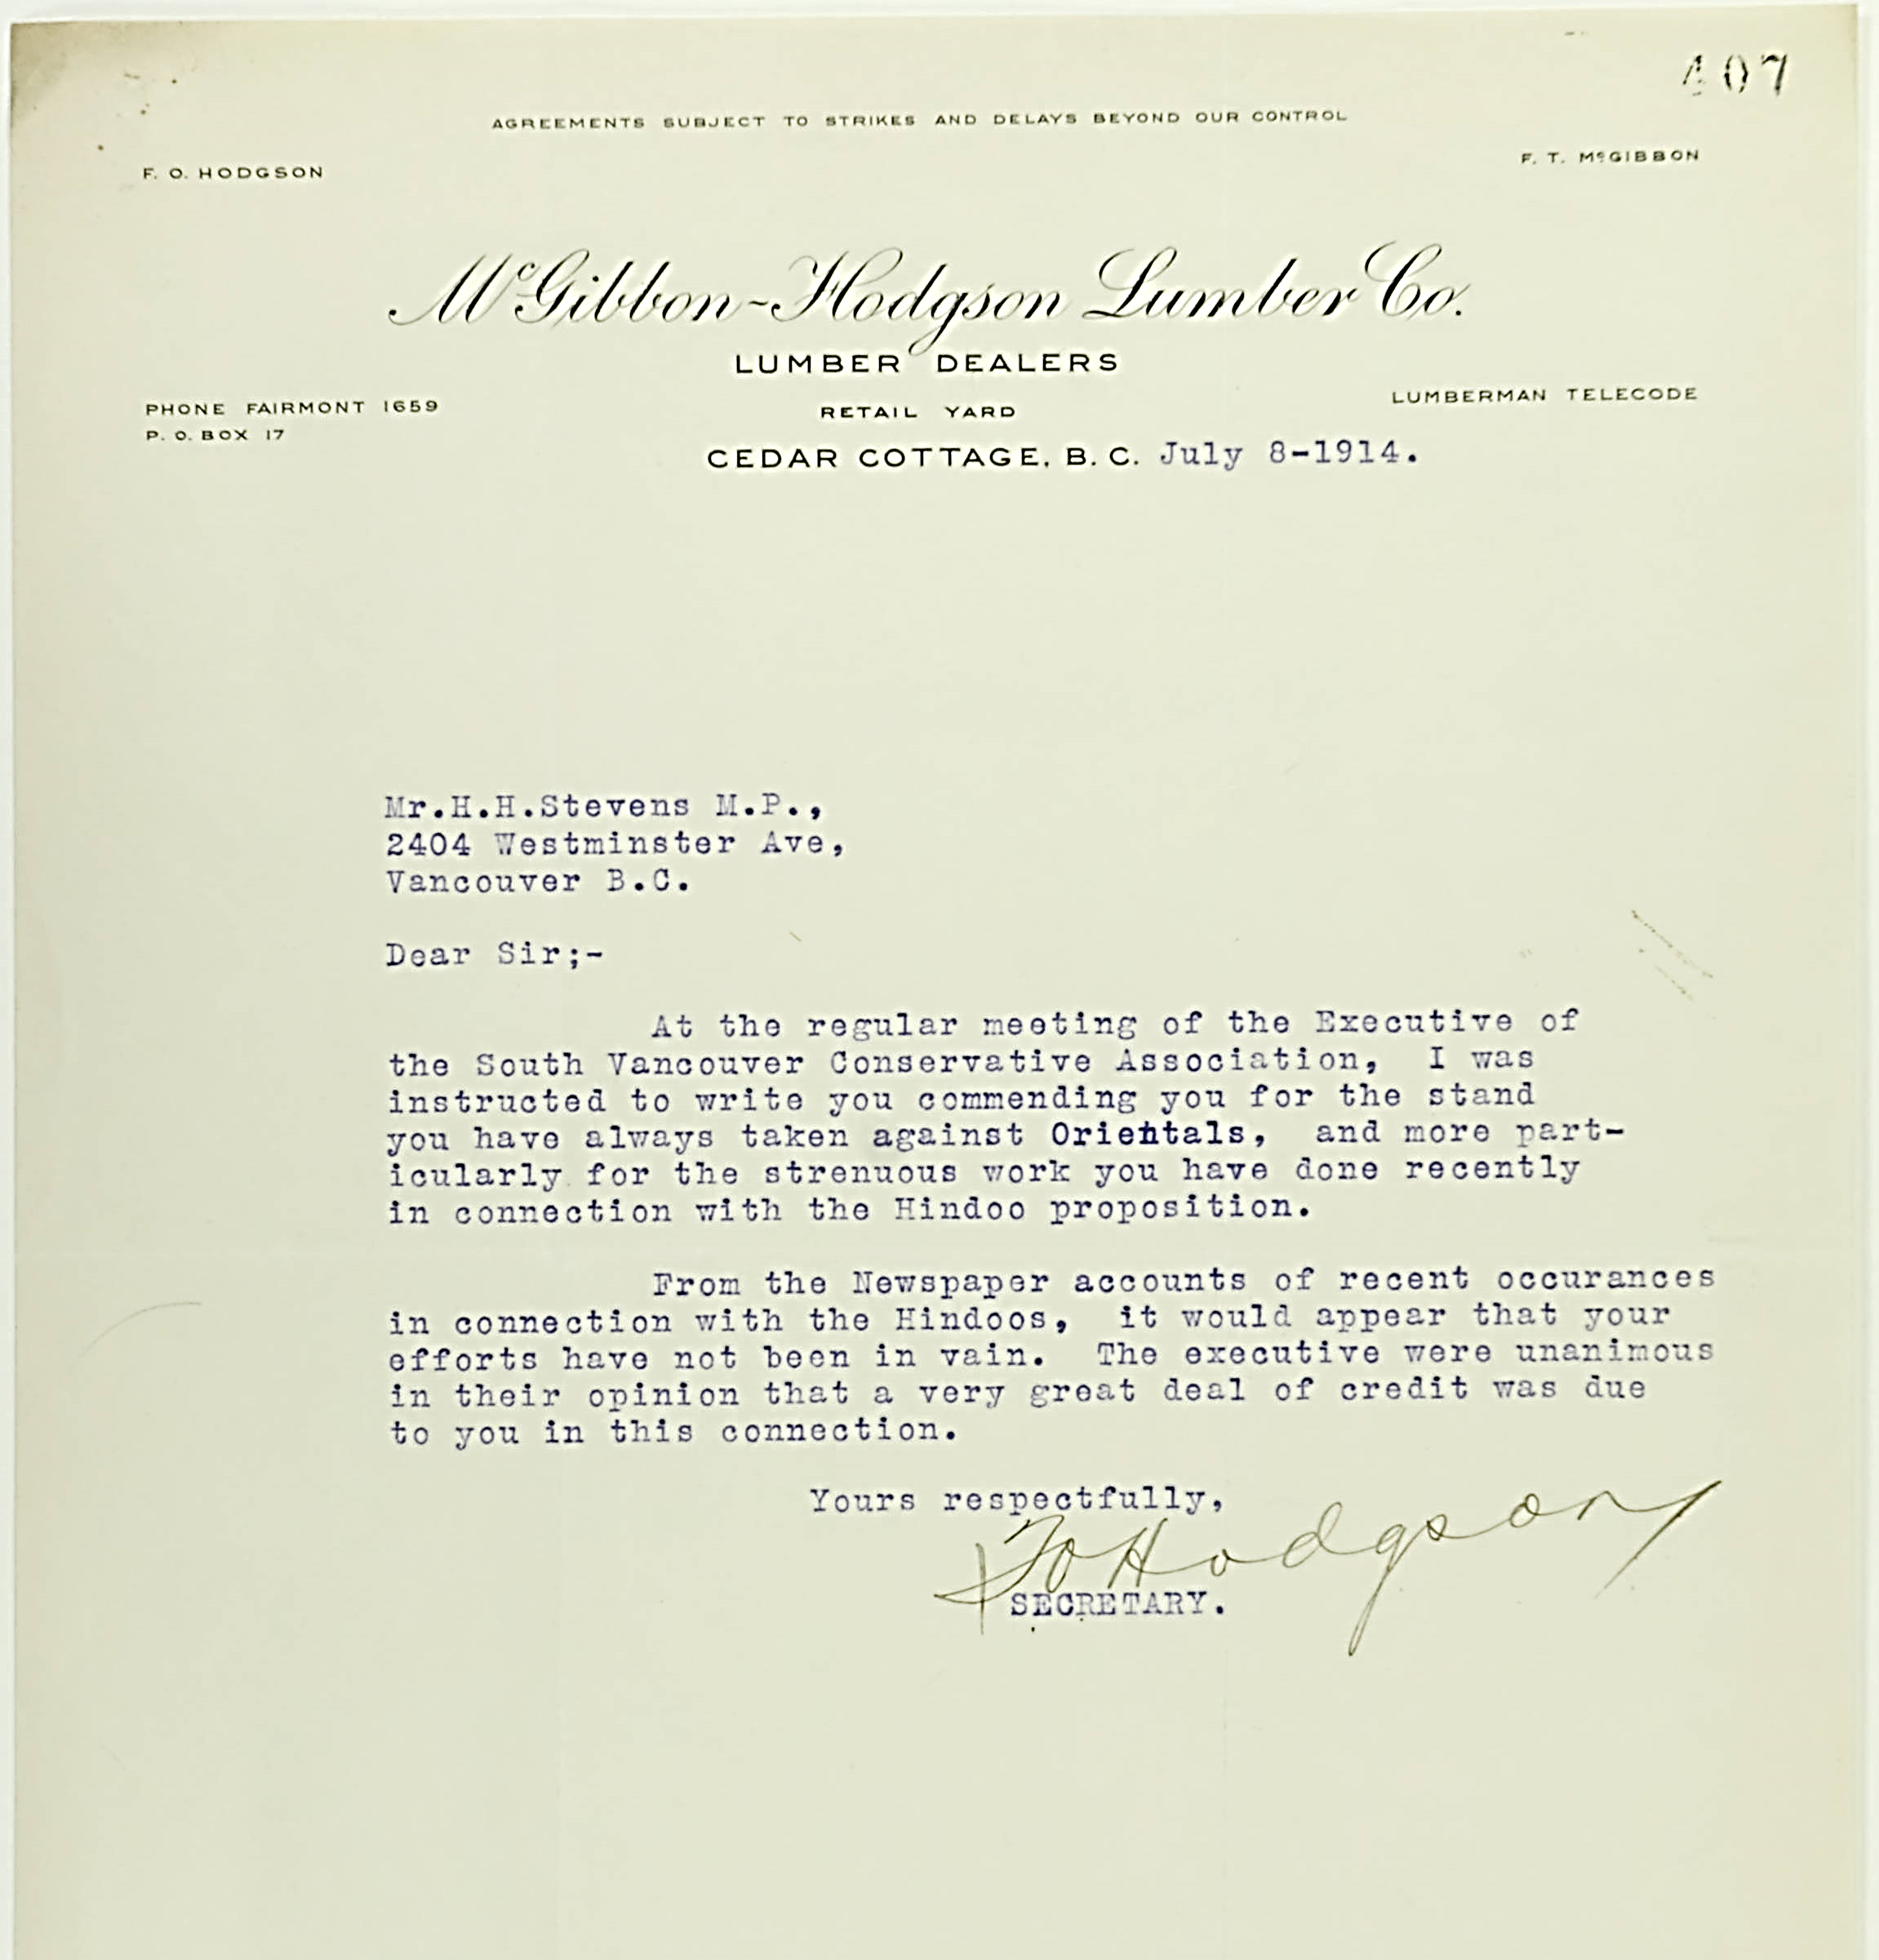
Examine your primary source
Complete the Reading within a Document handout
Share with the class: place the words you came up with on the spectrum

Slide 12
Place Your words on this spectrum:
Strongly Supportive (FOR)
Strongly Opposed (AGAINST)

Slide 13
Apology for historical wrongs
Government’s formal apology (May 18, 2016)
CBC Article: “Canada makes ‘I’m sorry’ a recurring policy”
Response Question:
Canada has committed many “historical wrongs” against groups of people in the past. As we have realized by examining the attitudes of people at the time- racism and discrimination were deeply embedded in society during the period in which this incident occurred (as is the case with many historical wrongs).
Do you think we have the right to judge actions or events in the past by our own ethical principles today (when they were clearly very different at the time)? Explain.
Do you think apologies to ethnic groups for historic wrongs are the right thing to do? Explain.

