Slide 1
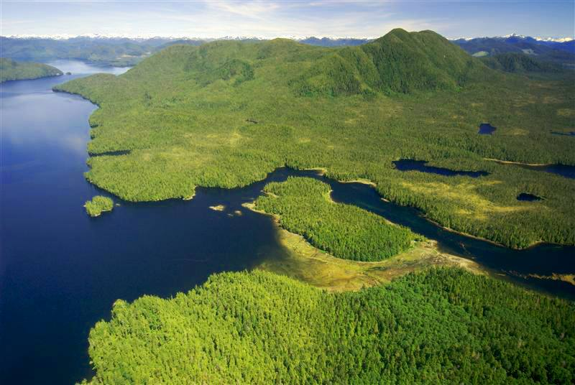
Land Use Discussion
The Great Bear Rainforest
Learning Outcomes:
Communication: I can connect and engage with others by participating in discussions.
Social Responsibility: I can consider others’ views and express a different opinion in a peaceful way

Slide 2
Land Use Discussion
Preparation
The Great Bear Rainforest
Complete “PART TWO” on your handout
Respond to the statements by stating whether you agree/disagree, and an explanation why. You could partially agree/disagree with the statement. Make sure you explain your opinion.

Slide 3
Discussion Point:
Logging should be a part of the land use plan, because BC forestry workers’ jobs must be protected now and in the future.

Slide 4
Discussion Point:
The Coastal First Nations should be given control of the Great Bear Rainforest region, so that they can ensure a sustainable future.

Slide 5
Discussion Point:
All development (logging, mining, road building, etc.) in the Great Bear Rainforest should be stopped and remain off limits. The entire region should be protected.

Slide 6
Discussion Point:
Any development in the region needs to bring income and sustainable economic opportunities for First Nations communities.

Slide 7
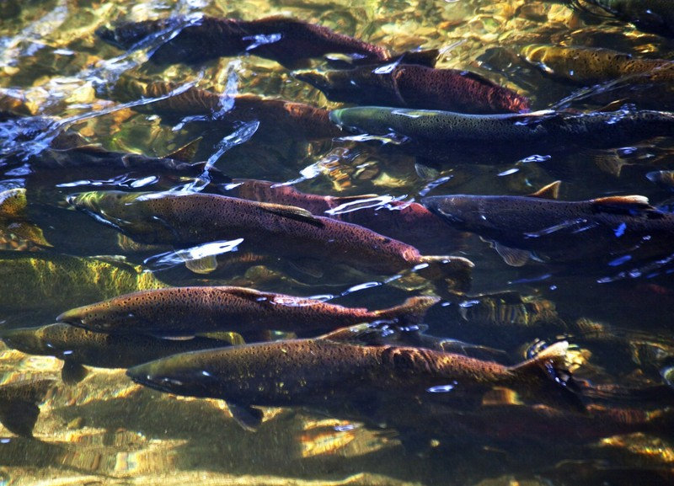
Salmon Farming
https://www.youtube.com/watch?v=miFMtgMcX58
How does salmon farming impact the natural environment (plants, fish, other animals)
How does salmon farming impact humans? (communities, cultures, etc.)
Do you think salmon farms should be allowed on the coast of B.C.?
What can we do about this issue?

