Slide 1
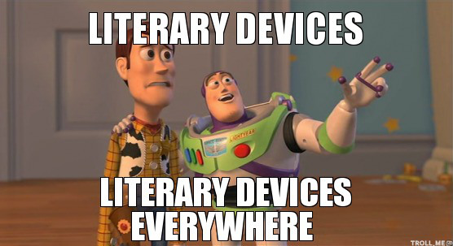

Slide 2
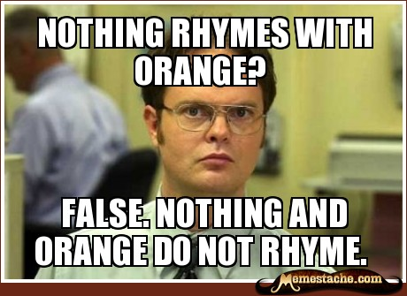
Rhyme
Sound Devices
Internal Rhyme:
A rhyme in only one line of verse
EXAMPLE
“We were the first that ever burst”

Slide 3
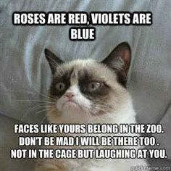
End Rhyme
Sound Devices
When a poem has lines ending with words that sound the same

Slide 4
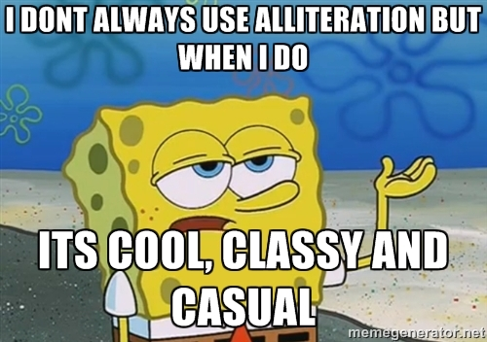
Alliteration
Sound Devices
Words used in succession begin with the same letters (or sound group)
Repetition of similar sounds in a sentence
Example: The wicked witch went on her way.

Slide 5
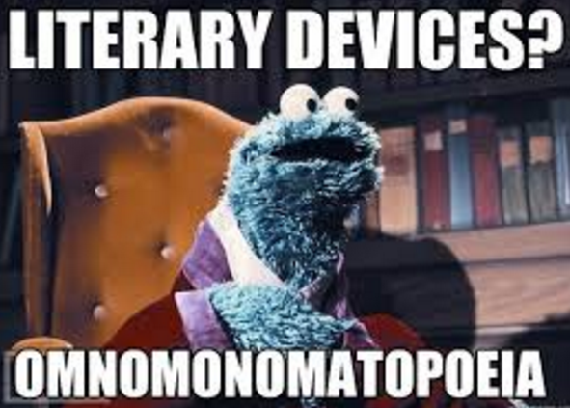
Onomatopoeia
Sound Devices
Words whose sound is close to the sound they are meant to depict

Slide 6
Repetition
Sound Devices
Repeating a word, phrase, or sentence.
Adds emphasis/unity
EXAMPLES
Boys will be boys
“When there is talk of hatred, let us stand up and talk against it. Where there is talk of violence, let us stand up and talk against it.”

Slide 7
Allusion
Figurative Language
When the author refers to a place, event, or person. It is up to the reader to make the connection.
EXAMPLE
He was starving, and couldn’t wait to get to the golden arches for some lunch.

Slide 8
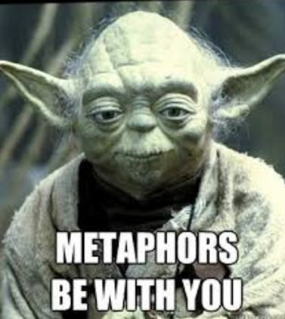
Metaphor
Figurative Language
One thing is compared to another by “being” it.
Helps us to take a well-known concept and use it to better understand a lesser known subject
EXAMPLE
He was a lion on the battlefield.

Slide 9
Simile
Figurative Language
Drawing a comparison between two things.
Use words “as” “such as” or “like”
EXAMPLES
She is as busy as a bee these days.
Life is like a box of chocolates.

Slide 10
Imagery
Figurative Language
When the author uses words and phrases to create “mental images” for the reader
Helps us visualize the writing
Appeals to the five senses
EXAMPLE:
The gushing river made its way down the lush green mountains, dotted with tiny flowers in a riot of colours, and trees coming alive with gaily chirping birds.

Slide 11
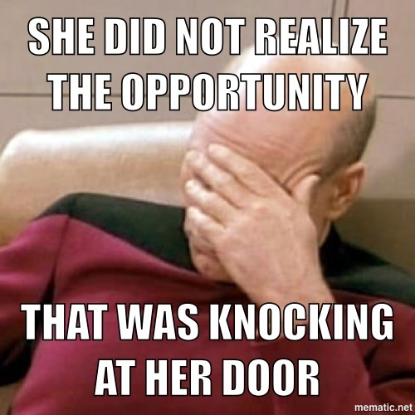
Personification
Figurative Language
Attaching human traits and characteristics to inanimate objects, phenomena, and animals
EXAMPLES
The wise owl
The fire ran wild
Time creeps up on you

Slide 12
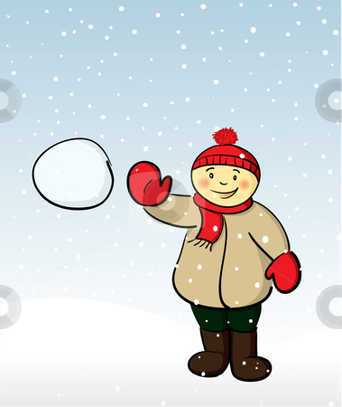
LITERARY DEVICE SNOWBALL TOSS

Slide 13
Choose one and write it at the top of your paper
He is such a pig.
He was a real Romeo with the ladies.
The stars danced in the dark sky.
He could hear footsteps of doom nearing.
The snake slithered and hissed.
Hopefully his home has some heat.

Slide 14
Crumple & Toss!
Pick one up and read the sentence to yourself.
Write down what it is an example of (simile, imagery, etc.- you can use your sheet to help!)

Slide 15
Choose one and write it on your paper
She was being such a Scrooge.
The sun glared down on us from above.
The bridge collapsed, creating a huge boom.
The barbarians broke through the barricade.
Life is a rollercoaster.
He stood on the wall, but it made him too tall.

Slide 16
Crumple & Toss!
Pick one up and read the sentence to yourself.
Write down what it is an example of (simile, imagery, etc.- you can use your sheet to help!)

Slide 17
Choose one and write it on your paper
The waffle jumped out of the toaster.
The music coursed through us, shaking our bodies.
Those clucking chickens are driving me crazy!
She bounced the ball in the backyard.
I’ll just wander over yonder.

Slide 18
Crumple & Toss!
Pick one up and read the sentence to yourself.
Write down what it is an example of (simile, imagery, etc.- you can use your sheet to help!)

Slide 19
Choose one and write it on your paper
He was acting like a monkey!
The flowers waltzed in the gentle breeze.
Birds tweeted happily outside the window.
The popcorn leapt out of the bowl.
He could hear rain trickling down the gutter.

Slide 20
Crumple & Toss!
Pick one up and read the sentence to yourself.
Write down what it is an example of (simile, imagery, etc.- you can use your sheet to help!)

