Slide 1
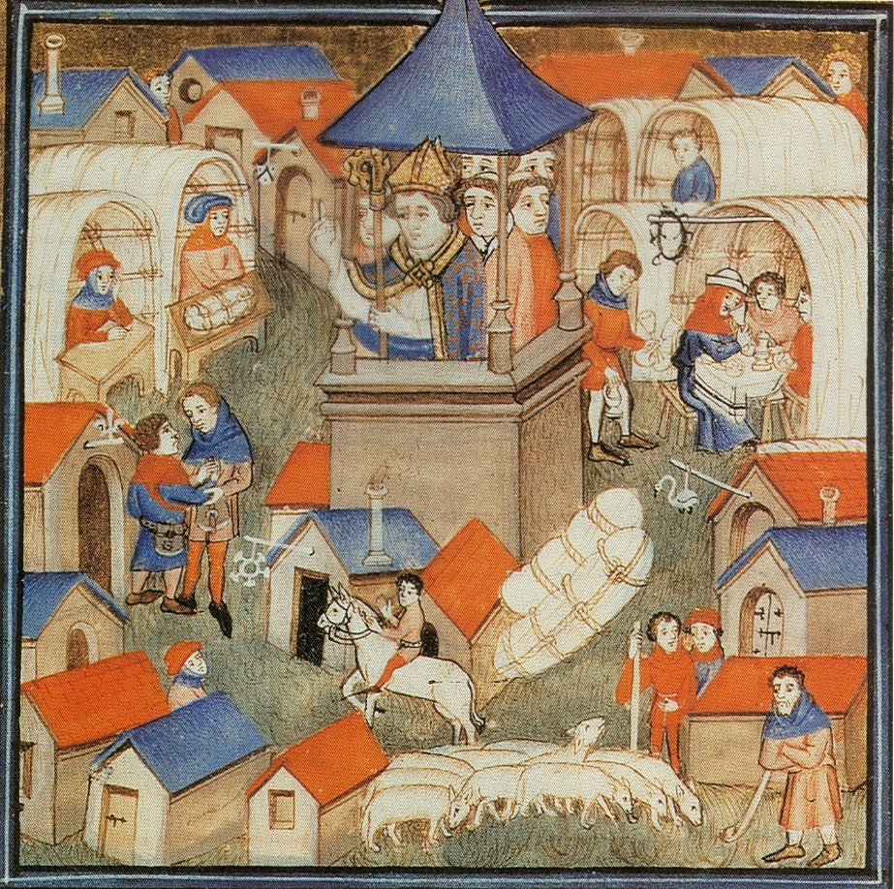
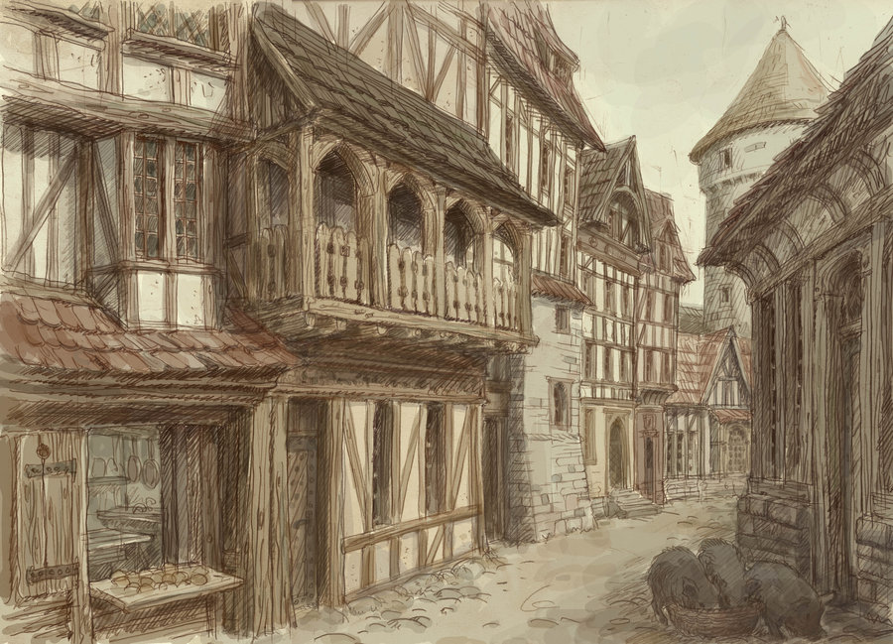
Medieval Towns & Trade

Slide 2
Learning Outcomes
Describe the factors that led to trade
Explain how trade led to the need for and growth of towns
Describe what life was like in a medieval town

Slide 3
Review: Think/Pair/Share
What was the significance of the 100 Years’ War? (i.e. what changed?)

Slide 4
https://www.youtube.com/watch?v=zZimXhjGshI

Slide 5
Trade
Towns
Craft Guilds
Crusades: influenced trade
Traders would make journey for goods and sell them at local markets/fairs
People began learning to produce their own goods to sell
The fair wasn’t good enough… seasonal and had to travel for them
Needed stability: permanent shops protected by town walls
Towns full of trade specialists
Organized and controlled by experts in that trade: “guild”

Slide 6
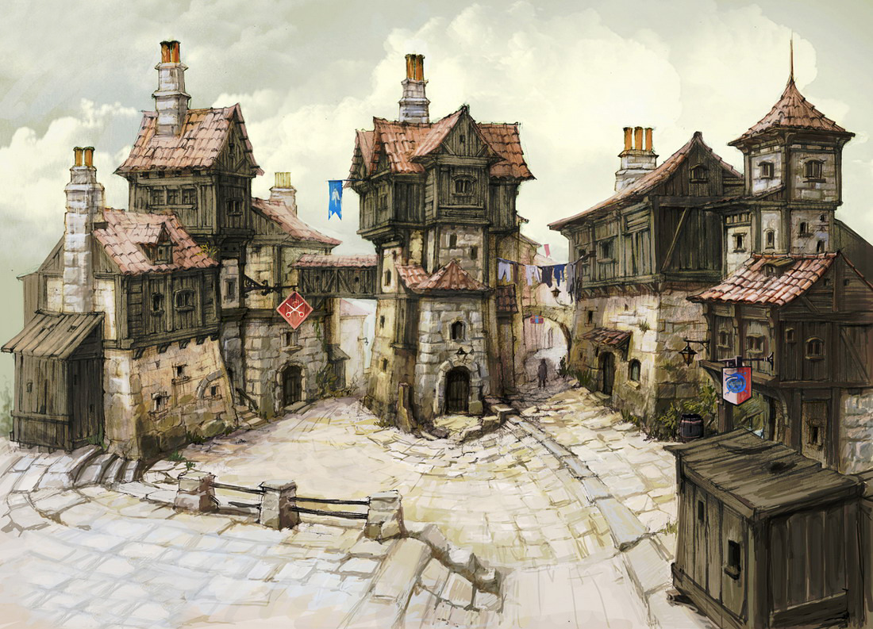
Cause and Consequence
What factors led to the growth of trade?
How did the growth of trade lead to the need for towns?

Slide 7
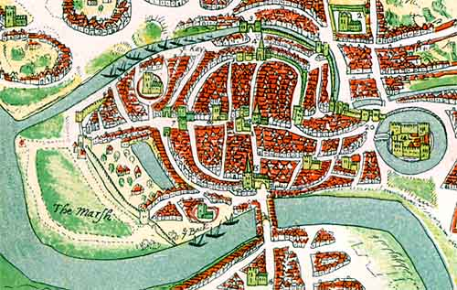
MEDIEVAL TOWNS
Some medieval towns grew up around a castle, where people hoped to be safe from attack. Some towns developed around trading centres such as busy crossroads or a village where local farmers gathered to sell their produce. Others grew up near natural harbours and rivers where it was easy to bring in goods by ship.

Slide 8
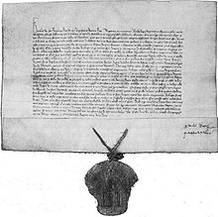
MEDIEVAL TOWN charter
At first towns were parts of kings or lords domain. As they became richer, townspeople resented having to work on the lords land. Instead townspeople paid their lord a fixed yearly sum in return for a charter which gave them the right to govern themselves.

Slide 9
MEDIEVAL TOWN charter
The Town Charter – Key Facts
A charter made a town a free borough with the power to hold a market, make its own laws, form guilds and raise taxes.
The townspeople became free citizens or burgesses.
The towns were governed by an elected mayor and a local council.
Any peasants who had run away to live in a town became free men if they avoided capture for a year.

Slide 10
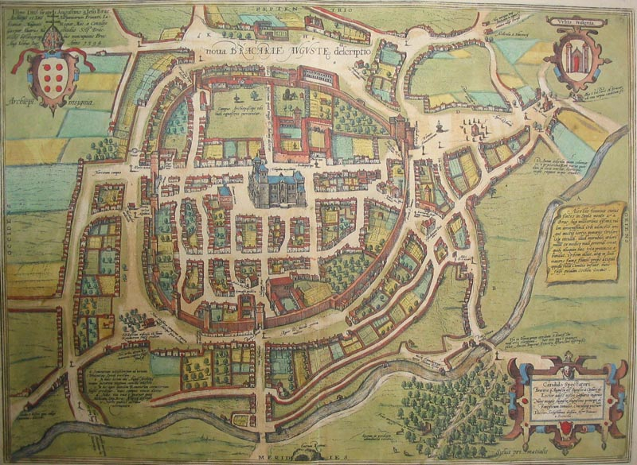
MEDIEVAL TOWN walls
Most medieval towns were fortified with high stone walls and strong gatehouses. This kept out enemies and also made sure that merchants and other visitors could only enter by the gates where they had to pay a toll.

Slide 11
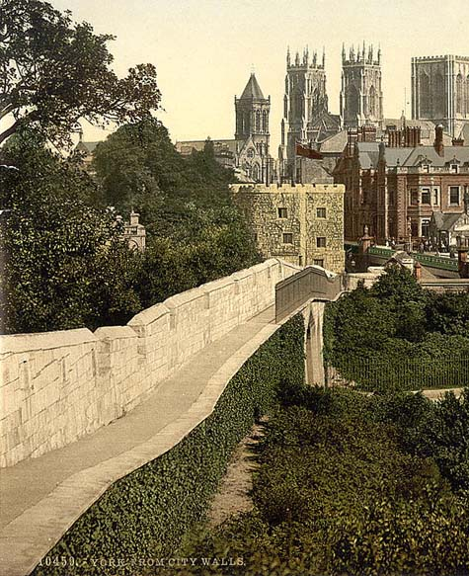
MEDIEVAL TOWNS
Town Walls – Key Facts
Town gates were opened at dawn and locked at dusk.
At sunset the town bells rang to sound curfew, telling everyone to finish work and lock their doors.
Curfew was also the signal for people to cover their fires with dome shape clay pots before they went to bed.
As the dark streets could be unsafe, nightwatchmen patrolled them with lanterns to deter criminals.

Slide 12
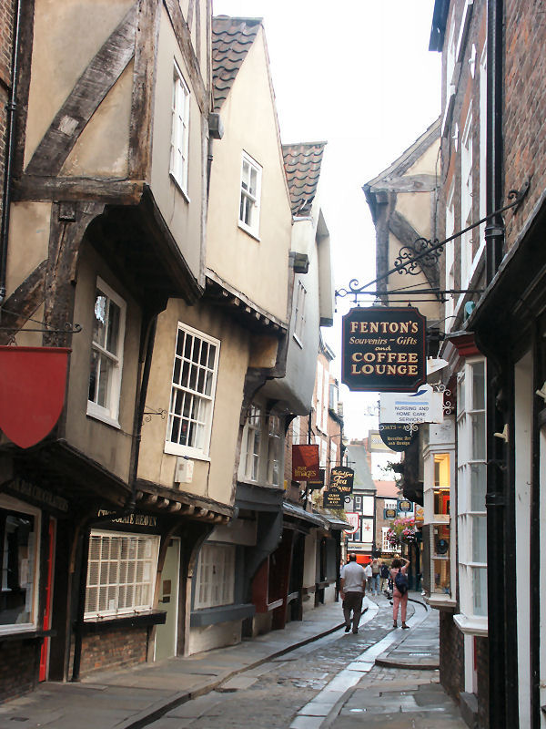
Town houses
As space inside a towns wall was limited houses were built close together, Upper stories often jutted out above lower floors making streets dark and gloomy.

Slide 13
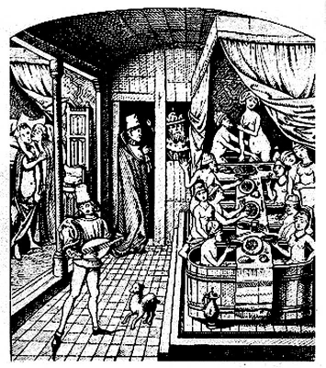
MEDIEVAL TOWN houses
Town Houses – Key Facts
Although houses did not have bathrooms or running water most towns had public bathhouses and some people bathed twice a day.
As there were no drains or sewers people emptied slop pails and chamber pots out of windows onto the street below.
Most craftsmen had workshops on the ground floor of their home.
Goods were displayed on a hinged shelf at the front. Shutters were pulled down at night for security.

Slide 14
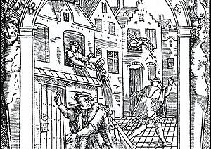
Living conditions
Dirty: no sewage system
Many threw toilet waste and other trash into the street
Rats were very common
Water was NOT clean
Disease was common and life expectancy was short

Slide 15
https://www.youtube.com/watch?v=JZq9cBzrIVI

Slide 16
Your Task
You have travelled back in time to a medieval town…
Try to summarize and describe key features and points by using some of these words:
Walls Curfew Rats Waste
Dirty Close Winding
Dark Disease
Task: Write a postcard to a friend/family member describing your experience living in a medieval town.
Use pages 154-155 in your textbook, as well as the notes you took

Slide 17
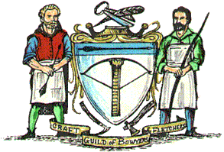
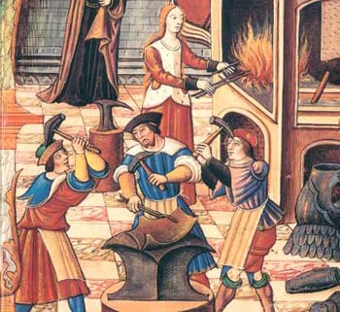
Task: guilds
Use your textbook and the information provided to answer the questions about guilds on your handout
Textbook pgs. 151-152

