Slide 1
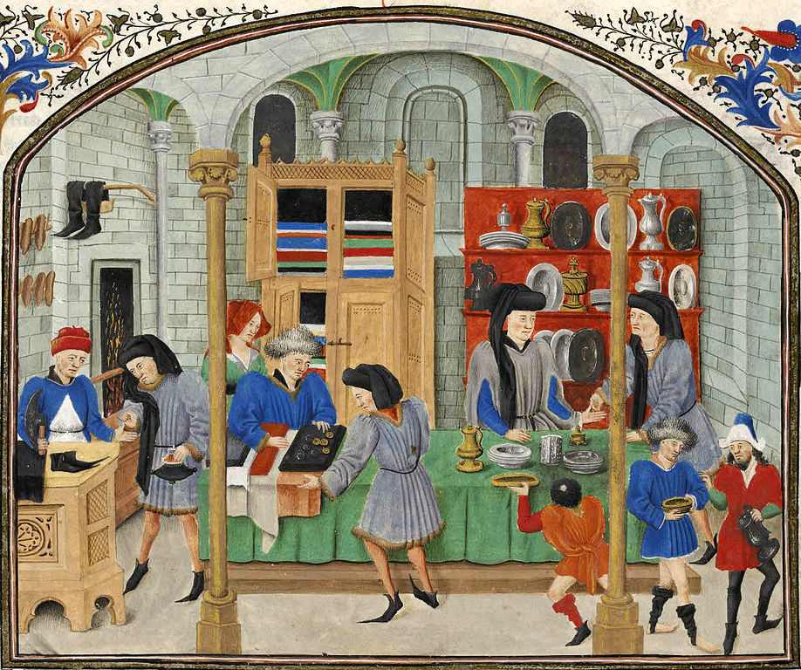
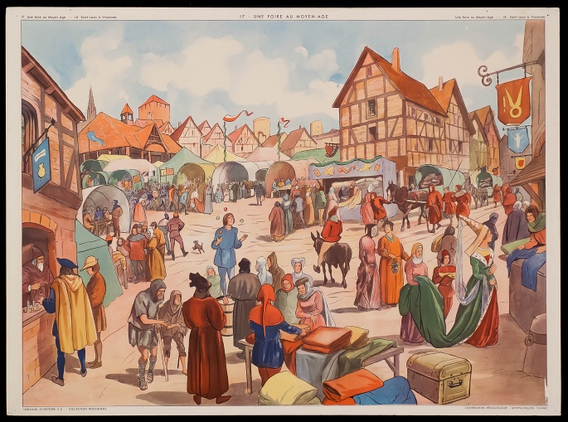
Medieval Towns & Trade

Slide 2
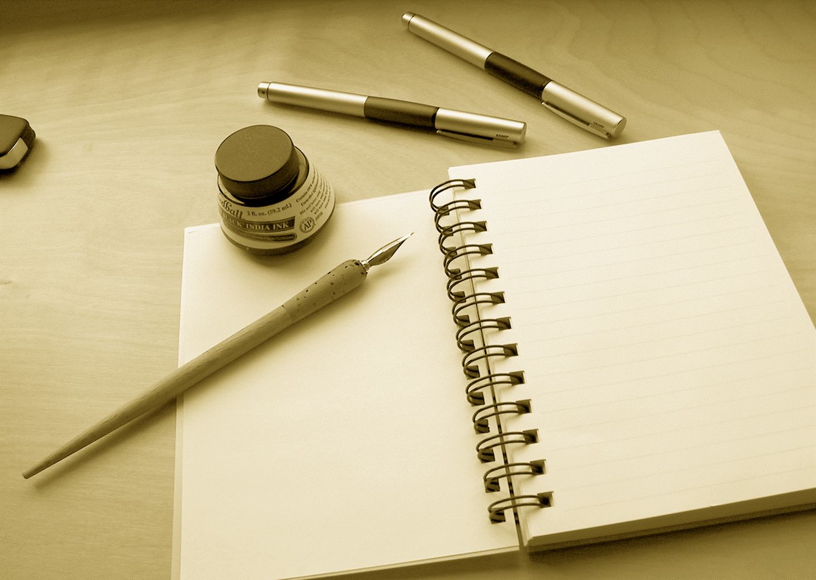
Review:
Write down 10 words (not a sentence, just individual words)
that describe what life was like in a medieval town

Slide 3
https://www.youtube.com/watch?v=_dwL9lqVBxY

Slide 4
Trade activity
Welcome to our medieval town market! In this activity you will be assigned a role as a local townsperson or a merchant.
Your goal is to trade your own goods with the other townspeople or merchants in order to get the necessities and some luxury goods!

Slide 5
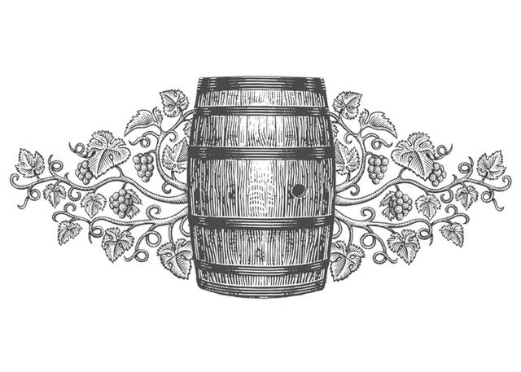
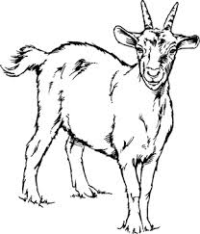
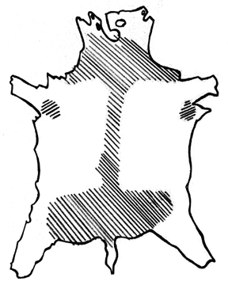
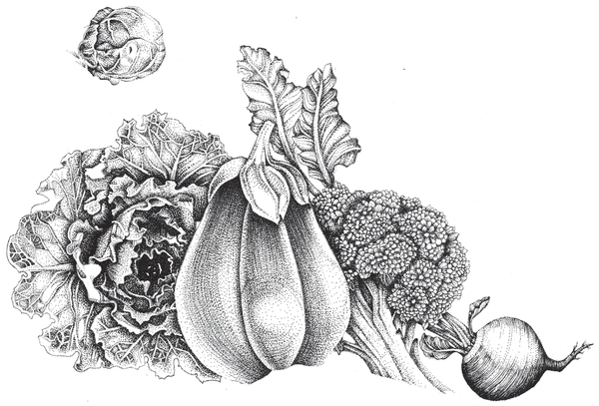
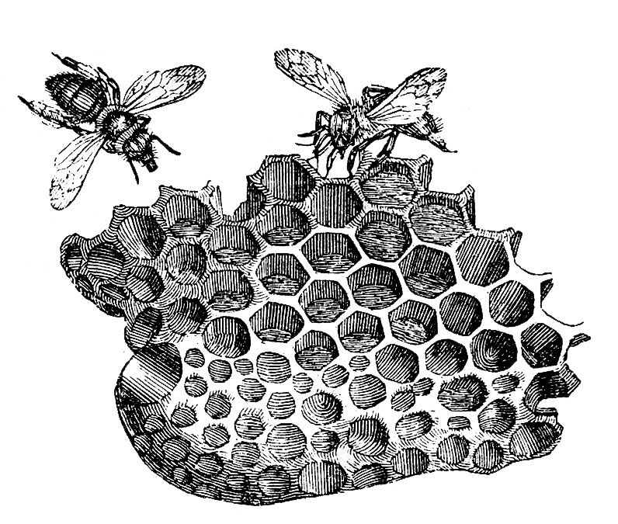
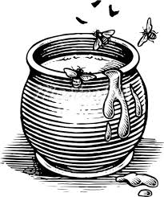
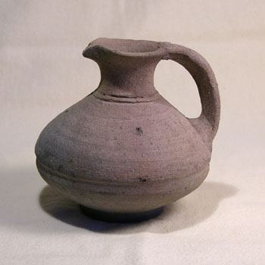
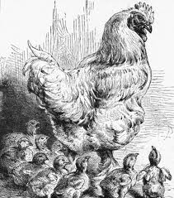
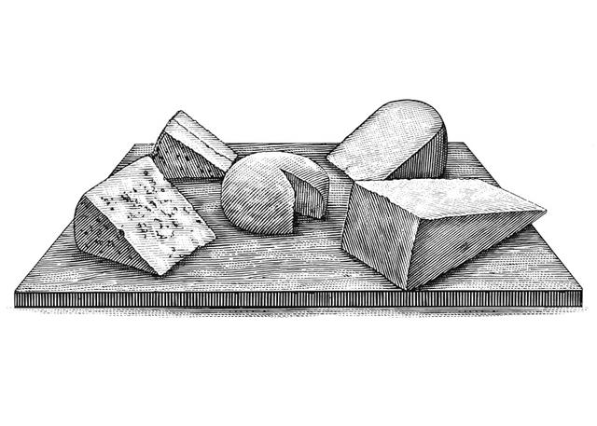
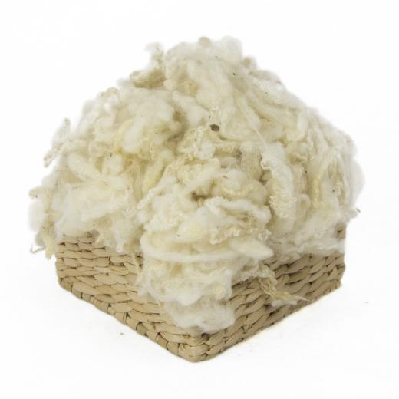
Local items

Slide 6
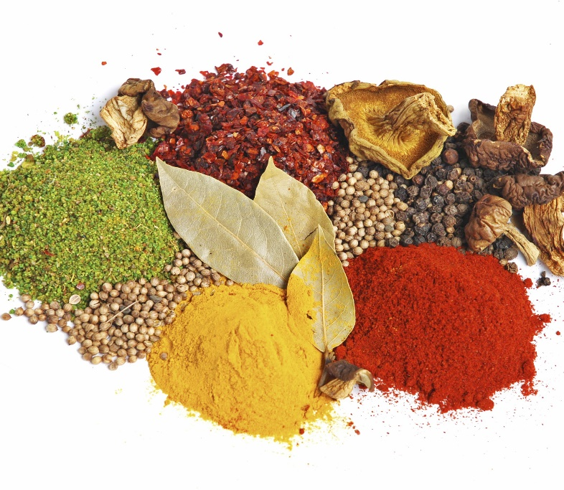
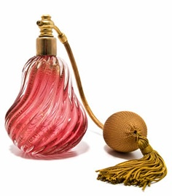
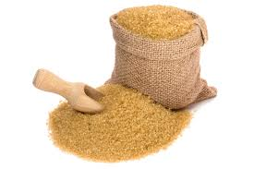
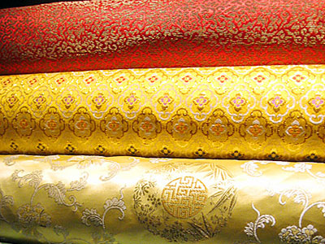
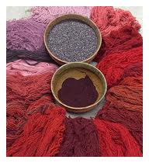
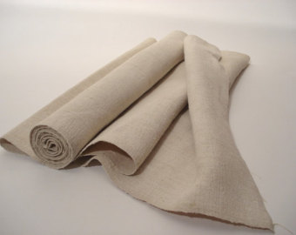
Imported goods (luxury!)

Slide 7
Trade activity
Look at which items you have to trade with and tally up the total number of credits you have
(use the chart provided)
These are the items that you have brought with you to trade with at the market. They are like your money, as they are all worth a certain value.

Slide 8
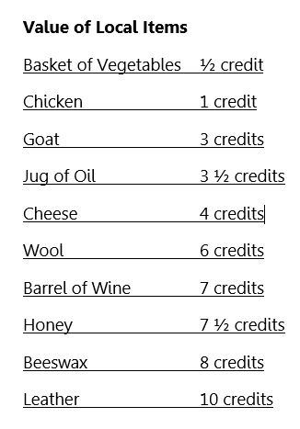
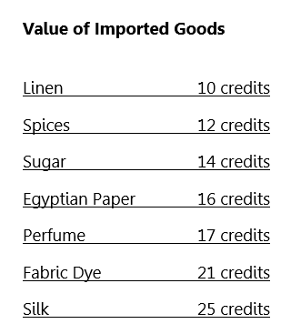

Slide 9
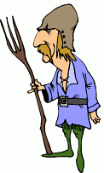
Trade activity
2. You may begin trading with other townspeople and merchants at the market. You must make sure that with each trade you are keeping the same amount of credits, and just changing which goods you have.
Example:
I give you two goats (3 credits each = 6 credits total)
I give you one wool (6 credits)

Slide 10
Your goal is to use your credits to trade for other items that will help you to live comfortably. What you need to live comfortably is:
4 Baskets of Vegetables |  | 1 Wool
2 Chickens |  | 1 Barrel of Wine
1 Goat |  | 1 Honey
1 Jug of Oil |  | 1 Beeswax
1 Cheese |  | 1 Leather
You may also want to buy some imported luxury goods with your left over credits! You may not get one of everything, as sometimes there are shortages at the market. Choose wisely!

Slide 11
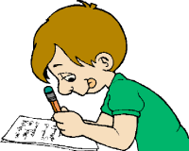
Trade activity
3. When you have made all of your trades, complete
“What did you end up with?” questions 1 & 2

Slide 12
Venn diagram: towns
Complete the provided Venn Diagram comparing and contrasting medieval towns with modern towns today.

