Slide 1
Goal: to practice effective group discussion and problem solving

Slide 2
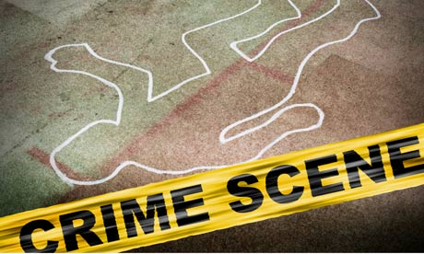
Your Task
Mr. Kelley was murdered. You must find:
The murderer (WHO?)
The weapon (HOW?)
The time of the murder (WHEN?)
The place of the murder (WHERE?)
The motive (WHY?)

Slide 3
Process
Each member of your group has some clues that will help to solve this mystery.
In your group, you will need to share the clues ORALLY (say it out loud)
(you MAY NOT allow anyone else to read your clue!!)

Slide 4
After receiving a superficial gunshot wound from Mr. Jones, Mr. Kelley went to Mr. Scott’s apartment where Mr. Scott killed him with a knife at 12:30 AM because Mr. Scott was in love with Mr. Kelley’s wife.
The murderer = Mr. Scott
The weapon = knife
The time = 12:30 am
The place = Mr. Scott’s apt
The motive = Mr. Scott was in love with Mr. Kelley’s wife

Slide 5
Debrief Discussion
How did you work together to solve the problem?
What were your group dynamics like?
How did you decide what was relevant vs. what was irrelevant information?

Slide 6
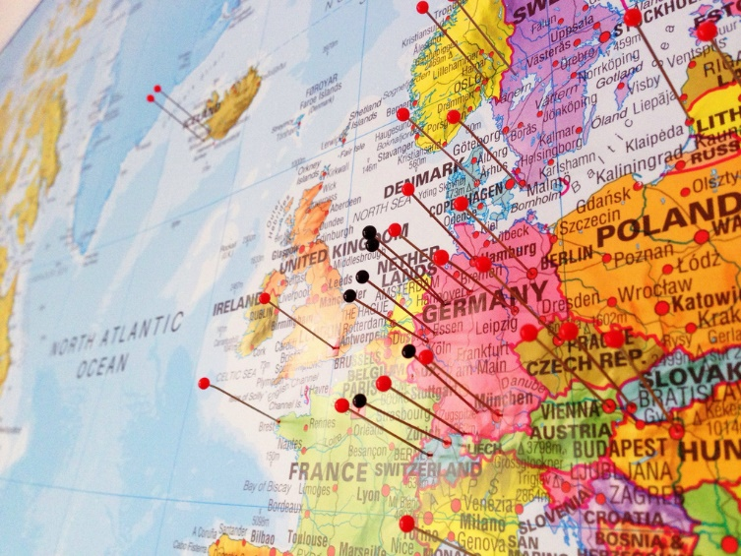
Your Homework
Talk to a parent, guardian, or relative to find out where your family originated from (which country did they live in before coming to Canada, or if First Nations, which area of Canada?
We will be doing an activity related to this tomorrow, so you will need to have ONE or TWO places written down, that you will then pinpoint on a map.

