Slide 1
Music & Lyrics

Slide 2
“I was tempted to eat the rotten flesh of my comrade.”

Slide 3
RAPS ABOUT
EX-CHILD SOLDIER
HELLISH LIFE
By Jill Dougherty

Slide 5
Emmanuel Jal
https://www.youtube.com/watch?v=nF_dHdNOgSA

Slide 6
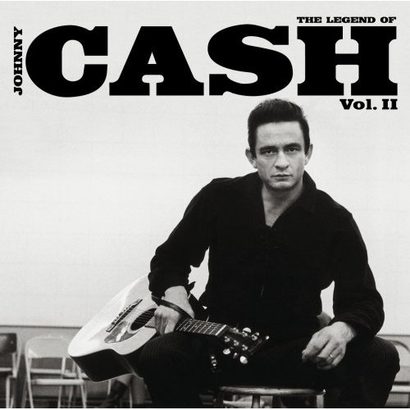
Folsom Prison Blues
Write
(individual- on back of your lyrics sheet)
What do you think is the theme or message of this song?

Slide 7
Folsom Prison Blues
Write
(individual- on back of your lyrics sheet)
Pick and write down 5 lines that make reference to crime

