Slide 1
War Criminals & Crimes Against Humanity
The aftermath & The wartime conferences

Slide 2
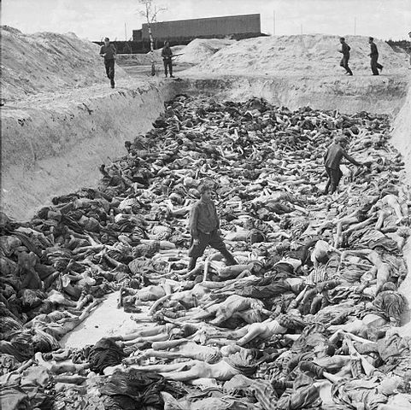
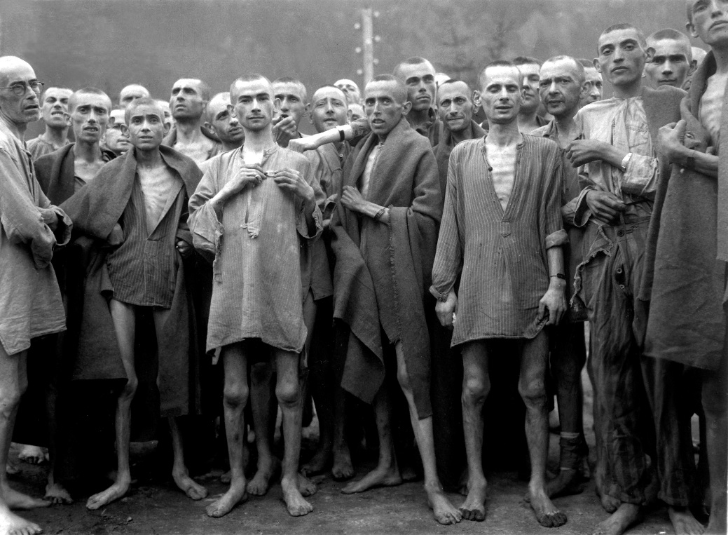
The Aftermath
The atrocities committed by the Nazis were on a scale never before seen
As war was winding down, deaths camps were discovered one after another, and the true scope of Nazi crimes was becoming clear
Allies decided that the perpetrators of these atrocities would be punished

Slide 3
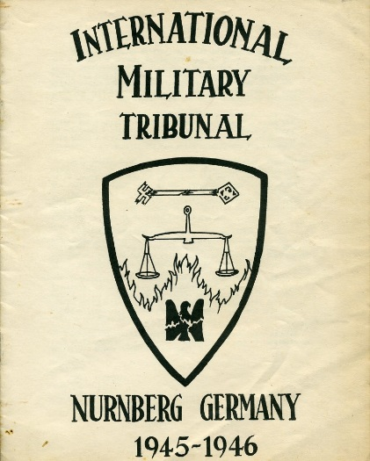
War Crimes Court
LOCATED AT NUREMBERG: “NUREMBERG TRIALS”
Never before had leaders legally charged other leaders for their immoral actions during a war.

Slide 4
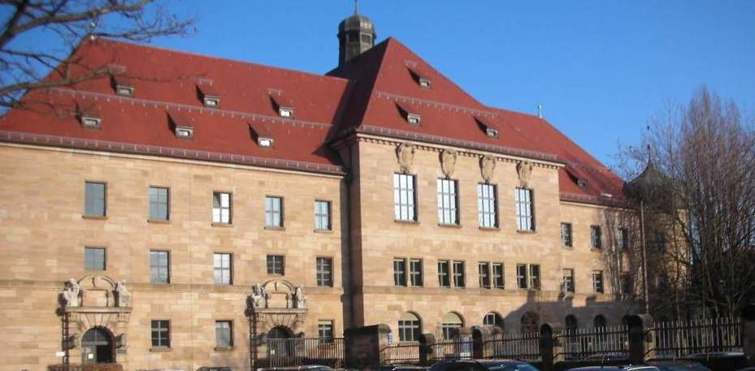
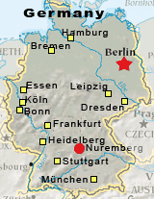

Slide 5
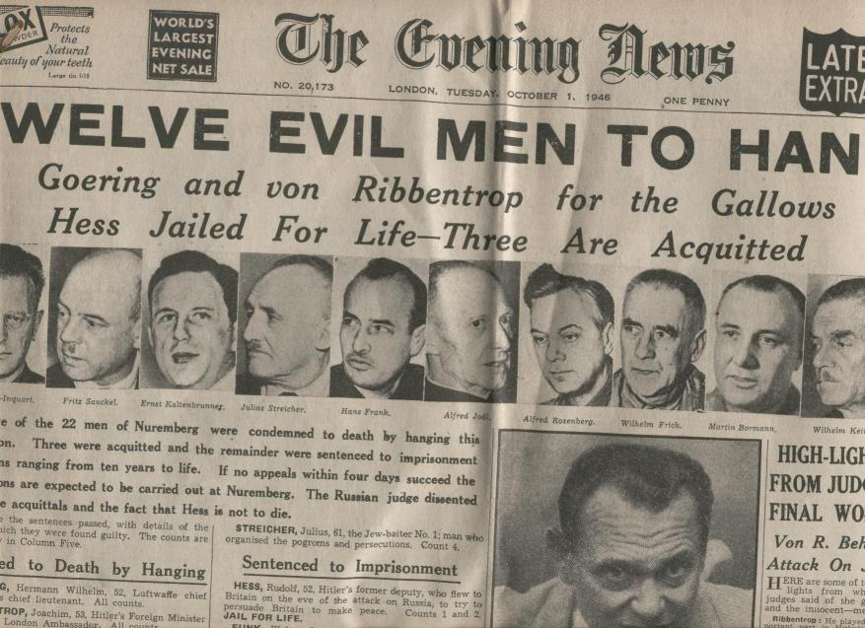
War Crimes Court
“NUREMBERG TRIALS”
177 Nazis were indicted for crimes committed during the Holocaust.
Several of the guilty were hanged, many were given long prison sentences

Slide 6
Nuremberg Trials
Some of the defendants at Nuremberg claimed that they were merely following orders and that they should not be individually held accountable. Do you agree? Why or why not?
What would you have done under the circumstances? Explain why.
Milgram Experiment: https://www.youtube.com/watch?v=xOYLCy5PVgM

Slide 7
War Crimes Court
LEGACY of the Nuremberg trials
Had impact on development if international criminal law
Eventually led to creation of International Criminal Court (ICC)

