Slide 1
Photo Analysis Project

Slide 2
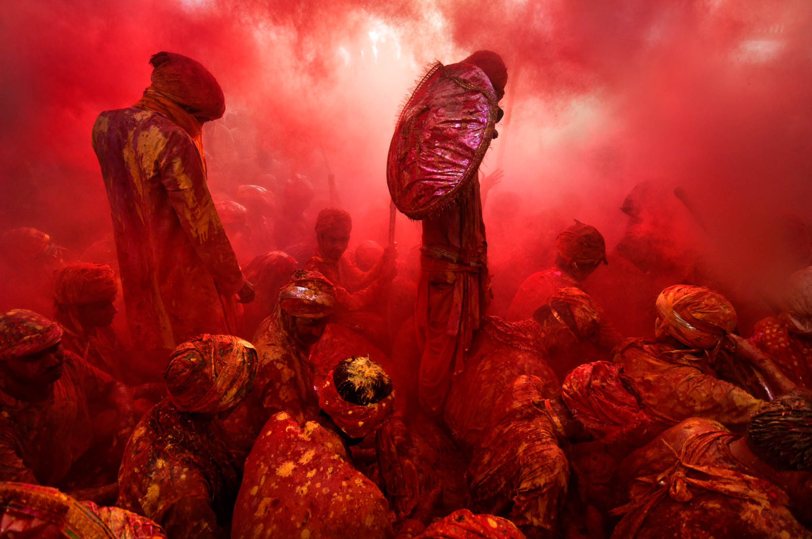
(http://proof.nationalgeographic.com/2016/02/02/photo-of-the-day-best-of-january-3/ )

Slide 3
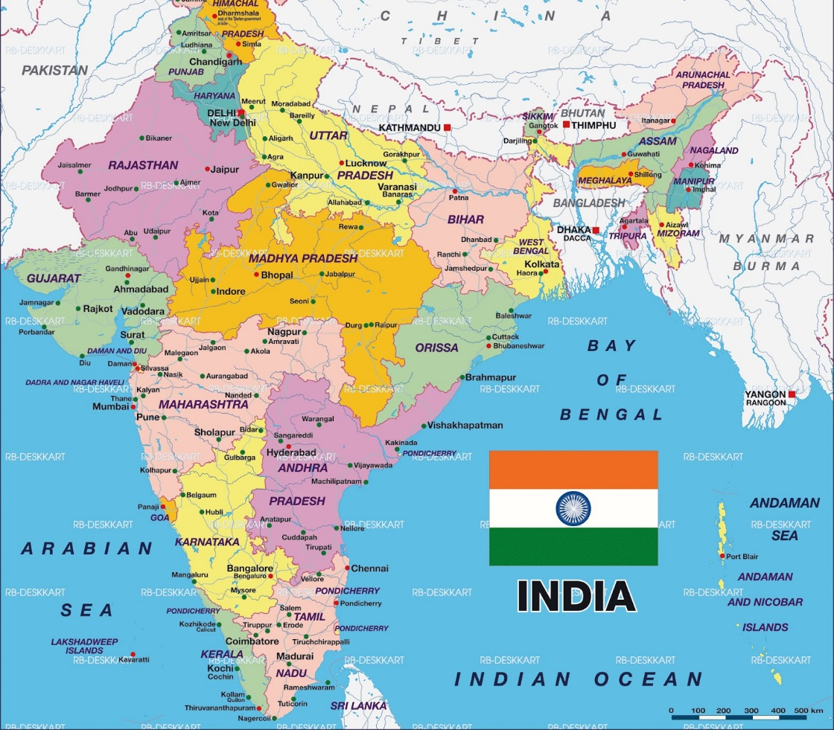
WHERE?
In the country of:
India
(exact location not specified)

Slide 4
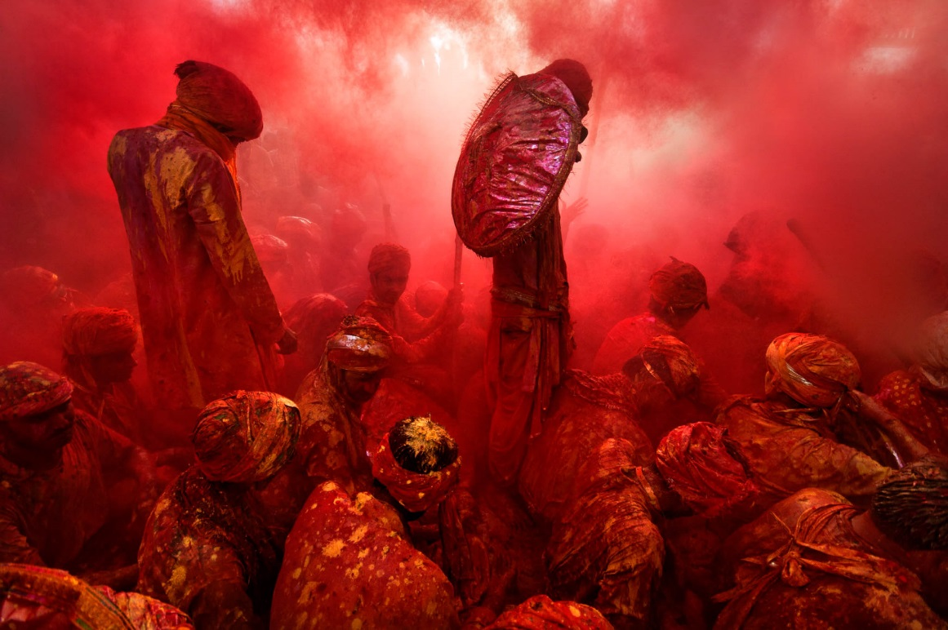
“Cheery Red”
WHO?
Photographer: Tarun Chhabra
Started a 15-year self-initiated photo project trying to capture Indian culture.
This photo features Holi celebrants in India.

Slide 5
WHAT/WHY?
Holi is the Hindu festival of love in which participants splash each other with bright colors that represent “energy, life, and joy.”
Chhabra writes of the experience, “I was kneeling down in the middle of a group of people who were singing bhajans (devotional songs). People were throwing lots of water and colors, and I was fully drenched … My eyes were filled with water-and-color paste, and this was very irritating and painful. With great difficulty I tried to slightly open my eye … and found the beautiful moment unfolding just in front of me. People … were singing devotional songs, and red color was flying like clouds. This amazing moment [gave] me inner strength, and I dared to open my eye slightly more to compose the picture.”

Slide 6
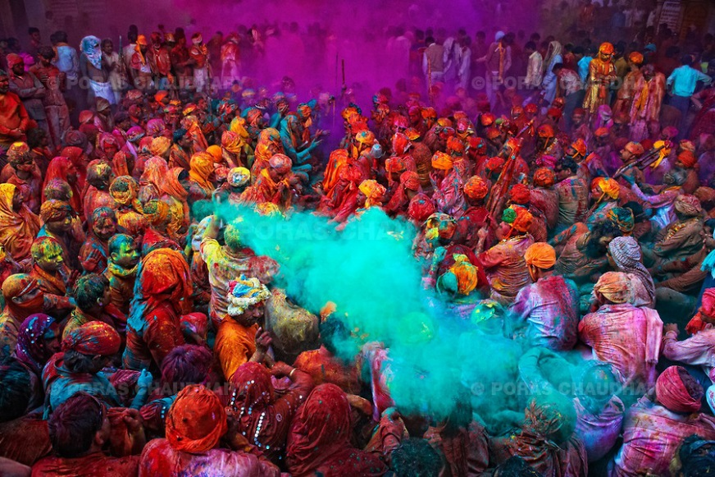
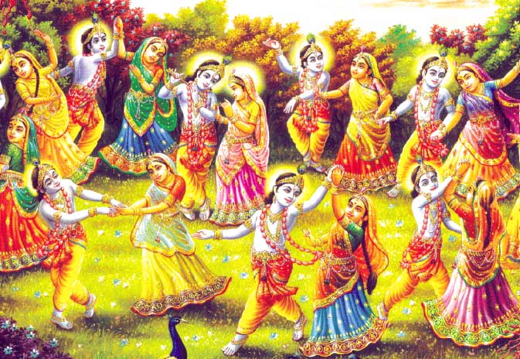
Connections to Geography
Human Geography: Cultural Geography
This photo captures a cultural festival of the Hindu people in India.
It is a festival unique to this culture and region of the world.

Slide 8
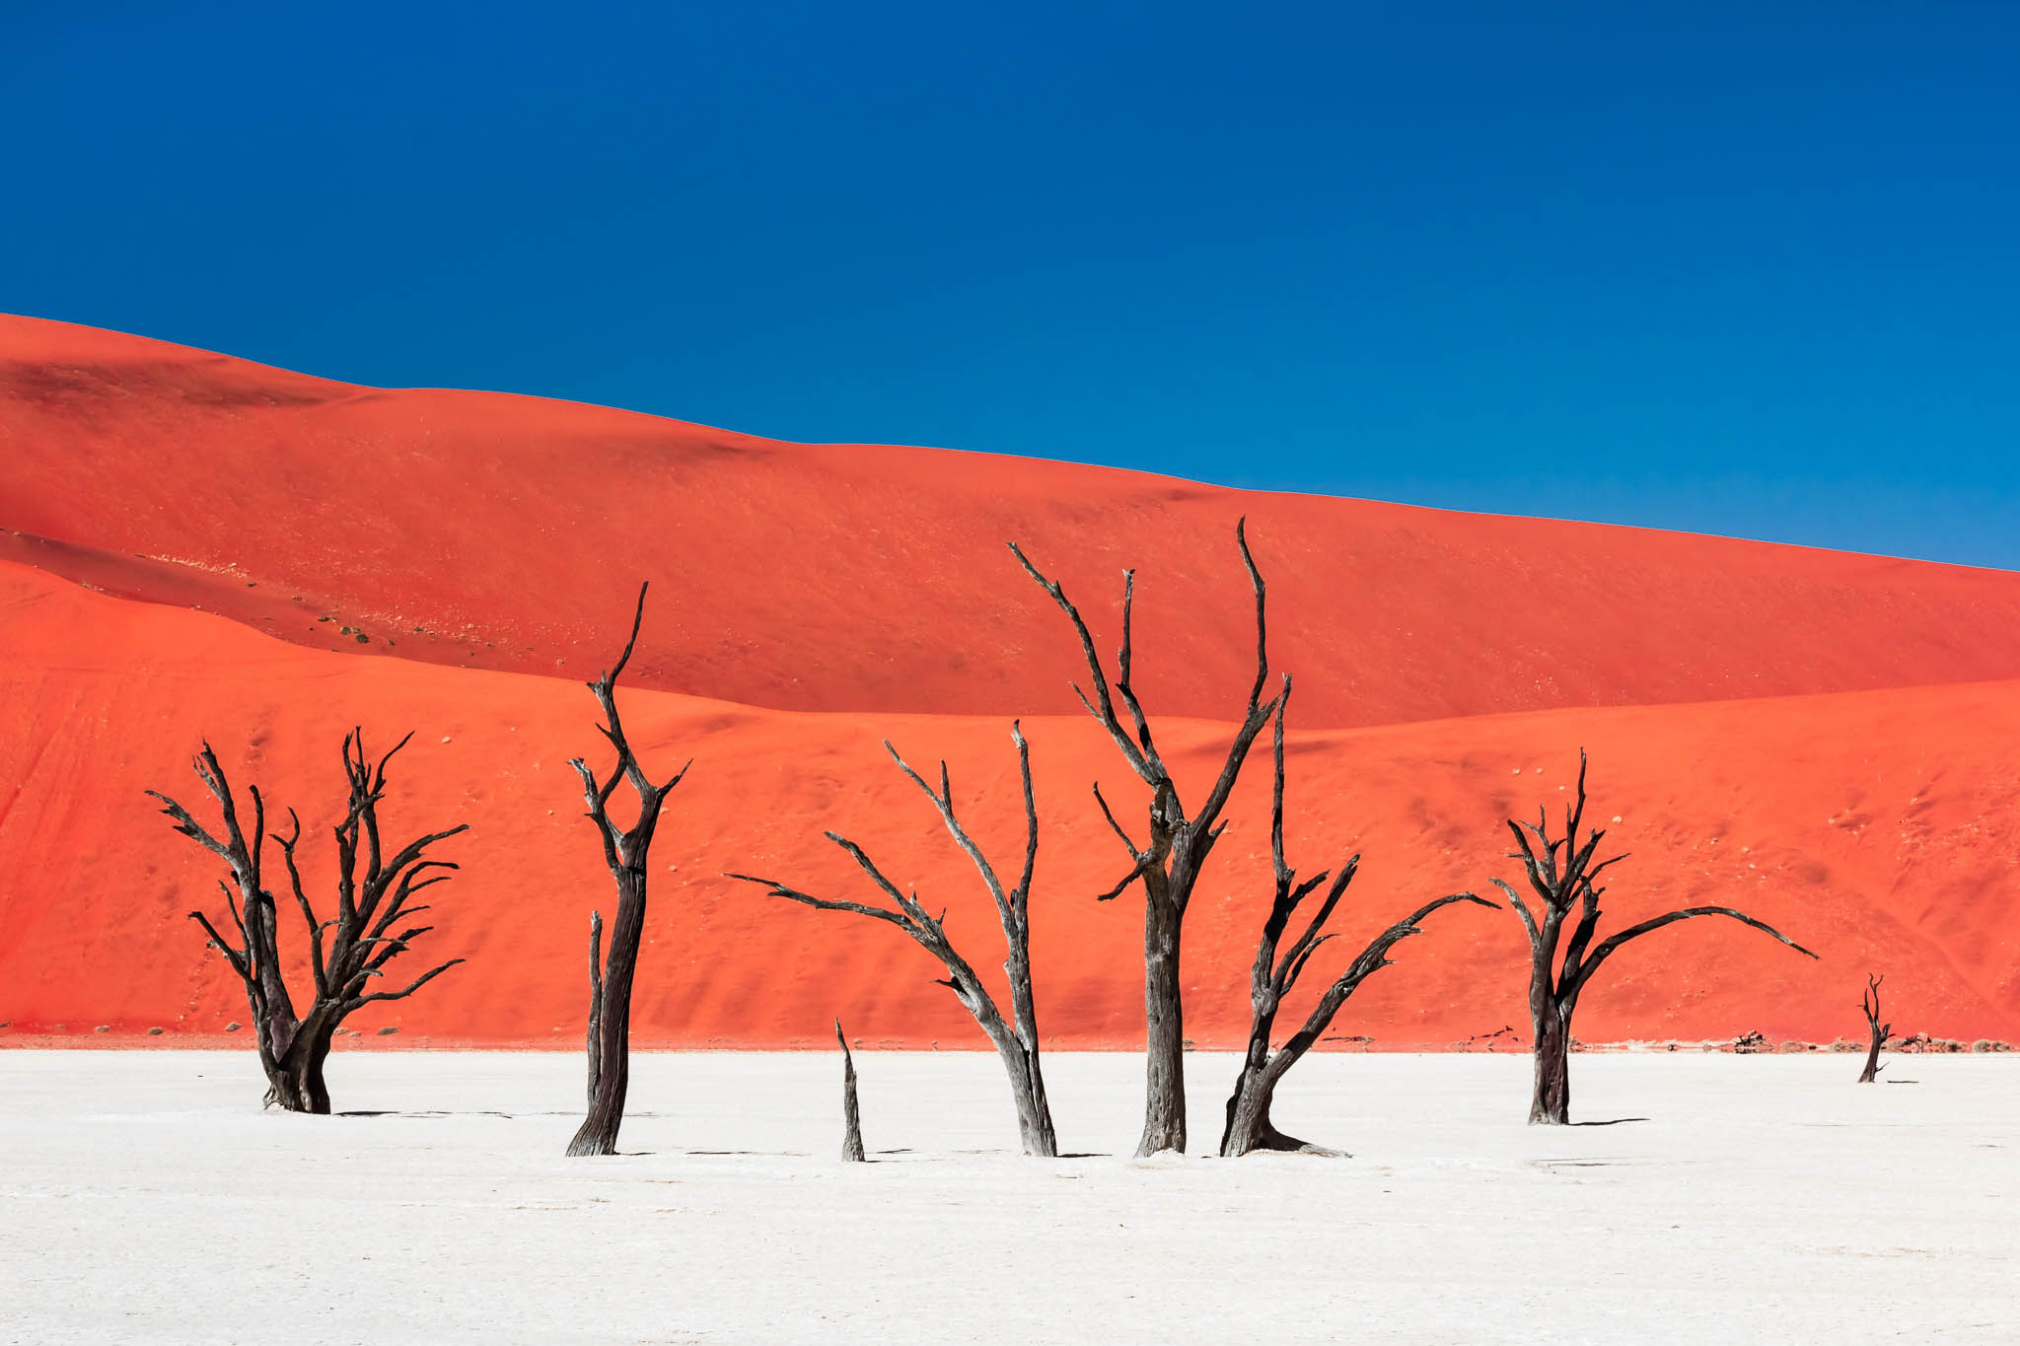
“Island of Silence and Heat” Photograph by Carsten Kruger

Slide 9
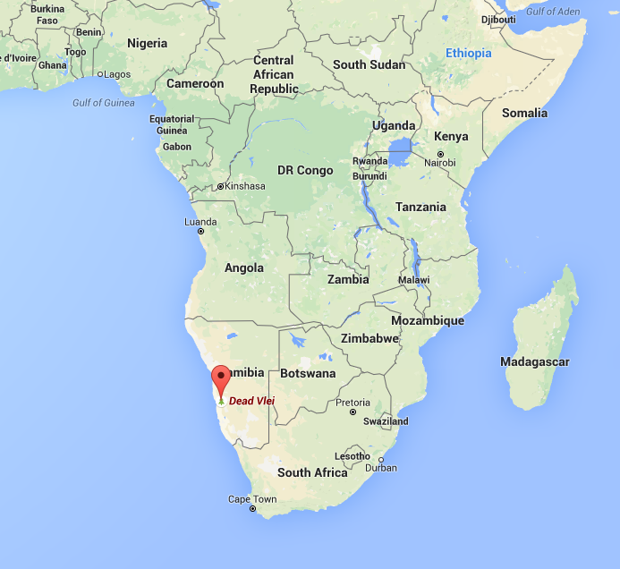
WHERE?
Coordinates: 24.7°S, 15.3°E
Country: Namibia
Region: Central Namib Desert
Area known as “Dead Vlei” (Vlei is Afrikaans for a type of marsh) in Namib-Naukluft National Park

Slide 10
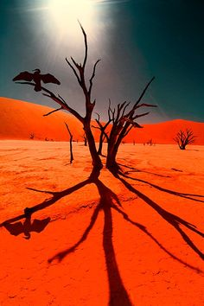
WHAT?
A wide salt-covered expanse.
Some dunes reach 1,312 feet high
It is cut off from a river, and has become too dry for the trees to even decompose. The trees scorched black in the sun, and are over 1000 years old.
http://www.atlasobscura.com/places/dead-vlei

Slide 11
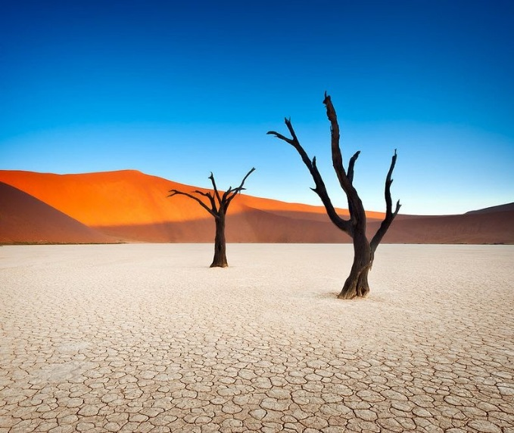
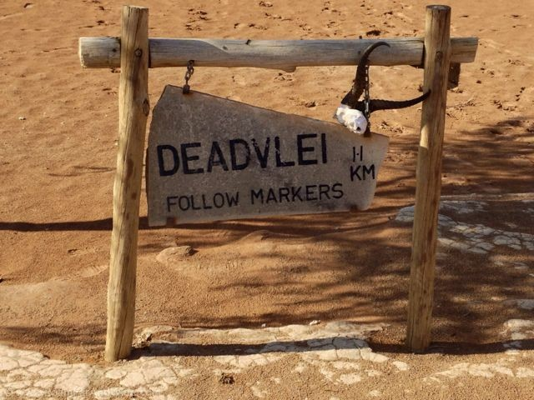
Connections to Geography
Physical Geography
Some of the highest sand dunes in the world
Climate changed, drought hit, and sand dunes blocked the river from the area. The trees died without water, and all that is remaining are their skeletons, which have been scorched by the sun. The wood does not petrify because it is so dry.

