Slide 1
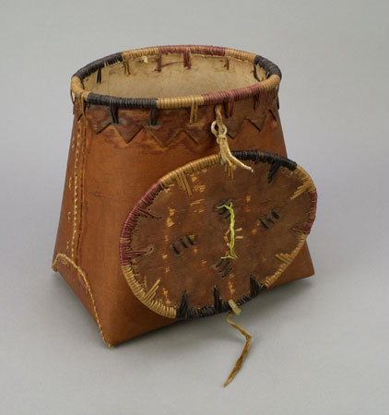
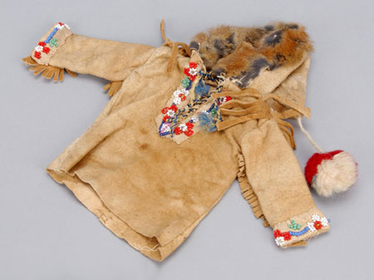
Canada’s First Peoples
Share: what is something that you want to learn about Canada’s First Peoples?

Slide 2
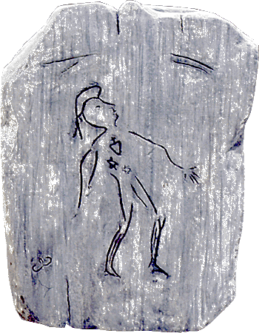
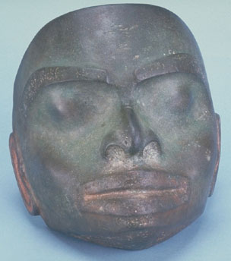
Canada’s First Peoples

Slide 3
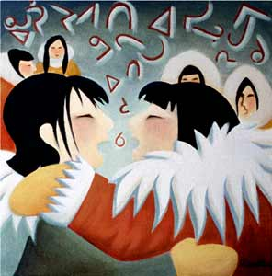
Inuit Throat Singing
https://www.youtube.com/watch?v=7uS_OadHCWM
https://www.youtube.com/watch?v=Phr1HVwrjlQ

Slide 4
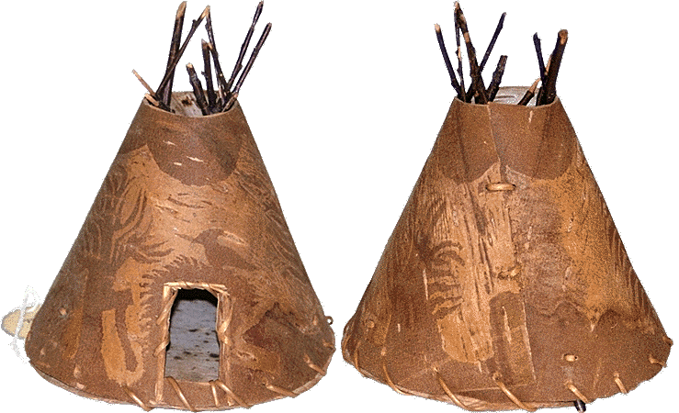
Learning Outcomes
Unit: I can describe the social, political, economic systems and structures of Indigenous groups in Canada.

Slide 5
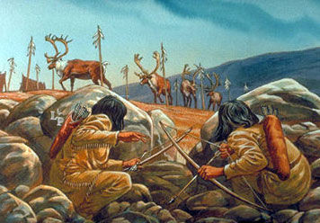
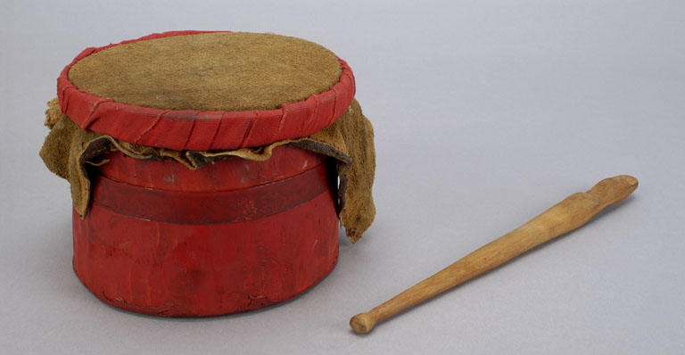
Questions for Today
How did the First Peoples of Canada get here?
How do we find out about their lives?
In general, what were their lives like?

Slide 6
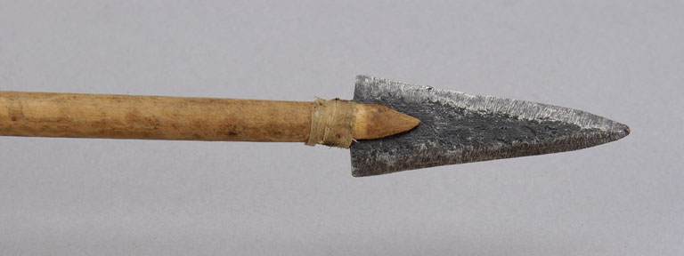
Canada’s First Peoples
“Aboriginal:” The original inhabitants
Indigenous, First Nations, First Peoples
These are collective terms
Many different cultural groups

Slide 7
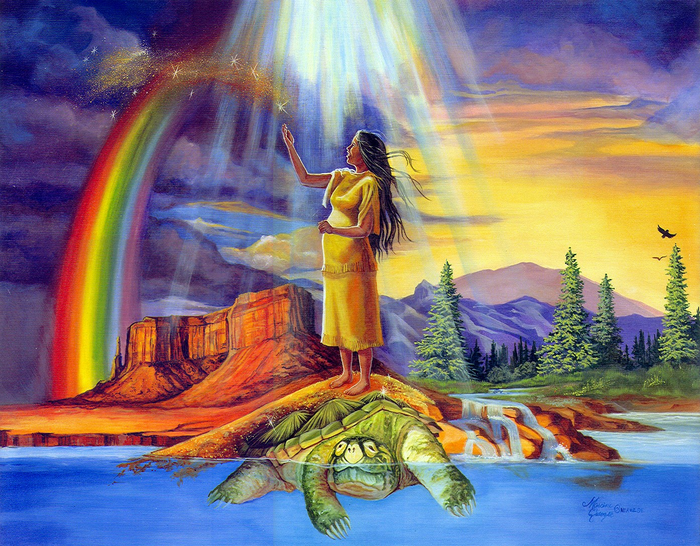
Canada’s First Peoples
How did they get here?
Earth Diver
Iroquois Creation Story
https://www.youtube.com/watch?v=jlOierP0iGg
Ojibway Creation Story: https://www.youtube.com/watch?v=cX4GJTtSigY

Slide 8
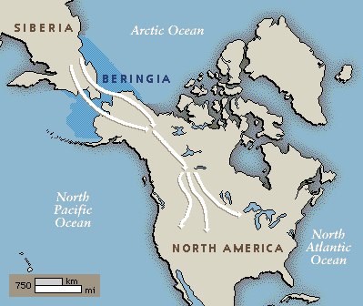
Canada’s First Peoples
How did they get here?
The Land Bridge
https://www.youtube.com/watch?v=mmbU7mQIc-c&list=PL49B3331A41AB1D40
https://www.youtube.com/watch?v=CroosReFVfk&list=PL49B3331A41AB1D40

Slide 9
Jigsaw Activity
Learning Outcomes: (Communication)
I can connect and engage with others by participating in discussions and group work
I can acquire and present information
I can share and present what I have learned
You will each be responsible for handing in this completed assignment at the end of class

Slide 10
Jigsaw Activity
Group 1: Oral Tradition & Stories
Group 2: Religion & Spirituality
Group 3: Trade & Economy
Group 4: Food & Subsistence
Group 5: Government

Slide 11
Part 1
Read through the information provided
2. Discuss the answers to your two questions
3. Decide on the answers and write them down in that section

Slide 12
Part 2
The “group 1” member will start, and will share their answers to the two questions. Other group members will listen respectfully and write the answers down (ask questions if the answers do not seem clear to you)
Continuing on, each group member will share their answers with the group
Now you should have a completed assignment! Yay teamwork! ;)

Slide 13
Share
What is something that you learned in class yesterday? (think back to the videos, the jigsaw activity…)

Slide 14
Review: Yesterday’s Activity
How did the First Peoples of Canada get here?
In general, what were their lives like?

Slide 15
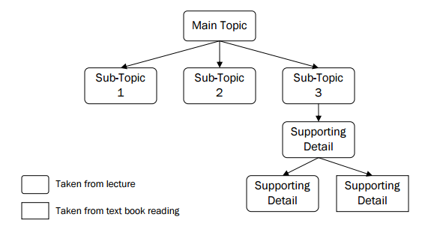
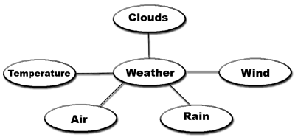
Mapping/web notes

Slide 16
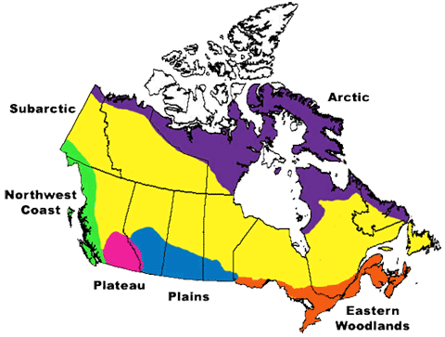
Divided in to geographical groups:
Each of these groups is comprised of many smaller groups, such as Carrier, Iroquois, Haida, Ojibway, etc

Slide 17
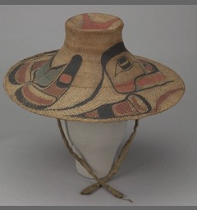
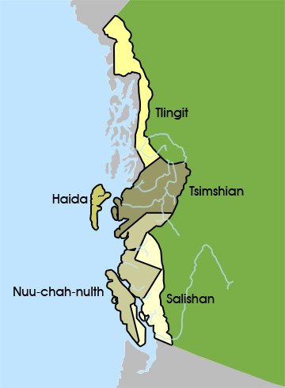
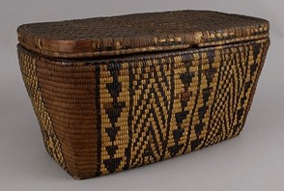
Northwest Coast
Salmon
Power & wealth
Red cedars
Canoes
Totem poles
Potlatch

Slide 18
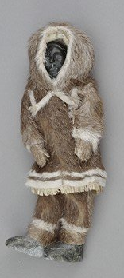
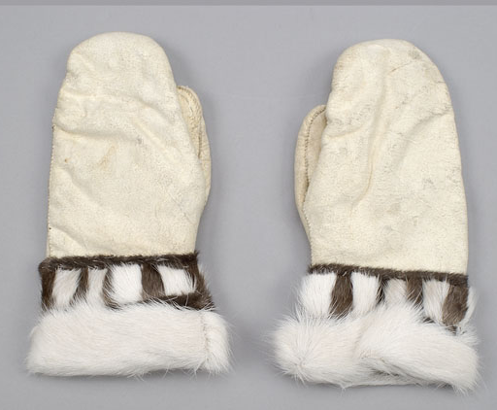
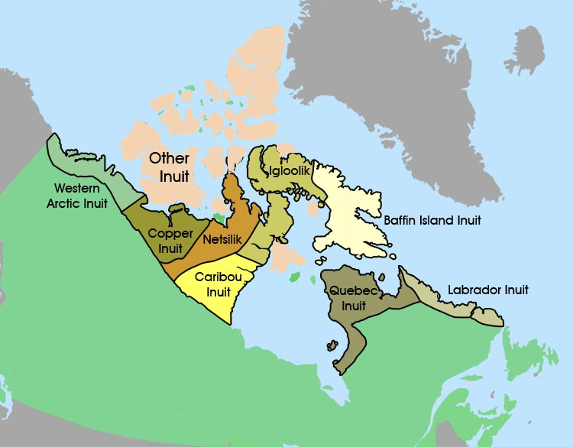
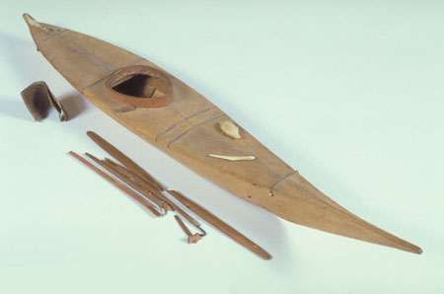
Inuit (Arctic)
Hunted seals, whales, caribou
Dog teams with snow sleds
Snow house villages
Shaman and medicine men

Slide 19
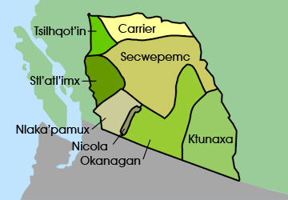
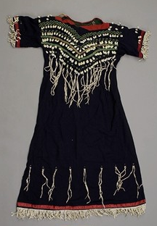
Plateau
Seasonal villages
Hunting
Berries
Canoes
Salmon

Slide 20
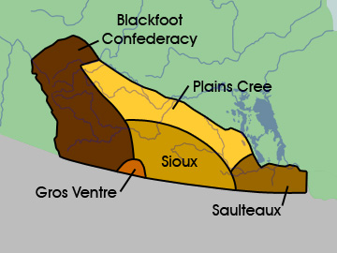
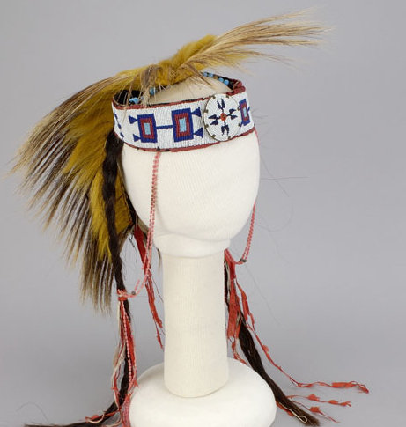
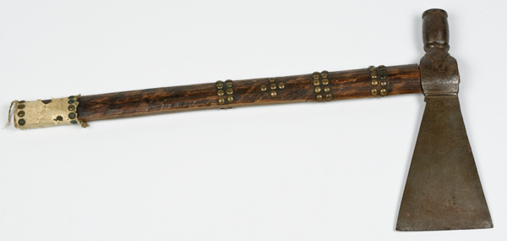
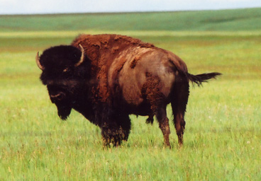
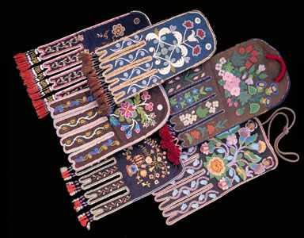
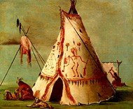
Plains
Buffalo
Tipis
Nomadic
Tomahawks

Slide 21
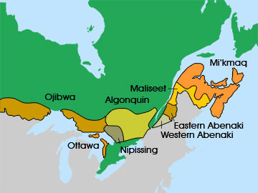
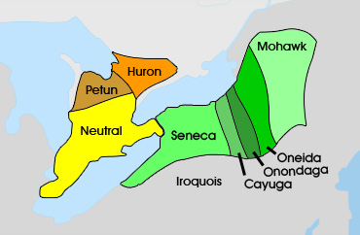
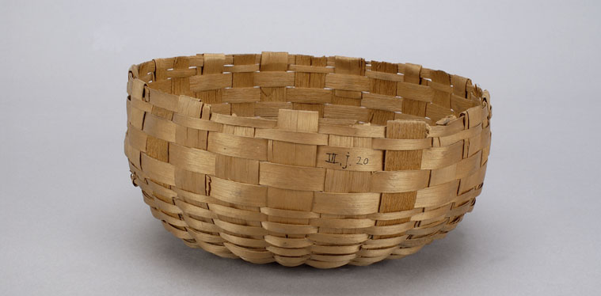
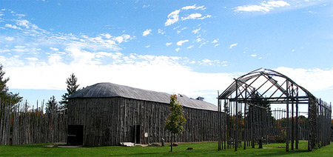
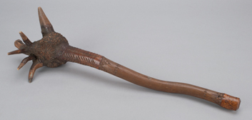
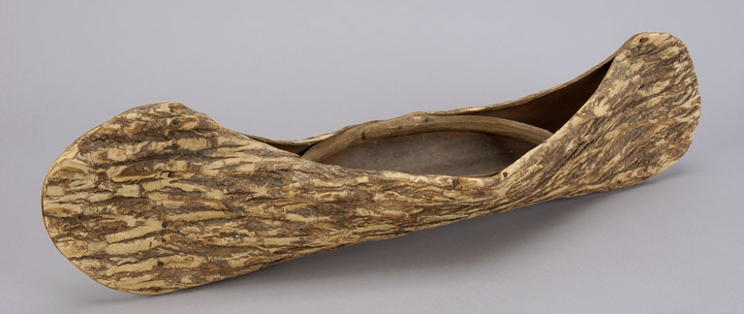
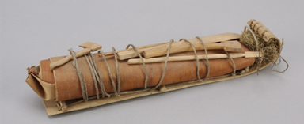
Woodlands
Cultivated beans, squash, maize
Lives governed by seasons
Towns, longhouses

Slide 22
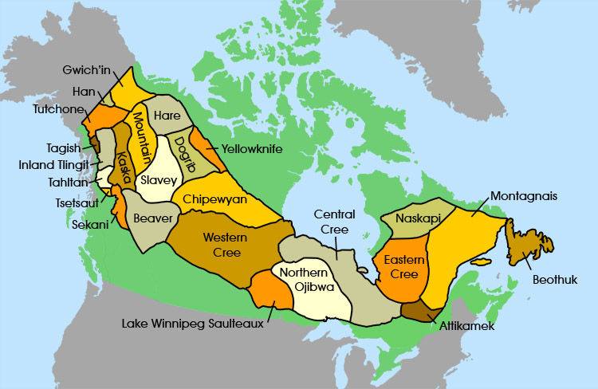
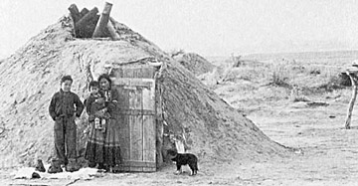
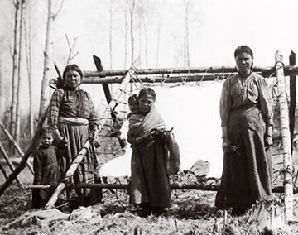
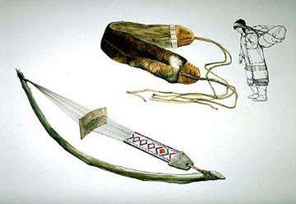
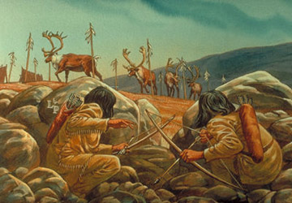
Subarctic
Lean-to/pit house
Hunted caribou & many other animals
Fishing
Berries

Slide 23
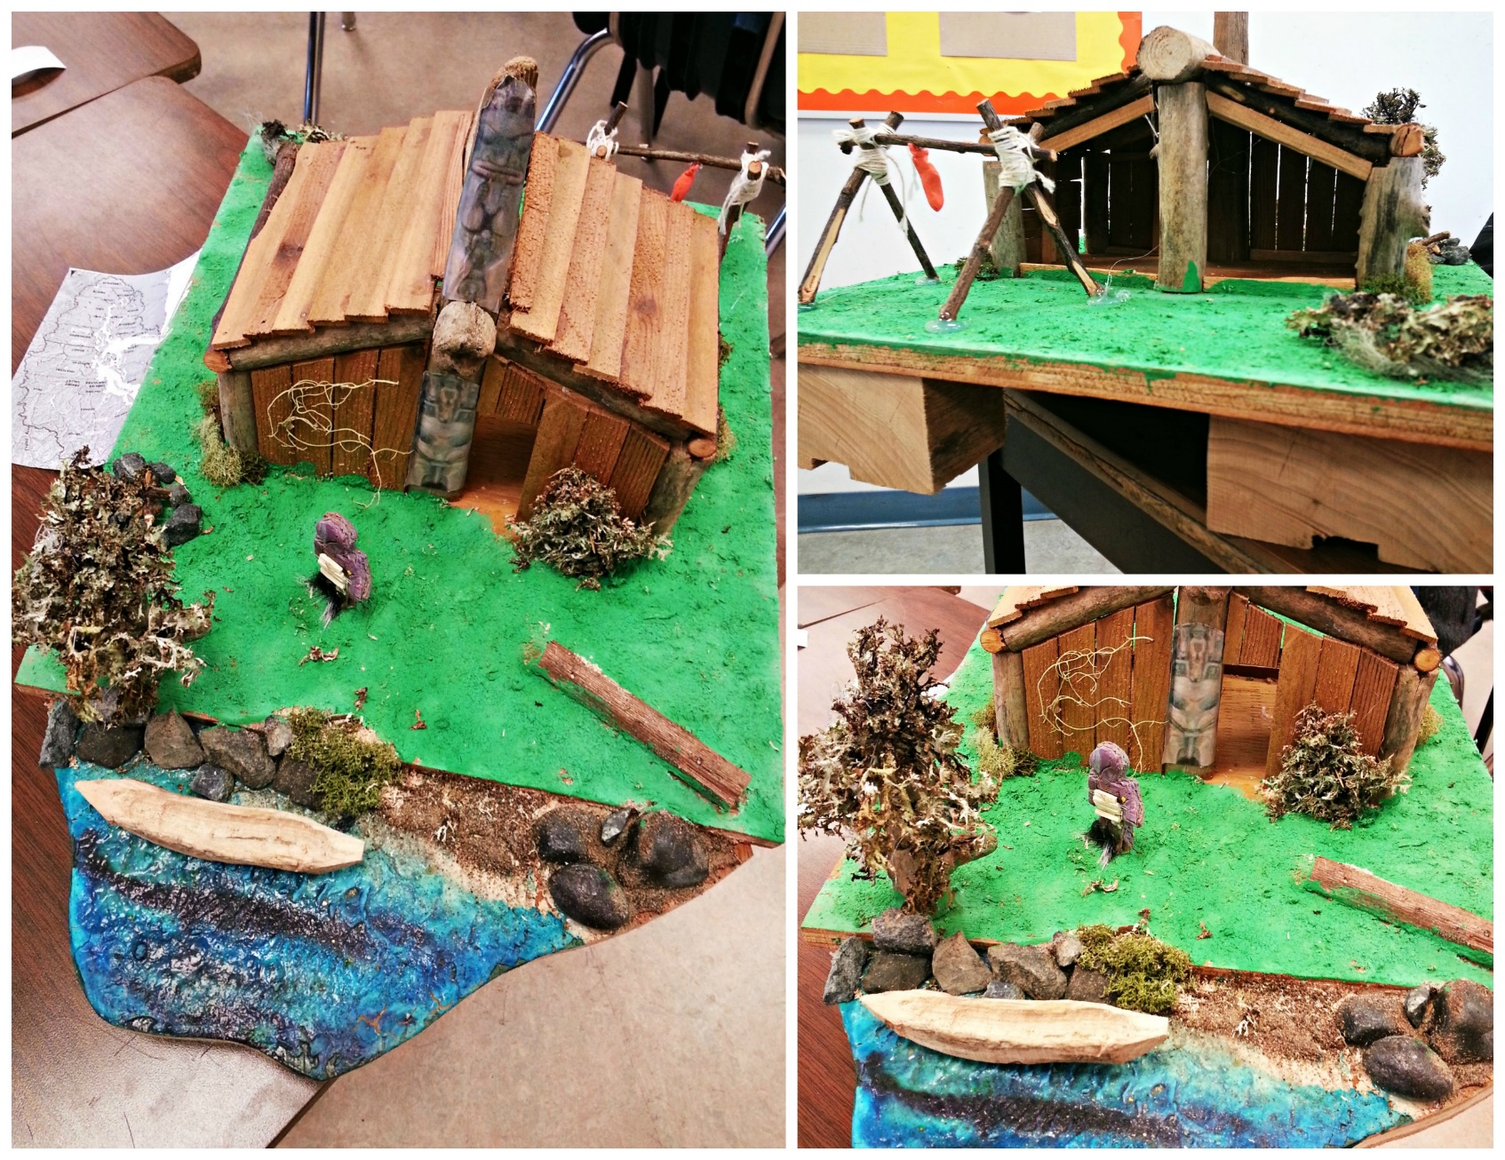
Diorama Project

Slide 24
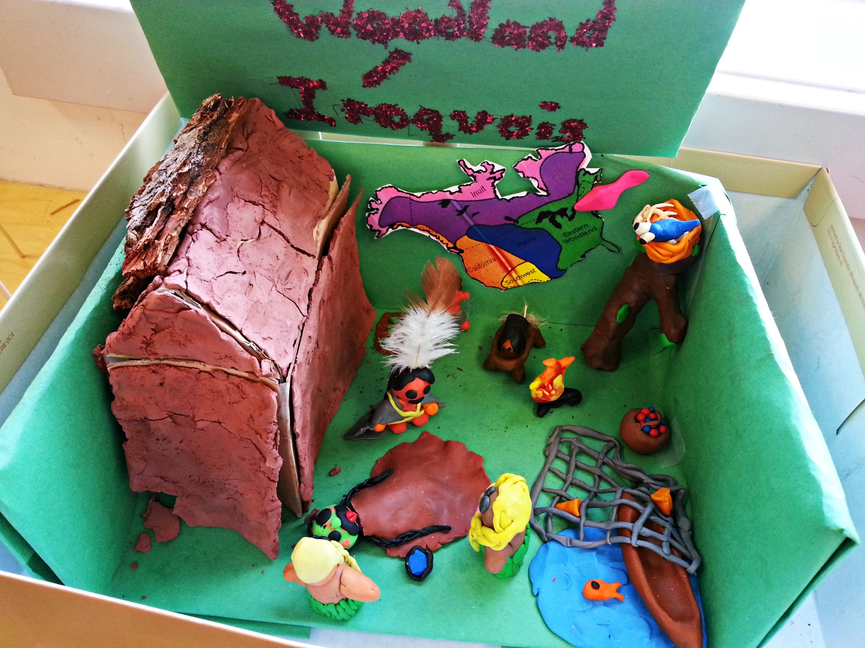

Slide 25
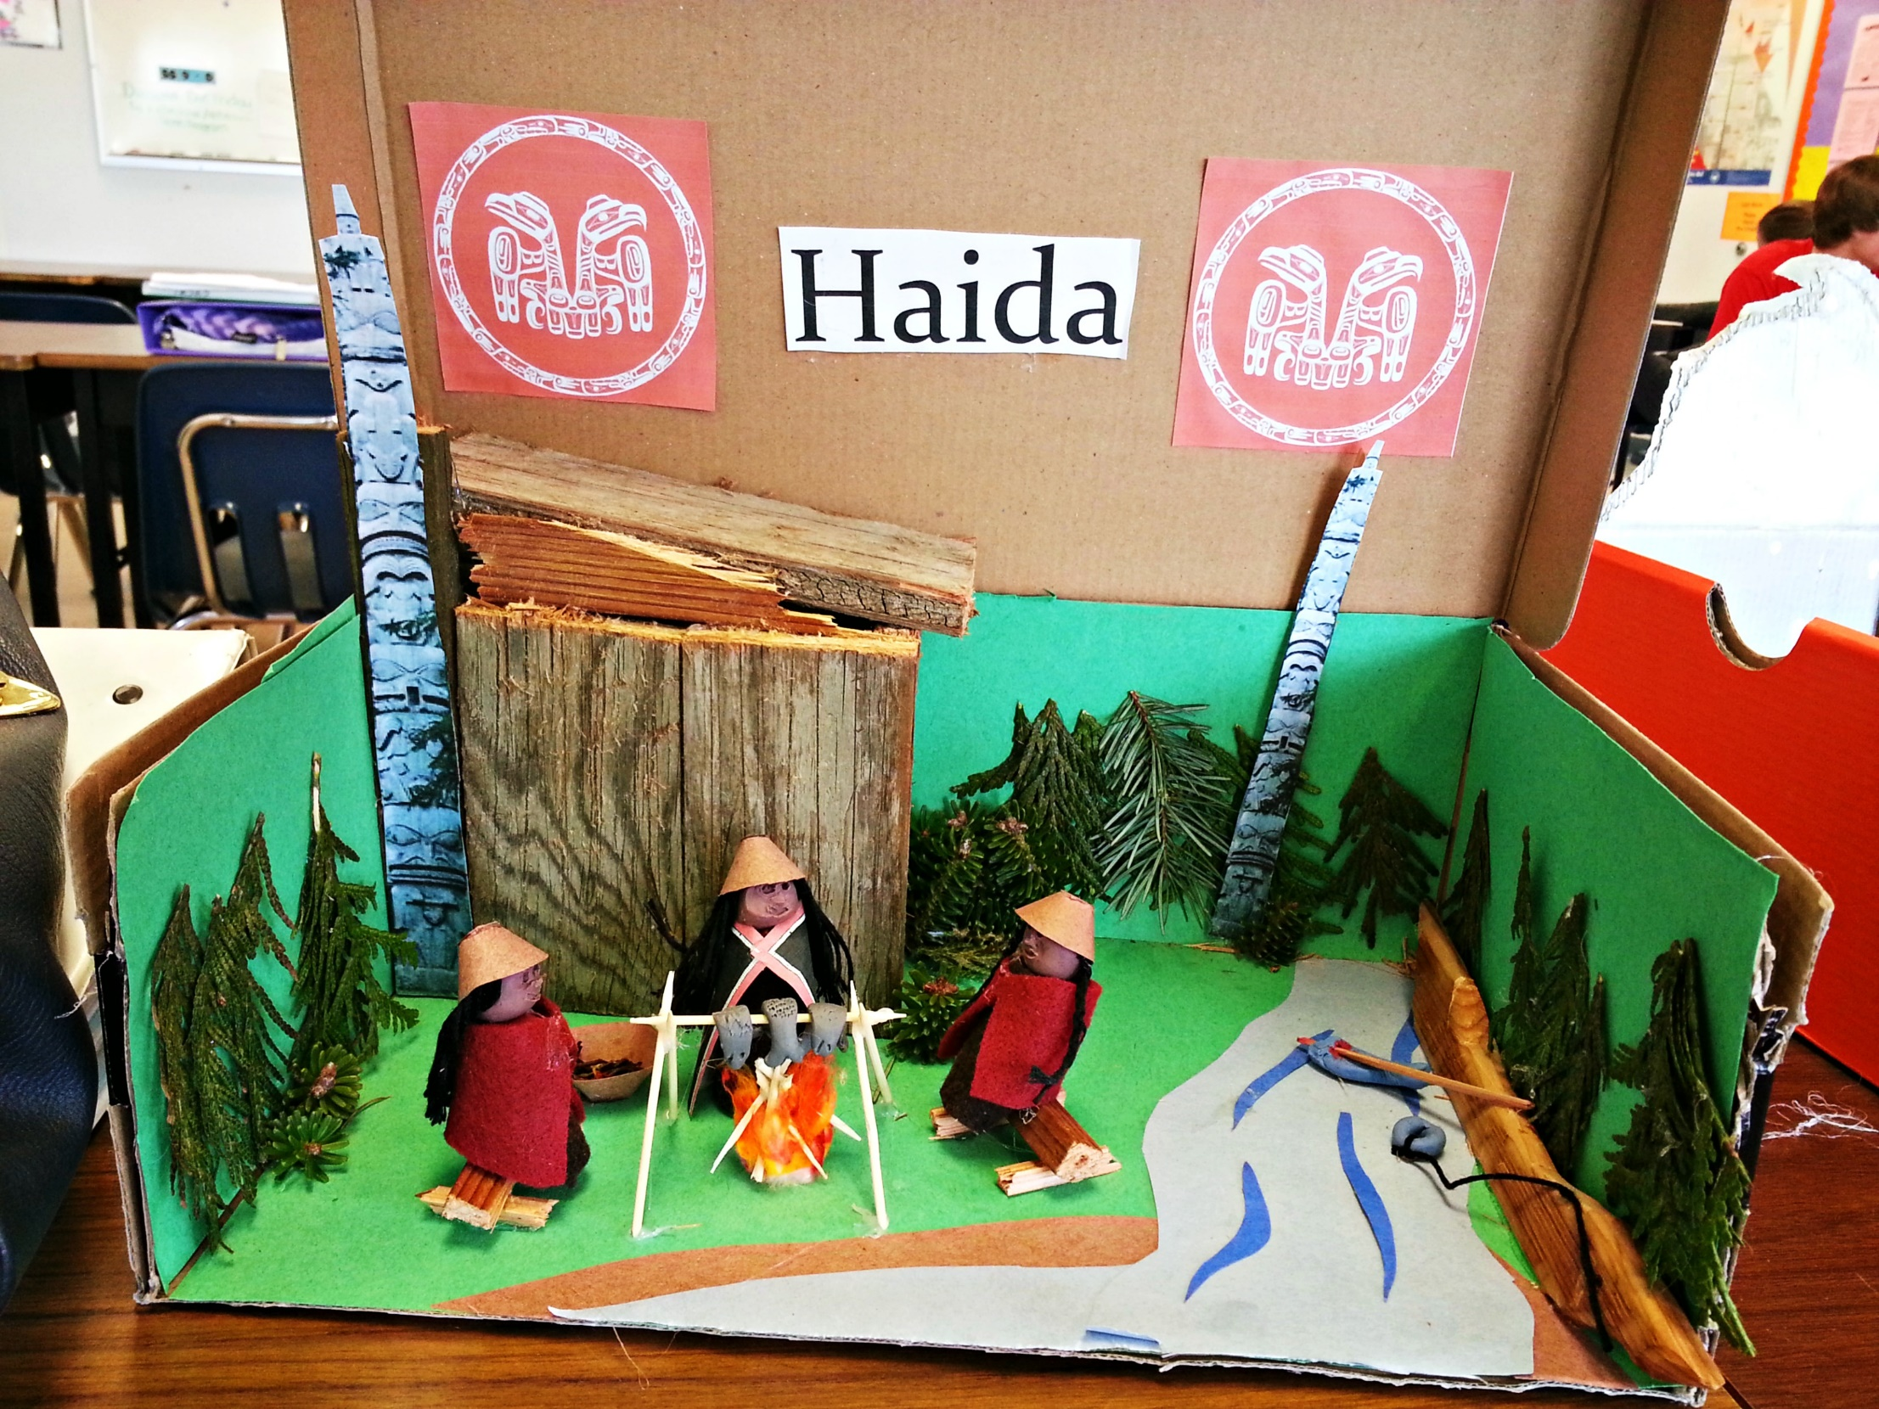
Diorama Project

Slide 26
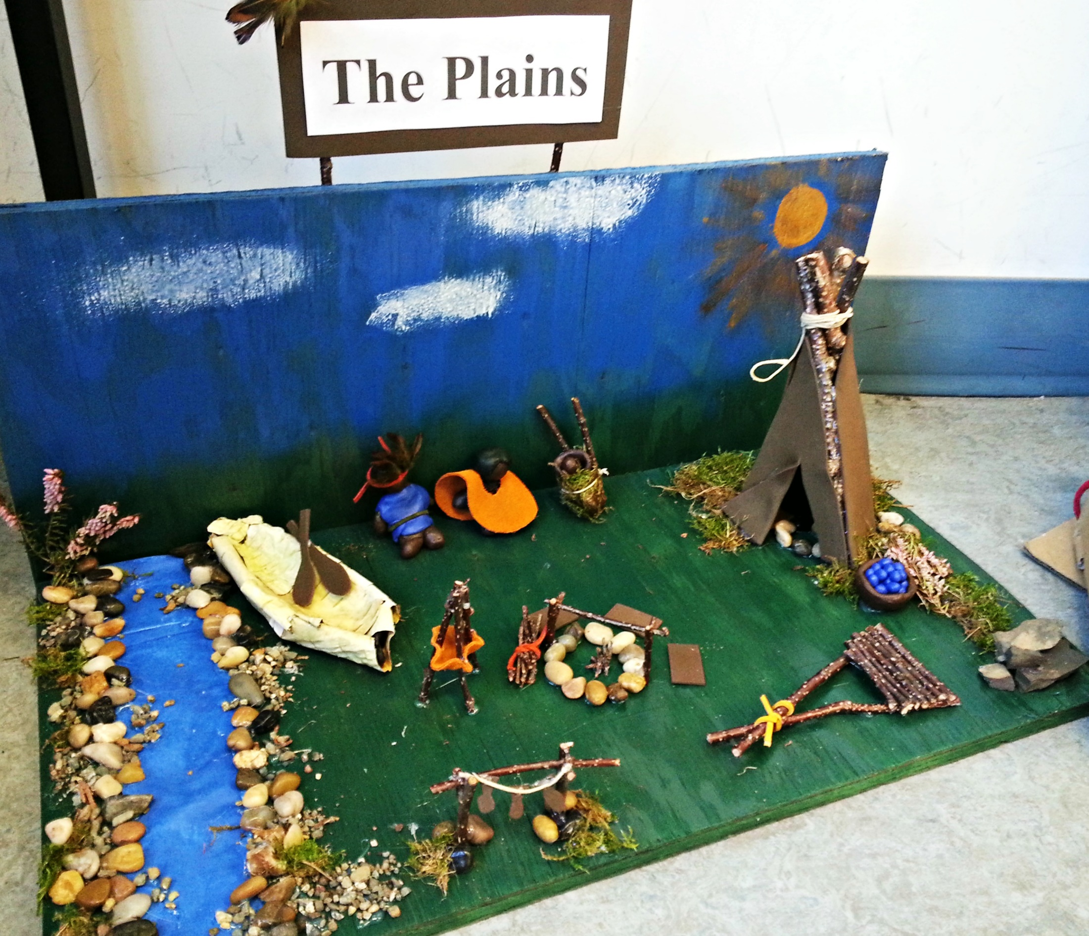
Diorama Project

