Slide 1
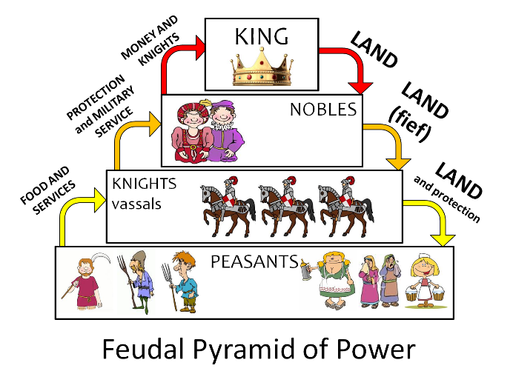
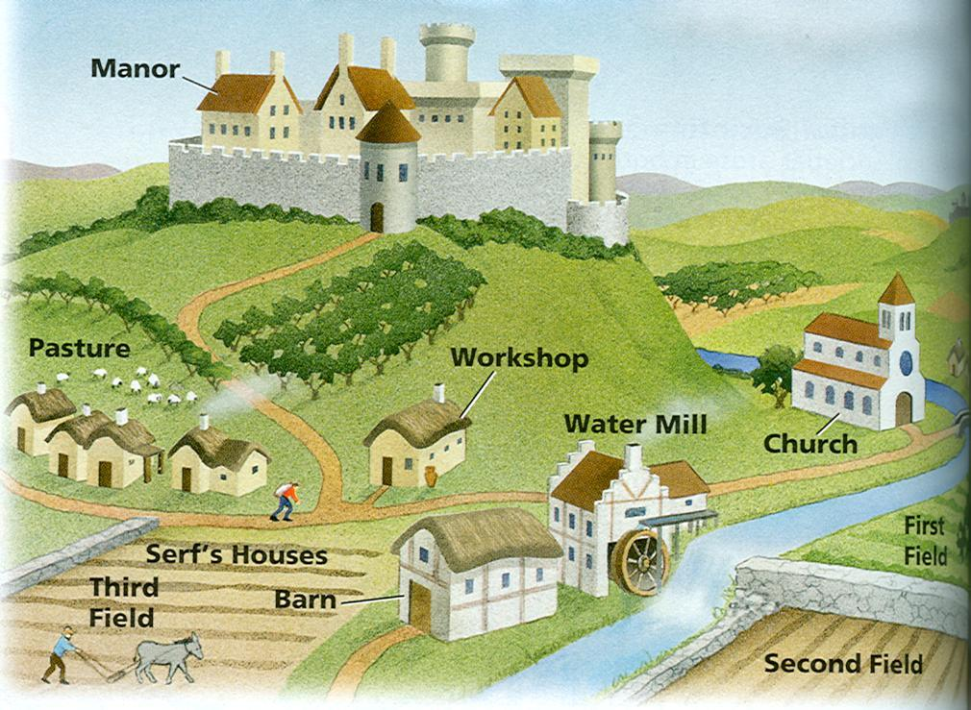
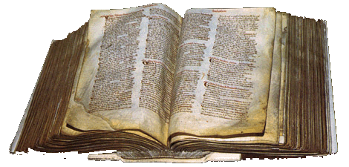
Outline for Today:
Review Feudal System
The Domesday Book
Manors

Slide 2
Why was the Battle of Hastings significant?
It marked the end of Anglo-Saxon England (because the Normans took over). It also brought Norman feudalism, a new social and political system, to Britain.
Why did William introduce the feudal system in Britain?
He was familiar with it, and decided it would work well in England because it gave him control over the people (they had to swear loyalty to him).
What was the feudal contract?
The agreement between nobles/vassals and king, which required them to swear an oath of allegiance, to maintain their part of the bargain (protection, land, loyalty, etc.)

Slide 3
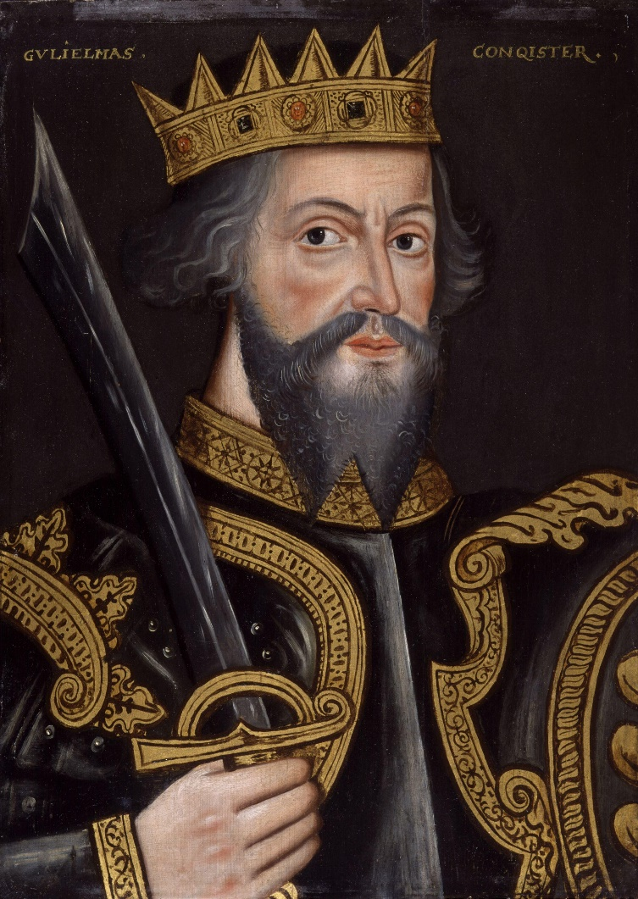
What sorts of problems did William face once he was crowned king of England?
I CANNOT TRUST THE SAXON LORDS TO CONTROL THE COUNTRY FOR ME.
I NEED TO COLLECT TAXES BUT I DON’T KNOW WHO OWNS WHAT.
IF I DON’T STOP THE REBELS IN THE NORTH THEY WILL SUPPORT A VIKING REBELLION.

Slide 4
I CANNOT TRUST THE SAXON LORDS TO CONTROL THE COUNTRY FOR ME.
TOOK THEIR LAND, GAVE IT TO NORMANS. INTRODUCED NEW SOCIAL SYSTEM=
FEUDAL SYSTEM
I NEED TO COLLECT TAXES BUT I DON’T KNOW WHO OWNS WHAT.
DOMESDAY BOOK= SURVEY OF POPULATION, LAND, LIVESTOCK, ETC.

Slide 5
Video
Horrible Histories Domesday Book (S1E5 5:00)

Slide 6
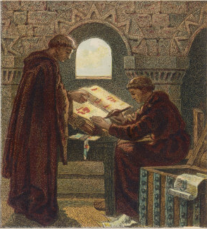
The Domesday Book
In 1085 William 1st ordered a survey to discover the resources and taxable values of all the boroughs and manors in England.
He wanted to discover:
Who owned what
How much it was worth
How much was owed to him as King in tax, rents, and military service.

Slide 7
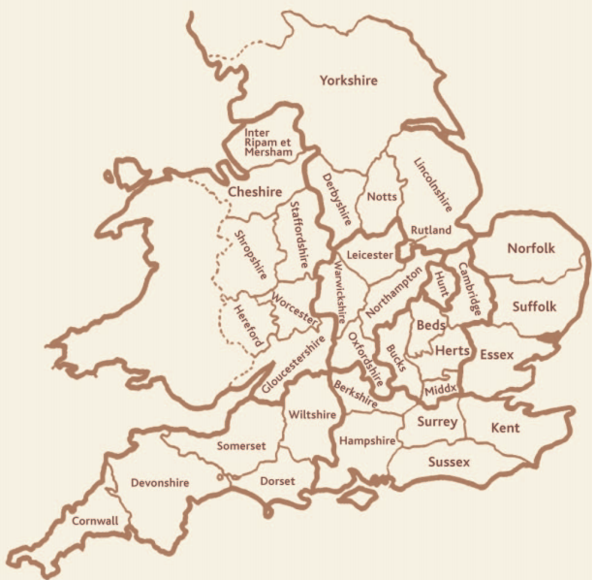
The Domesday Book
All the information was written down in two big books, which still exist today at the National Archives
The officials took over a year to visit 13,000 villages. Soldiers threatened to kill people if they did not tell the truth.
The book showed about 200 Normans controlled all the land of England
It valued England at £37,000!
It was the first survey of England and was written in Latin

Slide 8
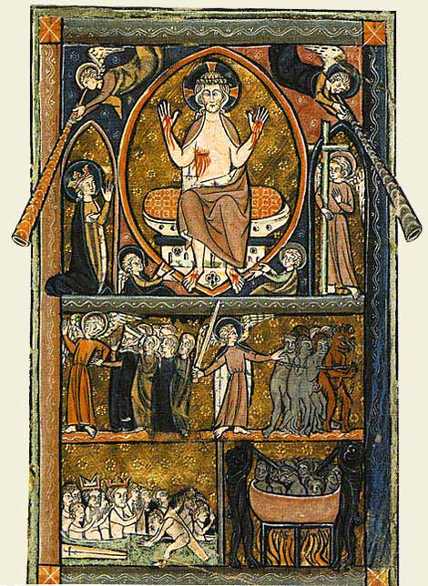
Why was it called Domesday?
Historians believe it was named after the biblical day of ‘Doomsday’
This was the Judgment day when Christ returned to judge the living and the dead
There was to be no appeal against the decisions made, and this was the same for the Doomsday Book

Slide 9
Task
Read the excerpt from the Domesday Book, and answer the questions about it.

Slide 10
Self-Sufficiency
Being able to supply one’s own needs (to survive)
Need to be able to grow/produce all basic items needed for food, clothing, and shelter
What would you need? How would you produce/get it?

Slide 11
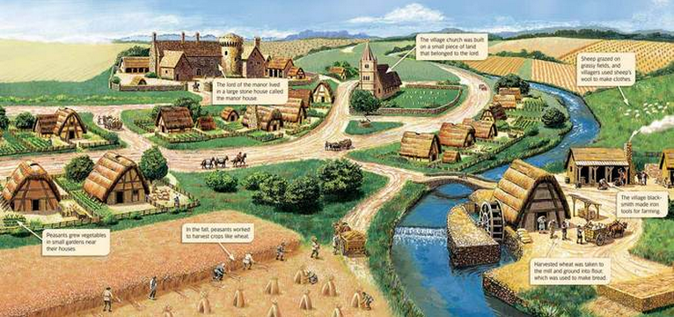
Life on a Medieval Manor
https://www.youtube.com/watch?v=NASCj4YcHDQ

Slide 13
