Slide 1
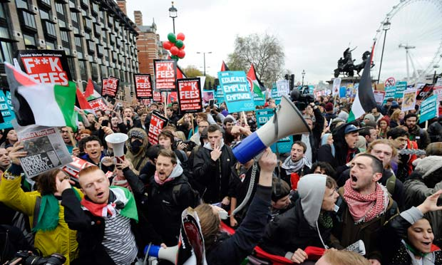
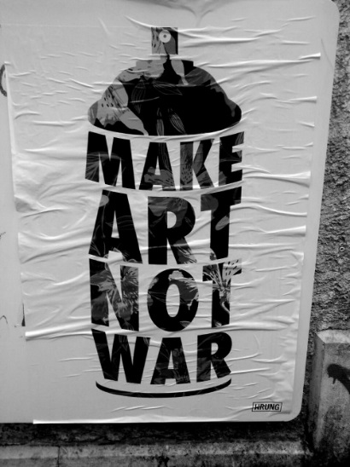
Protest: If you don’t like something… what can you do to change it?
Unit: Revolutions & Democracy

Slide 2
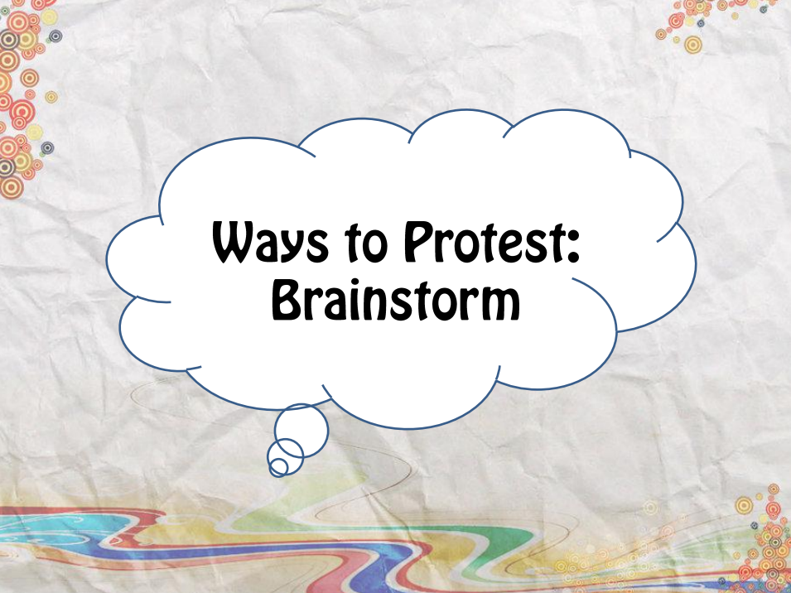

Slide 3
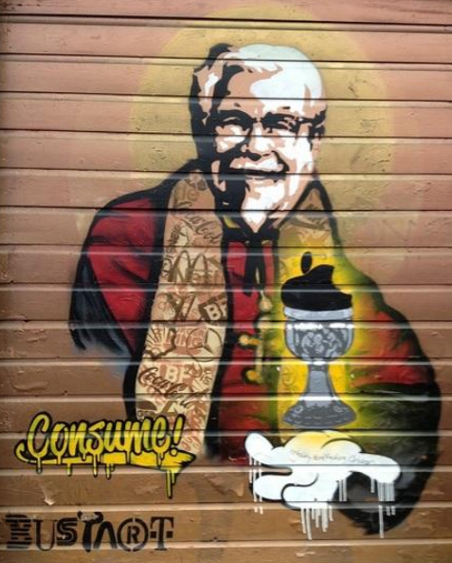
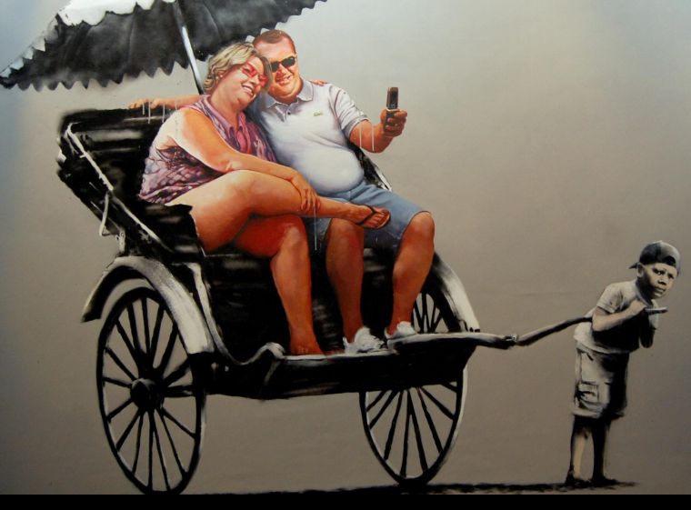
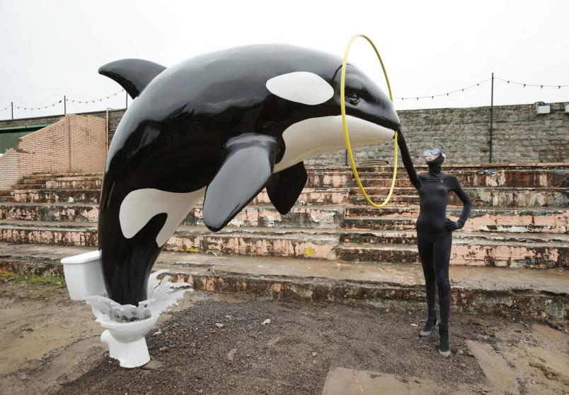
Protest: Social Issue Protest Art
Unit: Revolutions & Democracy
Protest Art Slideshow

Slide 5
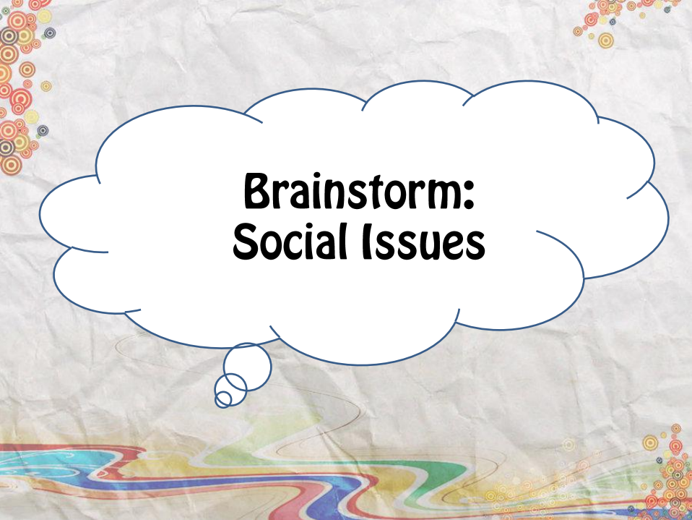

Slide 6
What is a social issue that you care about?
(Complete #1 on your handout)

Slide 7
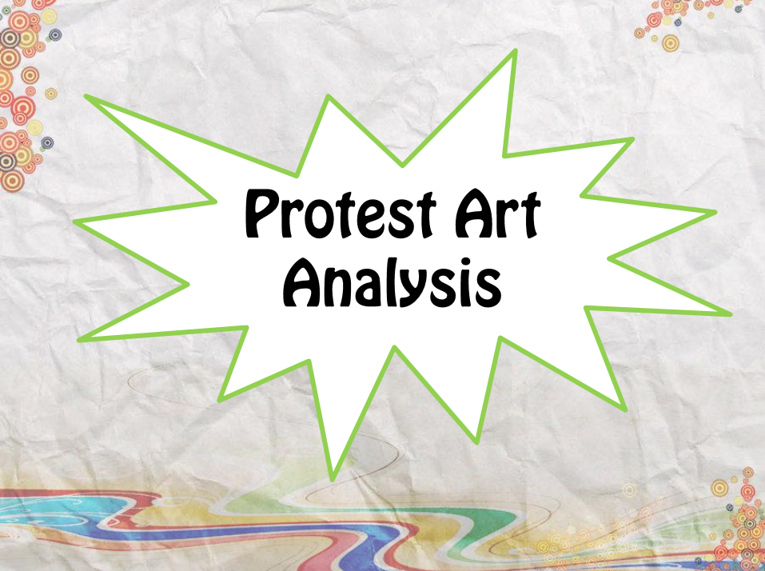
Examples

Slide 8
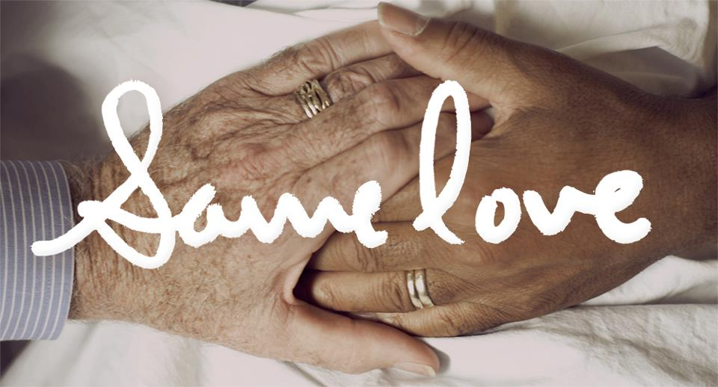
Same Love: Macklemore

Slide 9
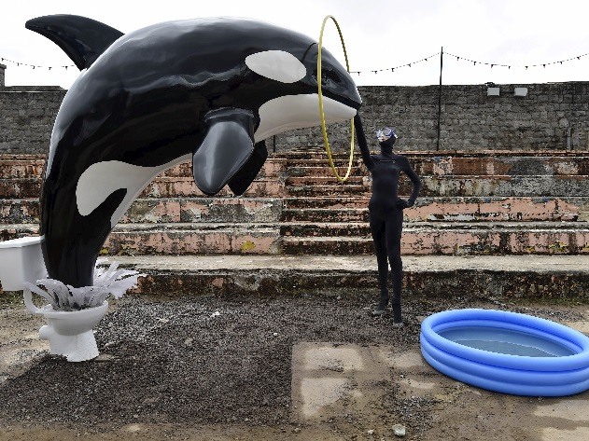
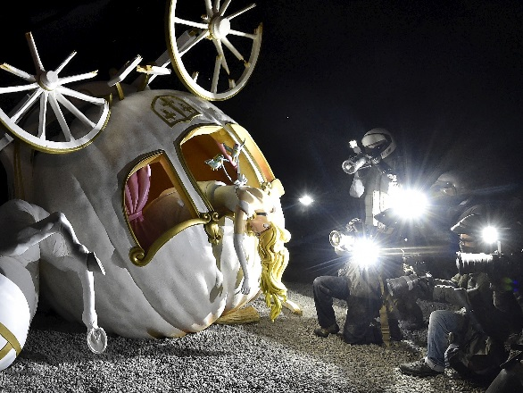
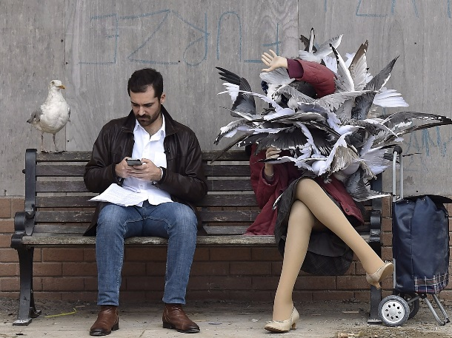
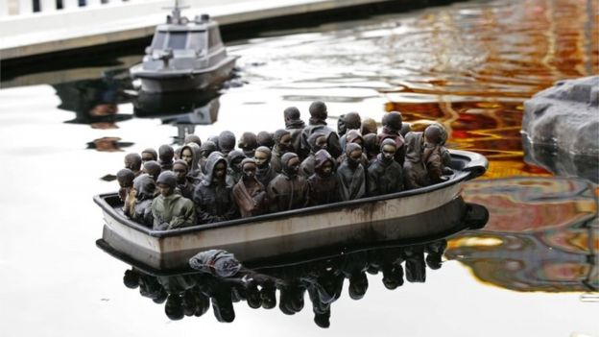
Banksy’s Dismaland
A look inside..

Slide 10
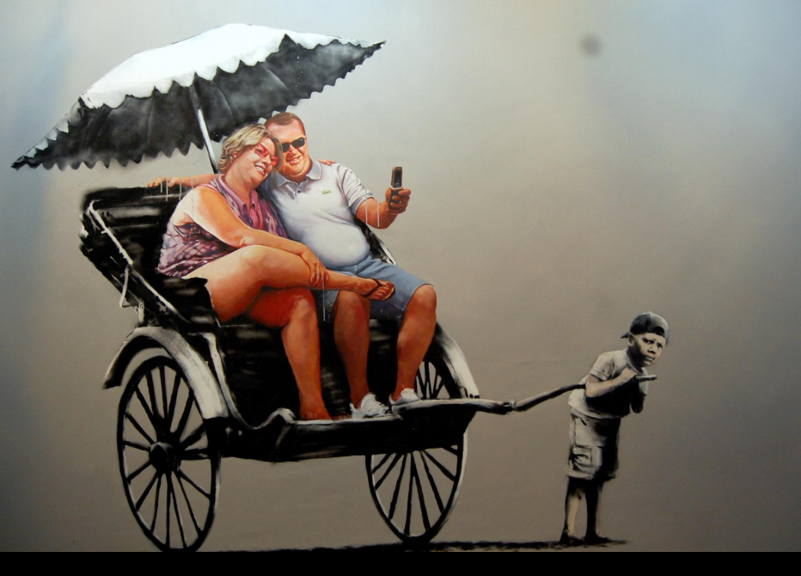

Slide 11
Spoken Word Poetry
On Behalf of the Silenced (Human Trafficking) https://www.youtube.com/watch?v=WFSzsZYOYZE

Slide 13
