Slide 1
Goal: to practice effective group discussion and problem solving

Slide 2
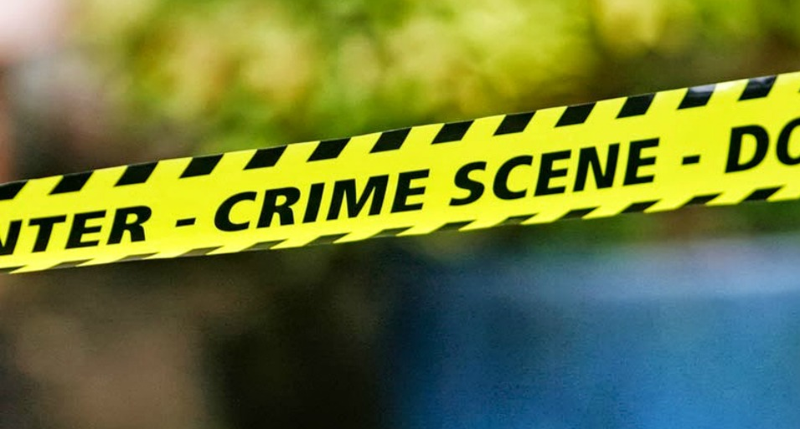
Your Task
The First National Bank of Minnetonka Minnesota was robbed of $1,000,000
(1 million dollars). Your job is to discover which person(s) did it.

Slide 3
Process
Each member of your group has some clues that will help to solve this mystery.
In your group, you will need to share the clues ORALLY (say it out loud)
(you MAY NOT allow anyone else to read your clue!!)

Slide 4
The Ellingtons collaborated to rob the bank. Miss Ellington supplied the front door key (borrowed from Mr. Greenbags) and Howard supplied the dynamite. Greenbags had already left for Brazil when the robbery took place. Mr. Smith was in Dogwalk on the night of the robbery. Dirsey Flowers was at the home of Anastasia’s parents. The Ellingtons were lying when they tried to implicate Smith. There was no evidence that Arthur Nodough was connected with the robbery any way.

Slide 5
Debrief Discussion
How did you work together to solve the problem?
What were your group dynamics like?
How did you decide what was relevant vs. what was irrelevant information?

Slide 6
WELCOME TO
Social Studies 10!

Slide 7
What are we going to study?

Slide 8
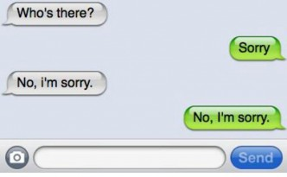
Collective Canadian Identity

Slide 9
Media Studies & Current Events

Slide 10
Social Responsibility (how we can make a positive difference in our school/community)

Slide 11
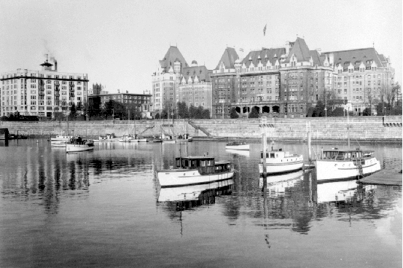
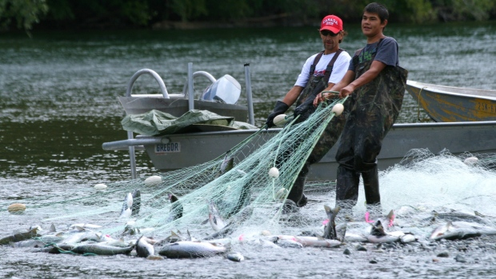
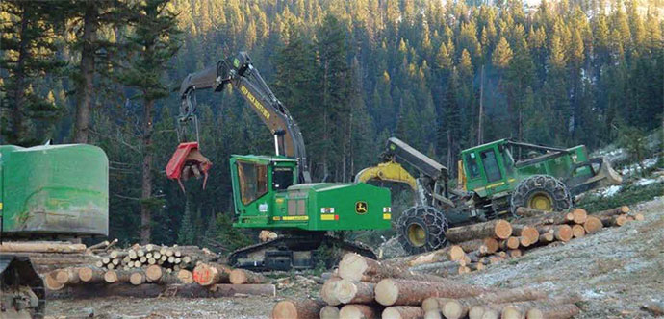
The History & Economy of B.C.

Slide 12
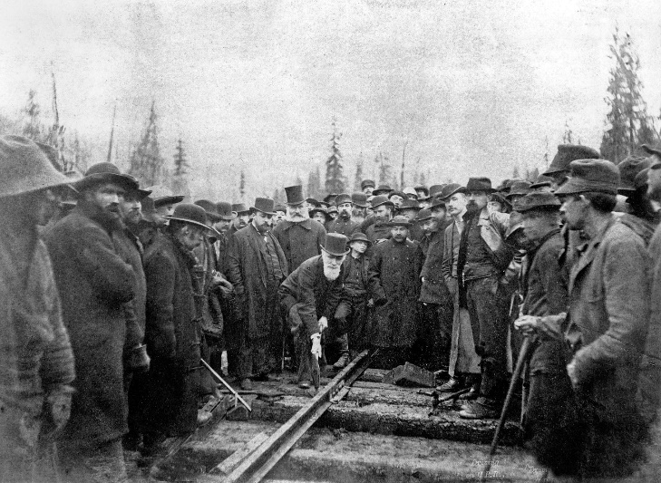
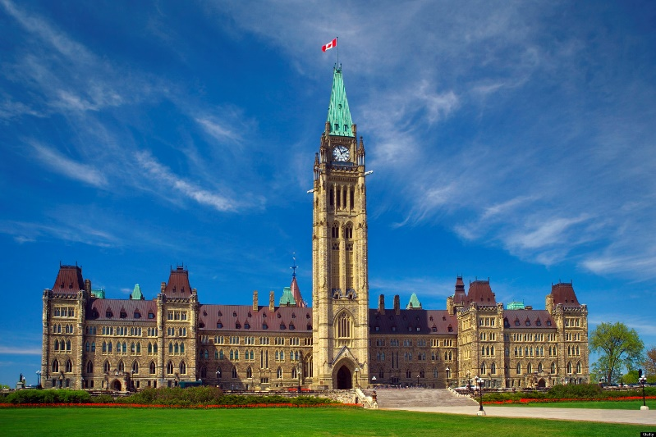
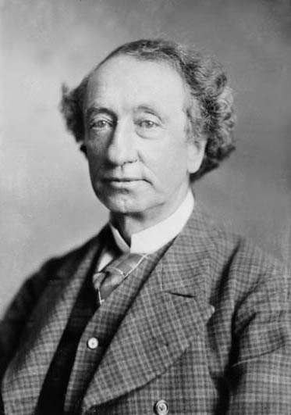
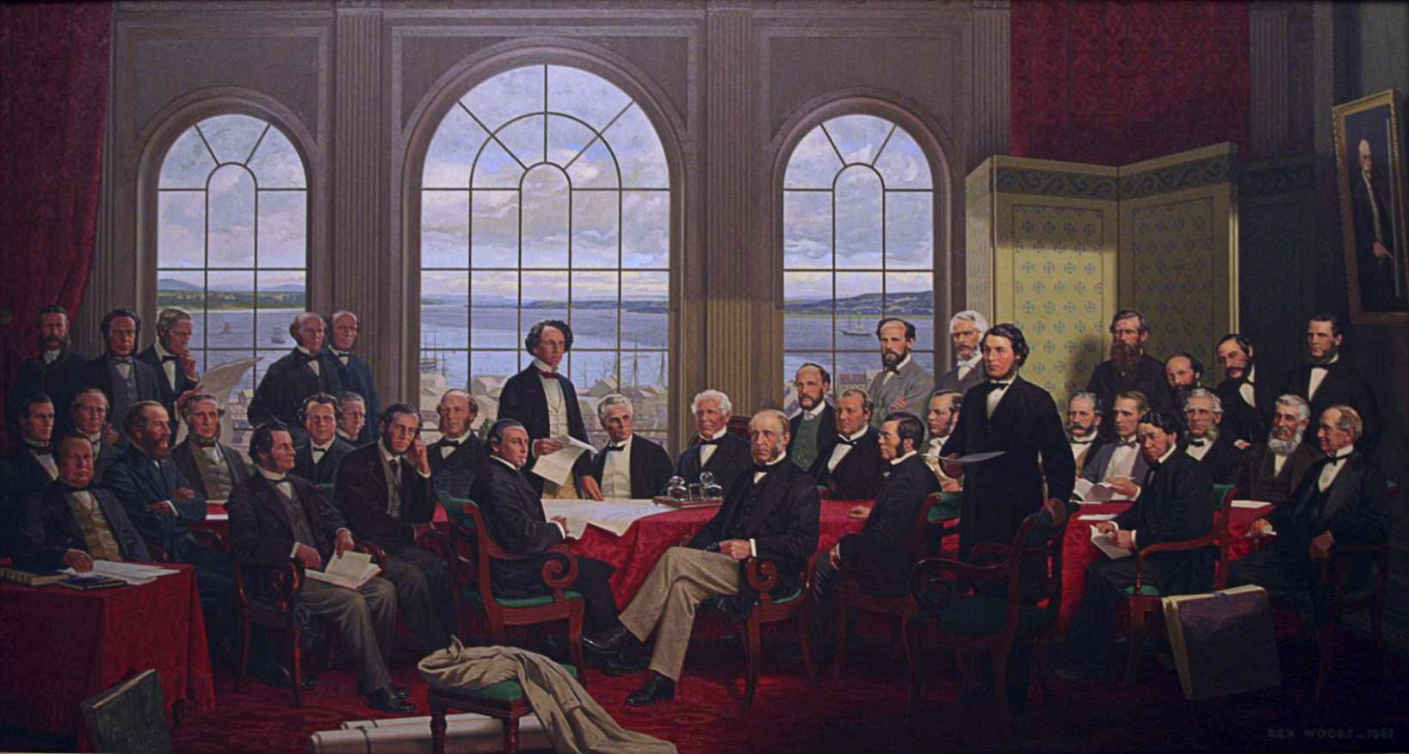
How Canada became a Nation

Slide 13
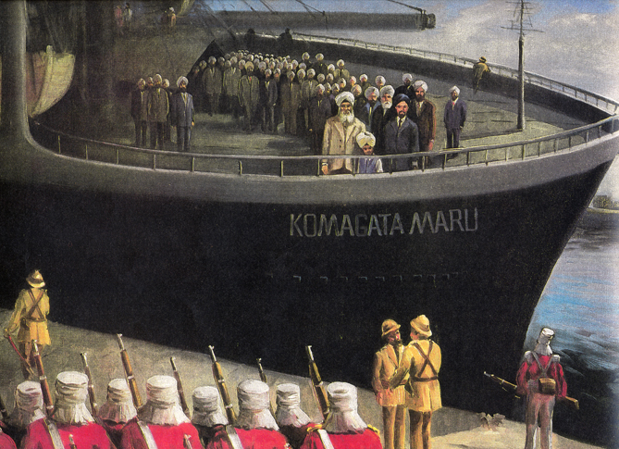
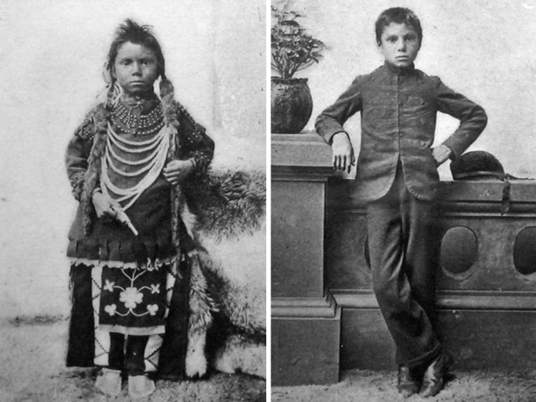
The experiences of immigrants and Indigenous peoples in Canada

Slide 14
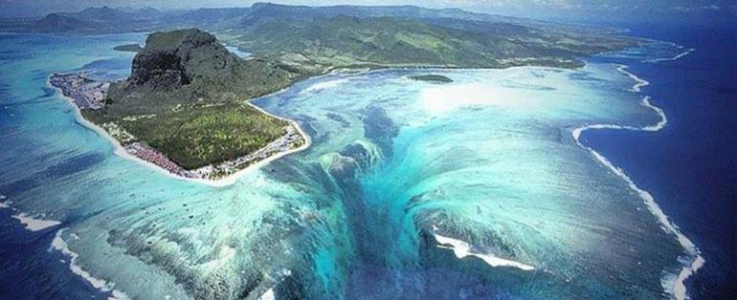
Geography

Slide 15
Classroom Expectations

Slide 17
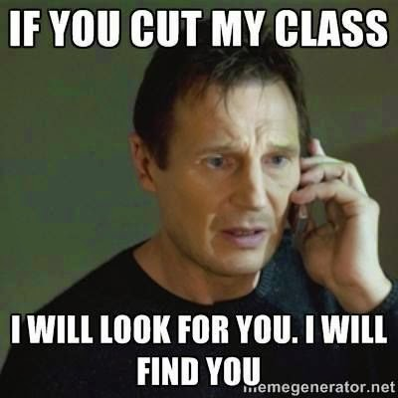

Slide 19
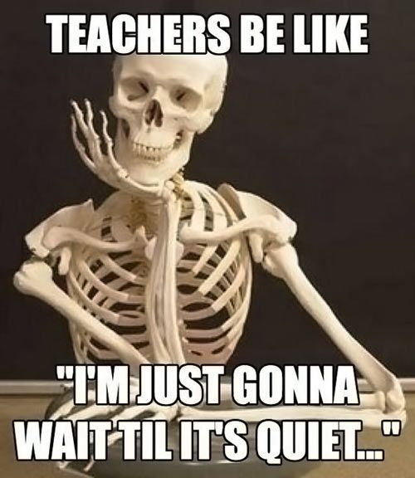

Slide 20
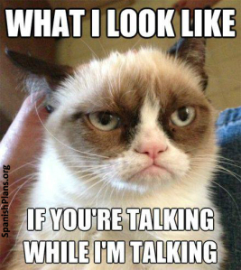

Slide 21
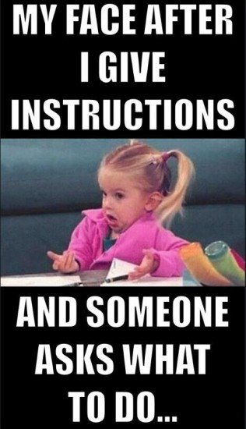

Slide 23
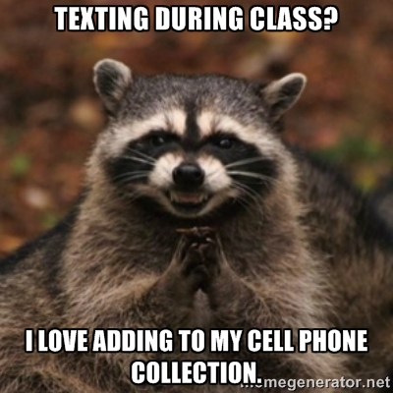

Slide 24
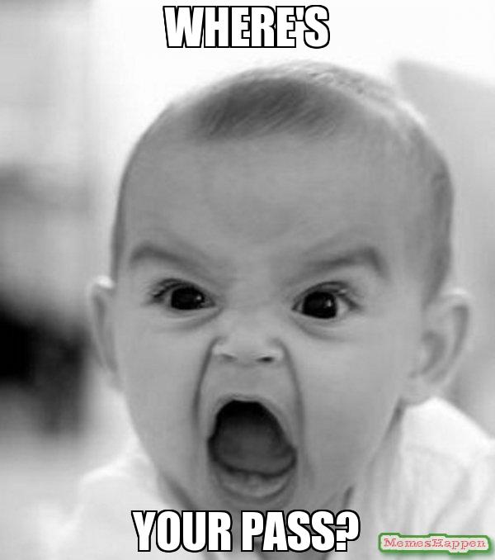

Slide 25
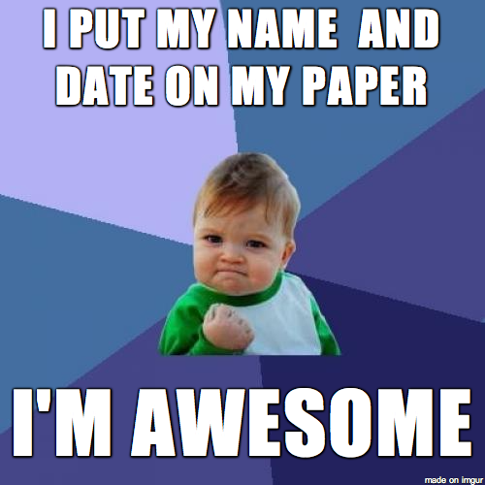

Slide 27
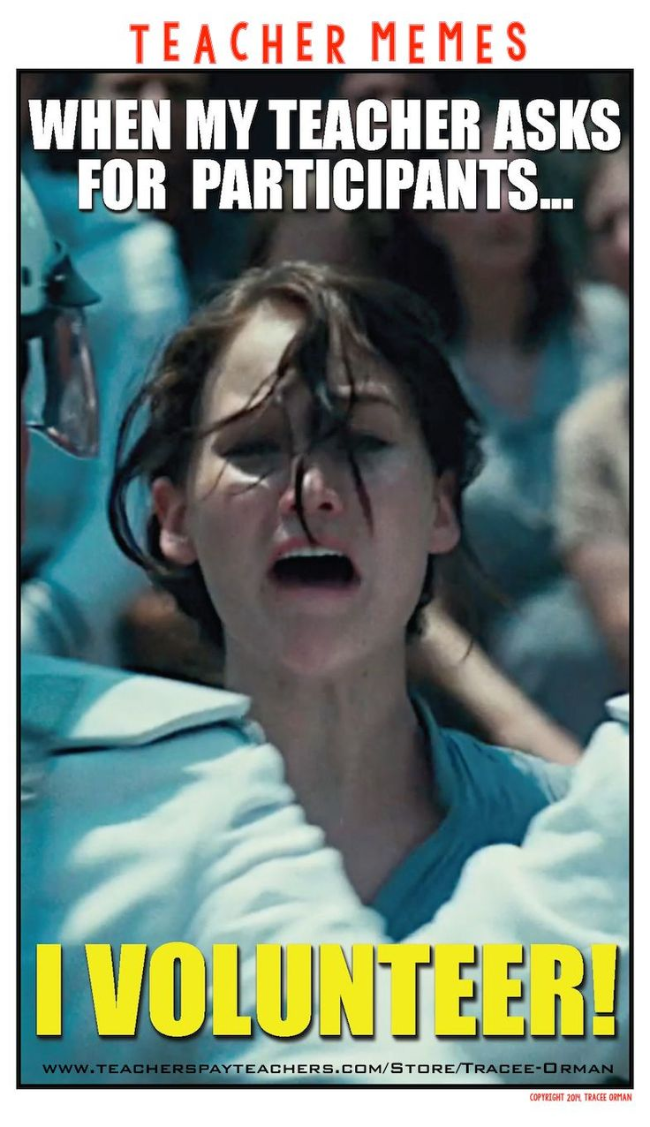

Slide 28
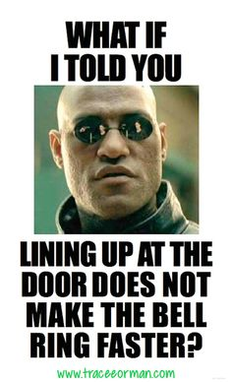

Slide 29
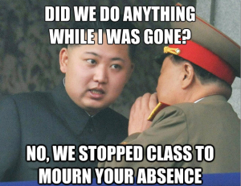

Slide 30
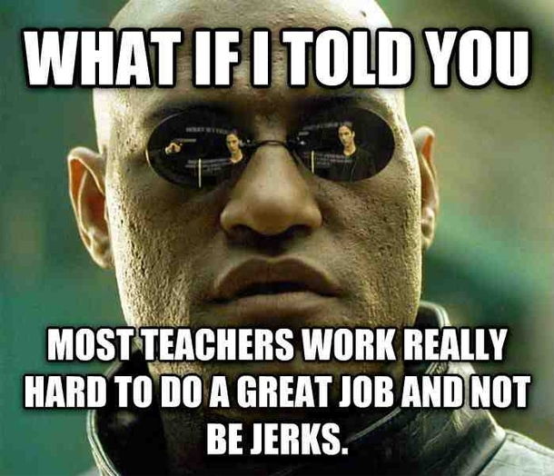

Slide 31
Classroom Expectations
What are your expectations of me, as your teacher?

