Slide 1
First Nations & The Environment
How does art reflect First Nations society and culture?
What is Traditional Ecological Knowledge?
Should the Northern Gateway Pipeline be approved?

Slide 2
Keepers of Life, Norval Morrisseau

Slide 4
Nature Story, Norval Morrisseau

Slide 8
Review
What did/do First Nations people believe about nature and the land?
How did they interact with the environment?

Slide 9
1) Read through handout
2) Write down key points
3) Discussion
Traditional Ecological Knowledge

Slide 10
Write & Share
What do you think life would be like if people today treated the earth as the First Nations believed it should be treated?
How would things change?

Slide 11
Definition
Subsistence
The minimum (food, shelter) necessary to maintain and support life

Slide 12
Fluency Writing
Write for 2 minutes, without stopping
Question: What do you know about the Northern Gateway pipeline, or the Alberta Oil Sands
What comes to your mind? What do you think about when you hear them?

Slide 13
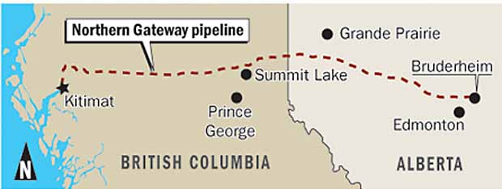
Northern Gateway Pipeline

Slide 14
Your Goal
To be able to defend a position on a controversial issue, after considering different perspectives
Pros/Cons on worksheet
Four Corners Activity
Reflection Journal

Slide 15
Why do we need the pipeline?
Challenge:
Canada’s most valuable resource is crude oil, with 99% of our oil exports going to the United States at discounted prices
Solution
The $6.5 billion Northern Gateway Pipeline will provide access to new markets in the Pacific Rim (fair market prices)

Slide 16
Northern Gateway Pipeline
Kitimat Marine Terminal: 19 tanks for oil
Westbound pipeline: 525,000 barrels per day
Eastbound pipeline: 193,000 barrels of condensate per day
“It will be a model of world-class safety and environmental standards”

Slide 17
Northern Gateway Pipeline
24/7 pipe monitoring: remote pump stations with staff
Leak detection
Jobs
Economy

Slide 18
Benefits: B.C.
Over 3,000 construction jobs
560 long-term jobs
$32 million income/year
Individuals, families, communities
Education, hospitals, infrastructure
Training: skills for industries

Slide 19
Benefits: First Nations
10% stake in the project
Employment and contracts
$1 billion long-term benefits for Aboriginal communities
Access to habitat protection initiatives
Assist in emergency response activities

Slide 20
BC’s 5 Conditions
1. Environmental review process
2. World-leading marine oil response
3. World-leading land oil-spill prevention, response and recovery systems
4. Include First Nation rights and opportunities
5. B.C. Receives fair share of benefits ($)

Slide 21
Videos
Videos
"Oil in Eden: The Battle to Protect Canada's Pacific Coast” http://www.youtube.com/watch?v=aO4s4P7eFk4
"Pipeline Benefits" http://www.youtube.com/watch?v=5EW9llGQQ1U

Slide 22
Four Corners Activity
Four Corners Activity
The Northern Gateway Pipeline should be approved

Slide 23
Four Corners Activity
Four Corners Activity
Decide whether you AGREE, STRONGLY AGREE, DISAGREE, or STRONGLY DISAGREE with the statement
Move to that corner (with your pros/cons list)
Discuss with your group WHY you are there
Report out to the class

Slide 24
Reflection Journals
Reflection Journals
1. How are you connected to the environment? How often do you spend time outdoors or in nature, and what do you do? Give reasons why it IS important to you, or why it IS NOT.
2. During the activity, which corner did you choose? Explain how you made that decision. Were there some pros/cons that were more important to you than others? What were some of the major factors in your decision?

Slide 25
Additional Resources
Additional Resources
http://www.youtube.com/watch?v=55mFyxQN2BQ (4:50)

