Slide 1
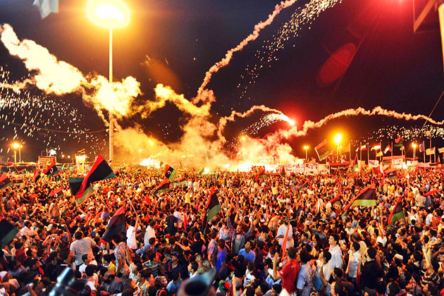
The Arab Spring

Slide 3
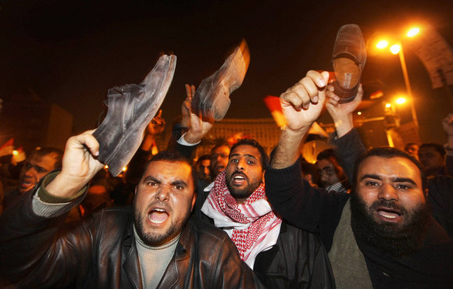
Put yourself in someone else’s shoes…..
"Facing the soles of your shoes toward anyone's face, striking them with your shoe soles, or throwing your shoes at them are considered to be grave insults in Arabic cultures. All Arabs regard streets and, by extension, shoe soles as unclean, and view being struck by shoe soles as a form of extreme disrespect."

Slide 4
Countries involved
Tunisia
Egypt
Libya
Yemen
Syria
Bahrain
Algeria
Government overthrown (Jan 2011)
Government overthrown (2011, 2013…)
Government overthrown (Aug 2011)
Government overthrown (Feb 2012)
Ongoing civil war
Ongoing: sustained civil disorder, governmental changes
Major protests

Slide 5
Countries involved (continued)
Jordan
Oman
Sudan
Iraq
Kuwait
Morocco
Lebanon
Iran
Protests and governmental changes
Protests and governmental changes
Major protests
Major protests
Protests and governmental changes
Protests and governmental changes
Protests and governmental changes
Major protests

Slide 6
Causes
Dissatisfaction with the rule of governments
Inequality (income) and Poverty
Dictators/absolute monarchs
Human rights violations
Political corruption
Economic decline
Large % of educated and dissatisfied youth in the population

Slide 7
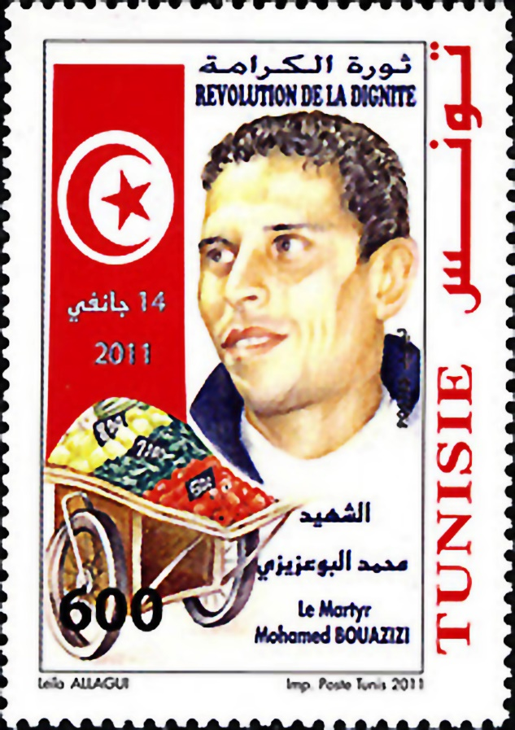
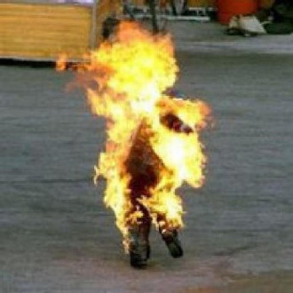
18th of December, 2010
Location: Sidi Bouzid, Tunisia
Mohamed Bouazizi’s (a street vendor) self-immolation
Why? Protesting police corruption and mistreatment
"Mohamed had no money to pay their stupid bribes because he had only just started working that day," his mother said.
"The frustration just boiled over. He was a decent man trying to earn money for his family and was sick of the corruption. Mohamed felt humiliated and insulted. It was far from the first time he had been asked for a bribe and he cracked."

Slide 8
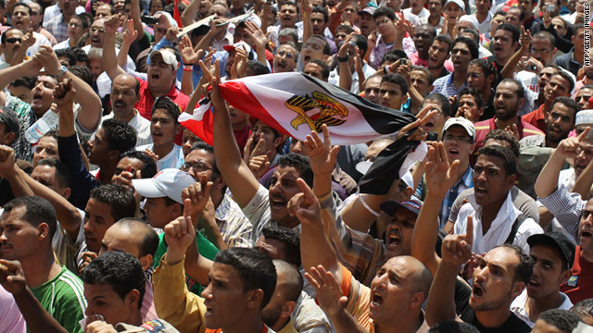
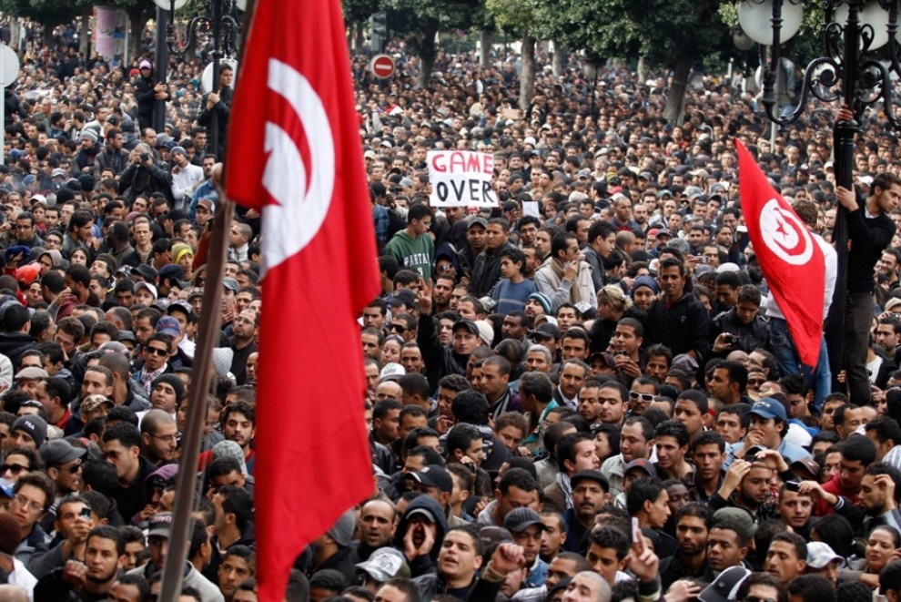
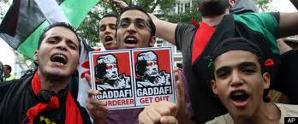
What happened?
Generally started as peaceful nonviolent protests (marches, etc.)

Slide 9
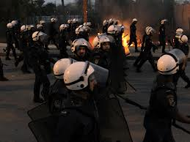
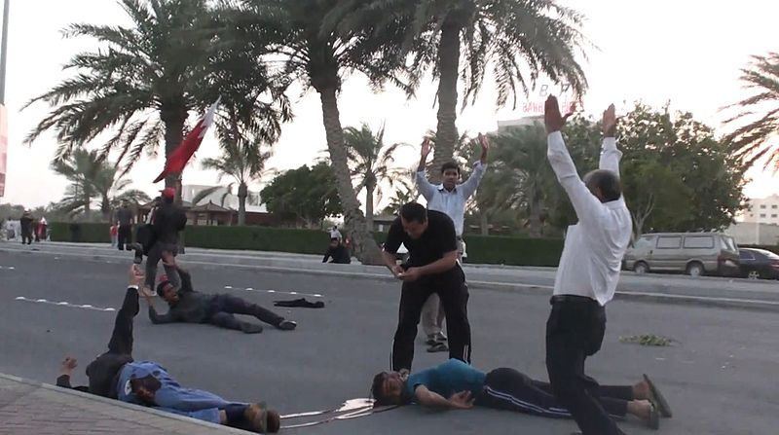
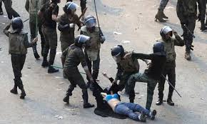
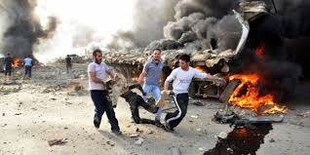
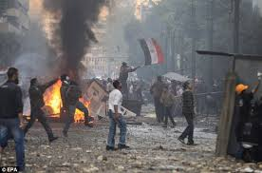
In most cases, met with violence from security forces and police

Slide 10
Egyptian Revolution
Who?
Millions of people
Variety of religions and socio-economic status
Why?
State of emergency laws, political censorship, police brutality, corruption, unemployment, low wages, expensive food, no elections (fraud) or freedom of speech
How?
Civil disobedience, civil resistance, demonstrations, riots, trikes, online activism, self-immolation
Outcome:
Overthrow of Mubarak (leader)
Gov’t responded with brutality (live ammunition), torture, beatings, arrests
Lifted state of emergency, armed forces took over
Democratic elections -> Morsi… overthrown…. Ongoing civil unrest

Slide 11
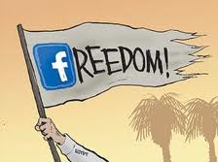
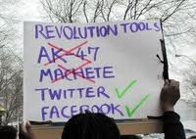
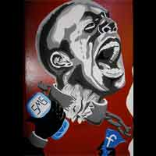
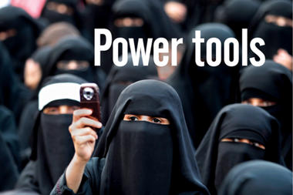
Role of Social Media
“We use Facebook to schedule the protests” an Arab Spring activist from Egypt announced “and [we use] Twitter to coordinate, and YouTube to tell the world.”
Distribution of information: uncensored

Slide 12
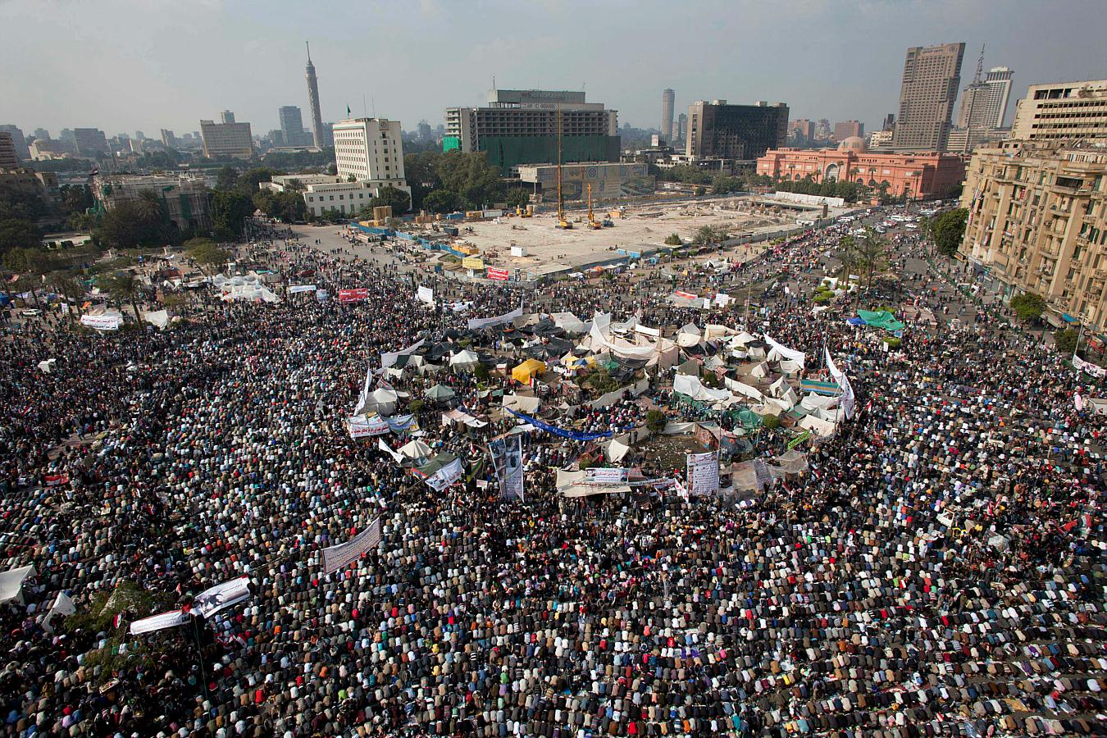
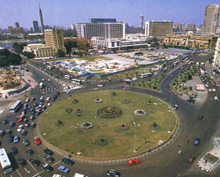
“The Square”
Tahrir Square in Cairo= where many demonstrations took place

Slide 13
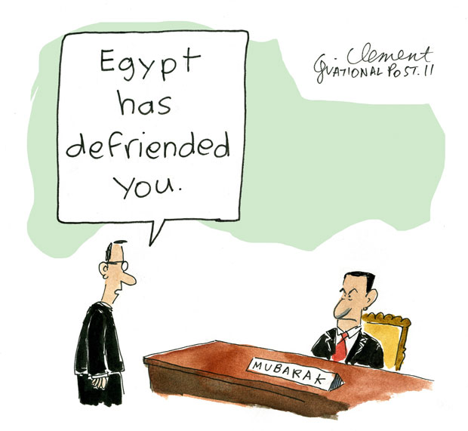
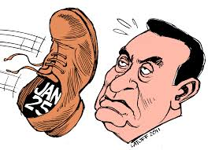

Slide 15
Video: “Can’t Take Our Freedom”
By Khaled M. feat. Lowkey

Slide 16
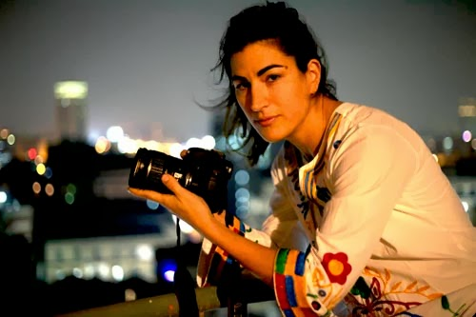
“The Square”
Directed by Jehane Noujaim
“This film was born from the square, so each person on the film crew came from the square and were protesters first. Each person on the crew was shot at, tear gassed, injured or arrested. Most have had their cameras confiscated, or smashed and footage stolen.”

Slide 21
Discussion
Your thoughts & reactions?
Questions?

Slide 22
“The Egyptian revolution is a dance, it’s a few steps forward, it’s a few steps backwards,” says Amer. The Square‘s protagonists are in the struggle for the longterm and haven’t failed just because their vision of a just, democratic society is not in sight, he says. “We grew up in an Egypt where people felt no agency over their future,” says Noujaim, the director. “People power did have an effect. It was a genie that was let out of the bottle.”

Slide 23
There is no denying that this is a dark moment in Egypt, but as Ahmed Hassan has said, "the revolution is a voice", it has entered into every Egyptian home and there has been a shift of consciousness in the country in people's ability to effect change. The political timeline may not bear the results that many had hoped for Egypt – however, the passion and dedication of the many like Ahmed who were willing to sacrifice their life for the future of their country will never be destroyed and they will continue to fight for that change until it comes.
Documenting this movement and witnessing the incredible relentlessness of people like Ahmed has only reaffirmed our belief in Margaret Mead's words: "Never doubt that a small group of thoughtful, committed citizens can change the world; indeed, it's the only thing that ever has."

