Slide 1
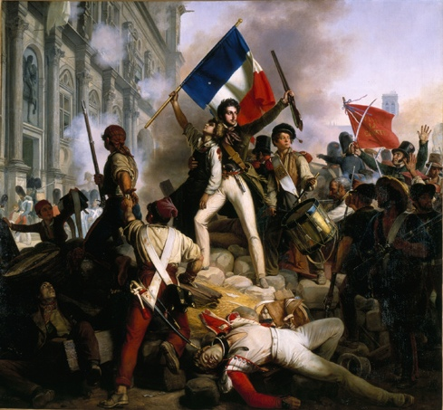
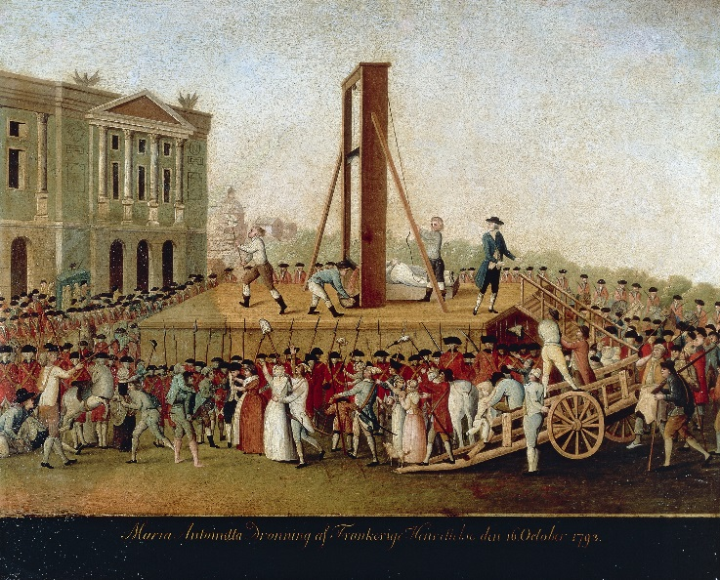
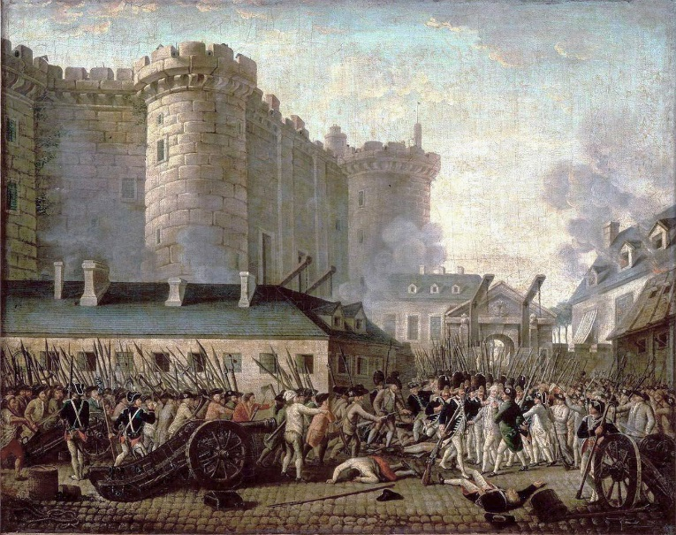
The French Revolution
Video
1789-1799

Slide 2
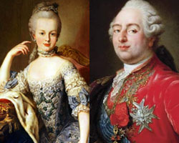
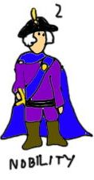
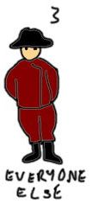
French society before the revolution…
King Louis XVI
Marie Antoinette
First Estate
Clergy
Second Estate
Nobility
Artisans, merchants, bourgeoisie, city workers, peasants, beggars...
Third Estate

Slide 3
Privileges
Obligations
Collected the tithe (Church tax)
Control of education
Kept records of births, deaths, etc.
State religion (honoured)
Owned 20% of the land
Paid no taxes
Moral obligation to assist poor & needy
Support monarchy & Old Regime
30,000
Collected rents & dues for lands
Worked for military and state
Owned 20% of the land
Support monarchy & Old Regime
110,000
Paid all taxes (SO MANY!!!)
Tithe (Church tax), tax on goods brought into cities, poll tax, income tax, salt tax, land tax
Feudal dues for use of local manor’s winepress, oven, etc.
(artisans, bourgeoisie, city workers, merchants, peasants…)
25,000,000

Slide 4
Peasants
Few could read/write
Epidemics & famine
No access to education
City workers
Shopkeepers, artisans, clerks, labourers
Half income went to food
Bourgeoisie
Middle class
Laws & regulations, tariffs, tolls
Hard to make $$$

Slide 5
The Three Estates: Activity
King Louis XVI
Marie Antoinette
First Estate
Clergy
Second Estate
Nobility
Artisans, merchants, bourgeoisie, city workers, peasants, beggars...
Third Estate

Slide 6
Response Questions
On the back of your graphic organizer answer the following questions in full sentences:
What is a revolution, and what kinds of factors do you think lead to a revolution?
How did the Three Estates Simulation make you feel?
If you were a peasant, what was unfair? Considering your position in society, what would/could you do to change the situation?
OR
If you were the clergy/nobility: did you feel bad for the peasants? Would you support them if they revolted against the government?

Slide 7
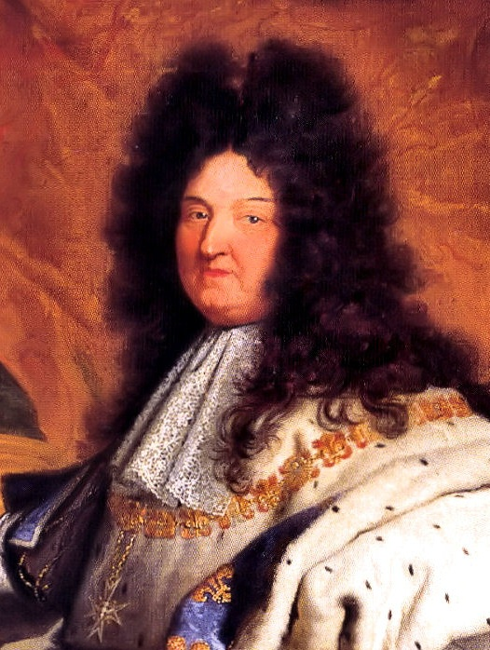
Monarchy
Louis XIV
Marie Antoinette
Louis XVI

Slide 8
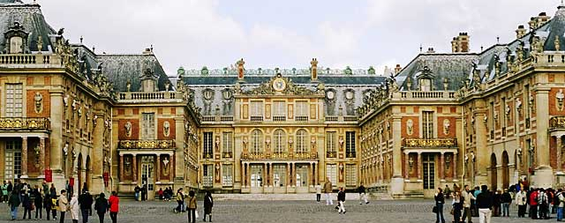
Monarchy
“The Sun King”
Palace of Versailles
Video
Virtual Tour
Inside: 360
Ballet
Wars: unsuccessful
Louis XIV

Slide 9
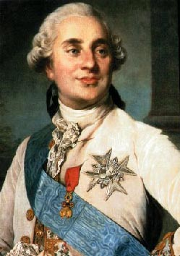
Monarchy
Does not have qualities of a good ruler
Little contact with lower classes
Did little to improve conditions
Poverty, taxes
Louis XVI

Slide 10
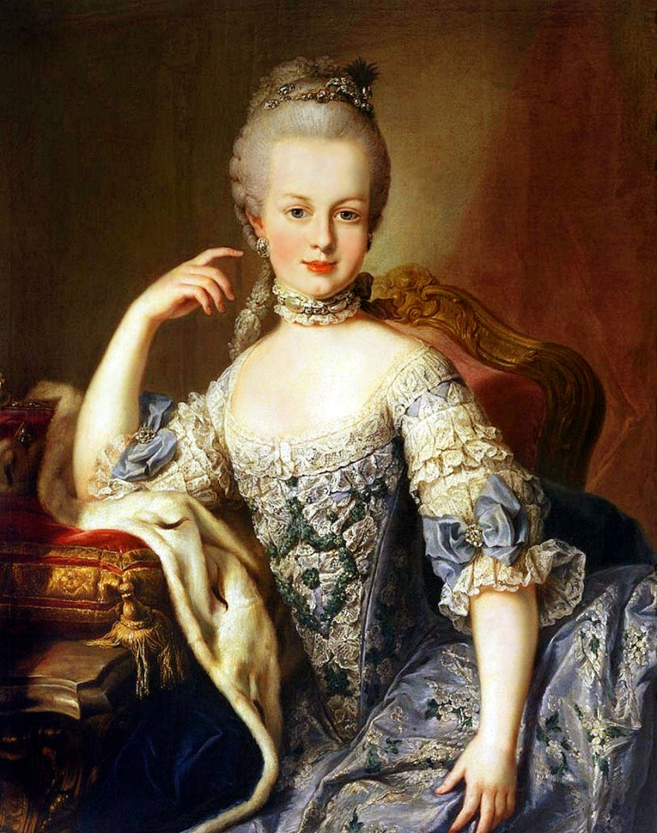
Monarchy
Wife of Louis XVI
Idealized peasant life “play farming”
Loved extravagant, fine things
Spent lots of $$$ on jewels
https://www.youtube.com/watch?v=a8TAQ0AnDMc
Marie Antoinette

Slide 11
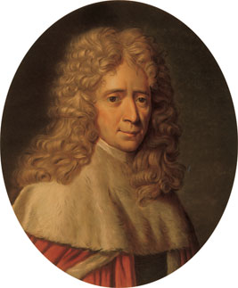
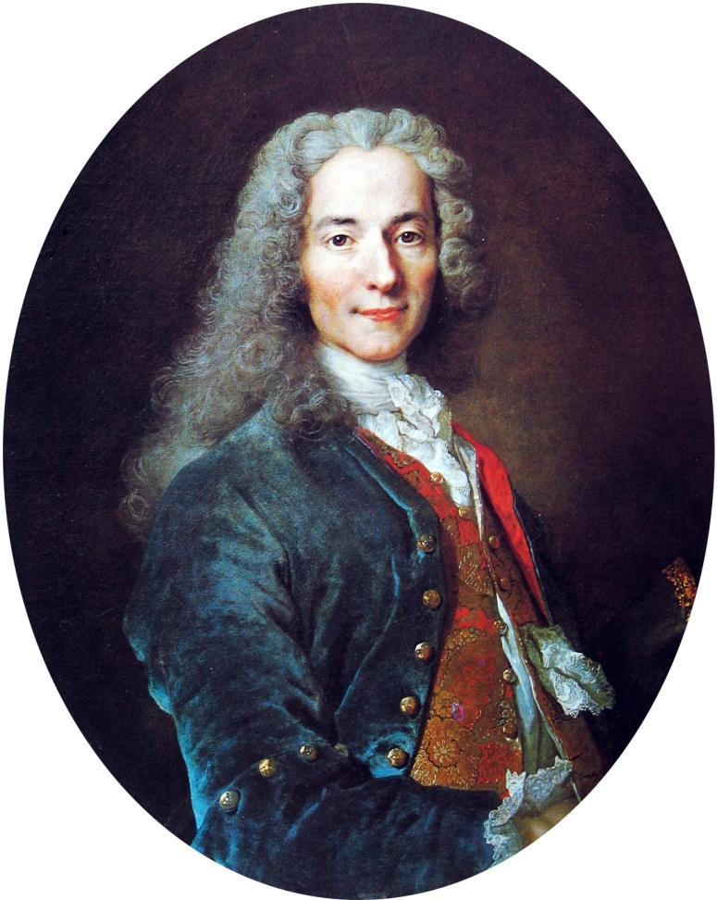
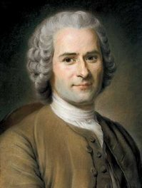
Philosophes
Montesquieu
Voltaire
Rousseau

Slide 12
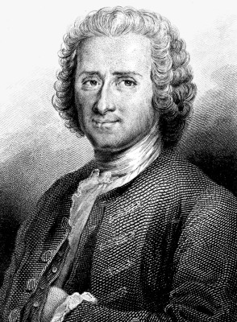
New ideas= catalyst for revolution
Discussion of society & problems
Absolute monarchy vs. Democracy
Scientific reasoning
Conflict with Church

Slide 13
Philosophes
Social Contract between citizens, where they agree to what the majority wants
Natural good will of humans is destroyed by government and society
Rousseau

Slide 14
Philosophes
Against the Church
For freedom of thought
Absolute monarchy= good
Hated injustice
Voltaire

Slide 15
Philosophes
Ruler should work with elected parliaments
Not well received by monarchs... Why??
Montesquieu

Slide 16
Character Role Play
Communication #2: I can collaborate with others to plan and carry out activities
Groups
You will be given a “character card”
Your job is to create some kind of a skit which MUST include the character on your card.
You will present it to the class
(Do not use names)
Classmates will guess which character(s) you are!

Slide 17
Causes of the French Revolution

Slide 18
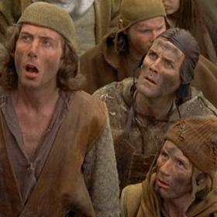
Some Causes...
No Money! (bankrupt)
American Revolution (democracy/freedoms)
Famines of 1780s
Industrial Revolution (unemployment)
Enlightenment ideas
The structure of society
People are UNEMPLOYED, STARVING, UNHAPPY
They don’t have much to lose...

Slide 19
The Beginning... of the French Revolution
Video

Slide 20
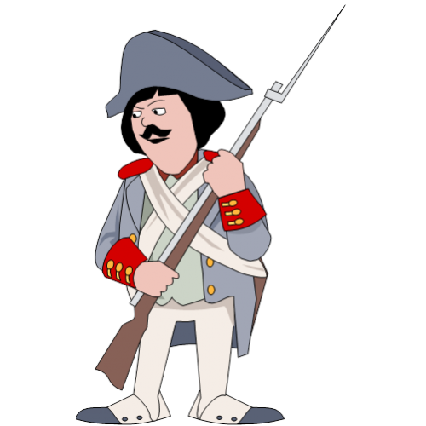
Crisis...
Riots
Response
$$$

Slide 21
Estates General, 1789

Slide 22
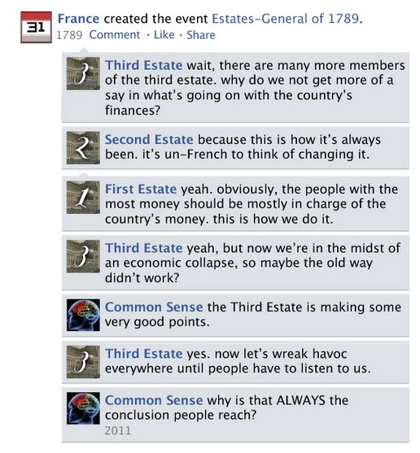

Slide 23
Tennis Court Oath

Slide 24
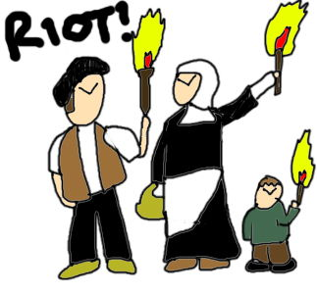
MORE RIOTS!
$$$

Slide 25
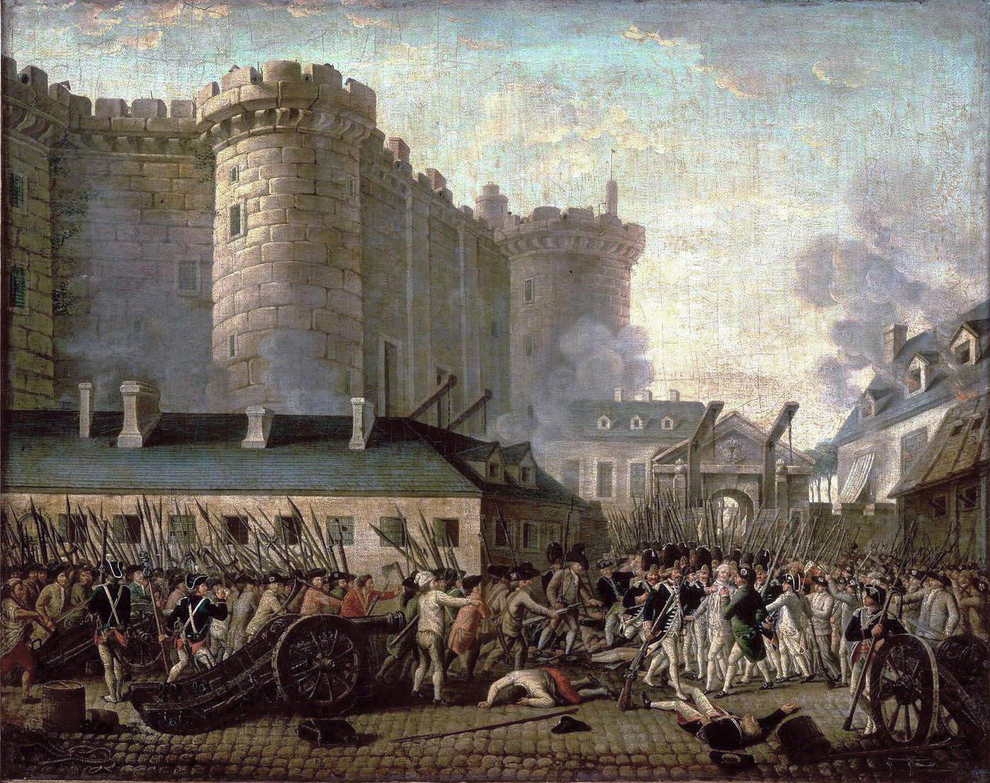
The Fall of Bastille

Slide 27
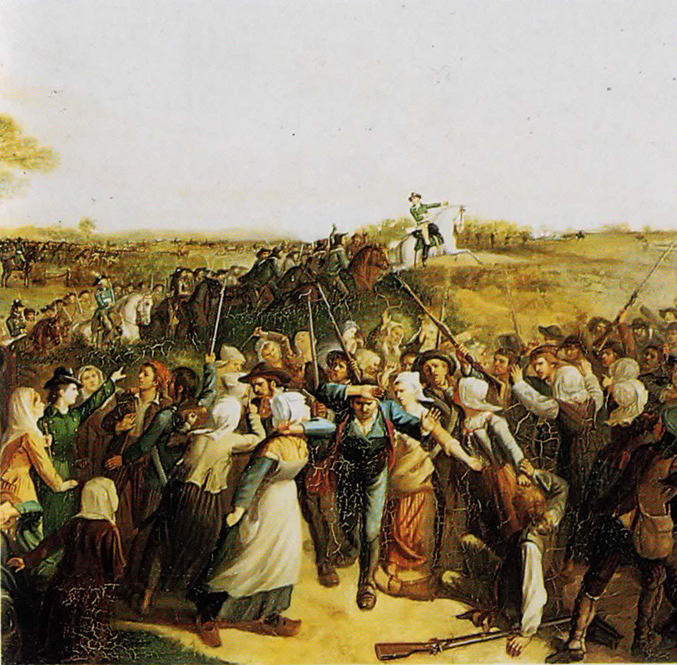
The “Great Fear”

Slide 28
END of Feudal Rights & Serfdom
HOORAY!!!!!

Slide 29
Women March to Versailles

Slide 30
Declaration of the Rights of Man and Citizen
Freedom of thought
Freedom of speech
Freedom of religion
Freedom of security
Freedom of property
**AND limits on the powers of the government

Slide 31
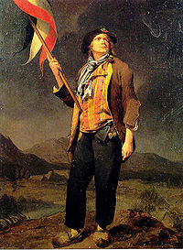
Political Clubs
Girondists: “conservative”
Jacobins: “radical”
Sans-culottes:
Poor
Wanted lower prices, supply of bread
Violent: attacked anyone against revolution
Led by Marat

Slide 32
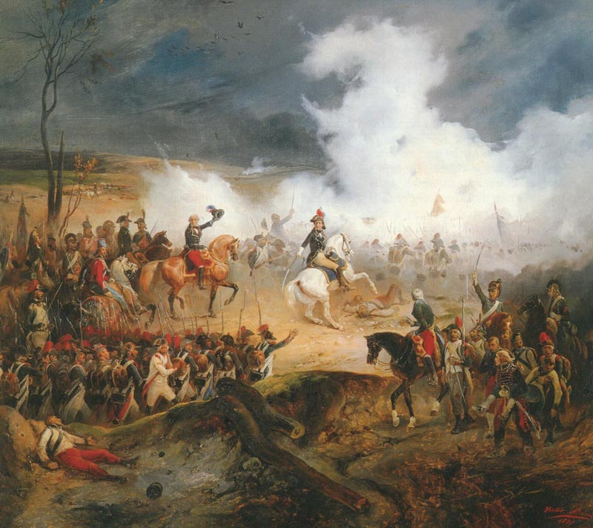
Revolutionary Wars
Other countries nervous about Revolution in France
Emigrés (nobles.. fled)
Invasion to restore the king’s power?
France declares war on Austria, 1792

Slide 33
https://www.youtube.com/watch?v=BvSod16wfgg

Slide 34
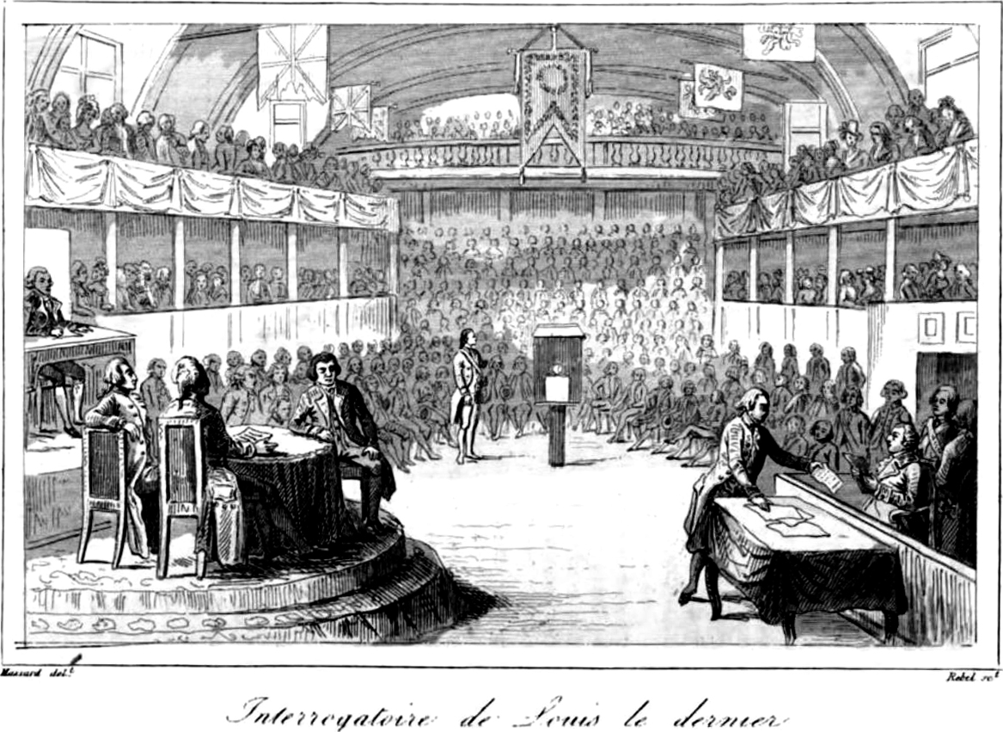
Trial of King Louis XVI

Slide 35
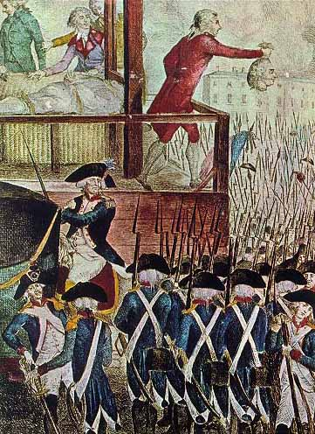
Louis XVI is beheaded January 21, 1793
Marie Antoinette is beheaded
October 1793

Slide 36
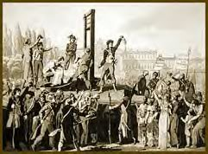
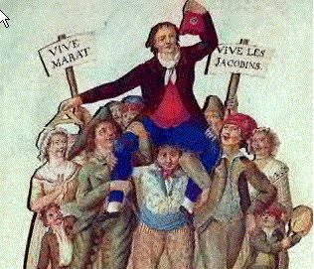
1793-94: “Reign of Terror”
Jacobins overthrew Legislative Assembly
Eliminated those who disagreed
Killed thousands: “enemies of the Revolution”
Over 37,000 guillotined!!!

Slide 37
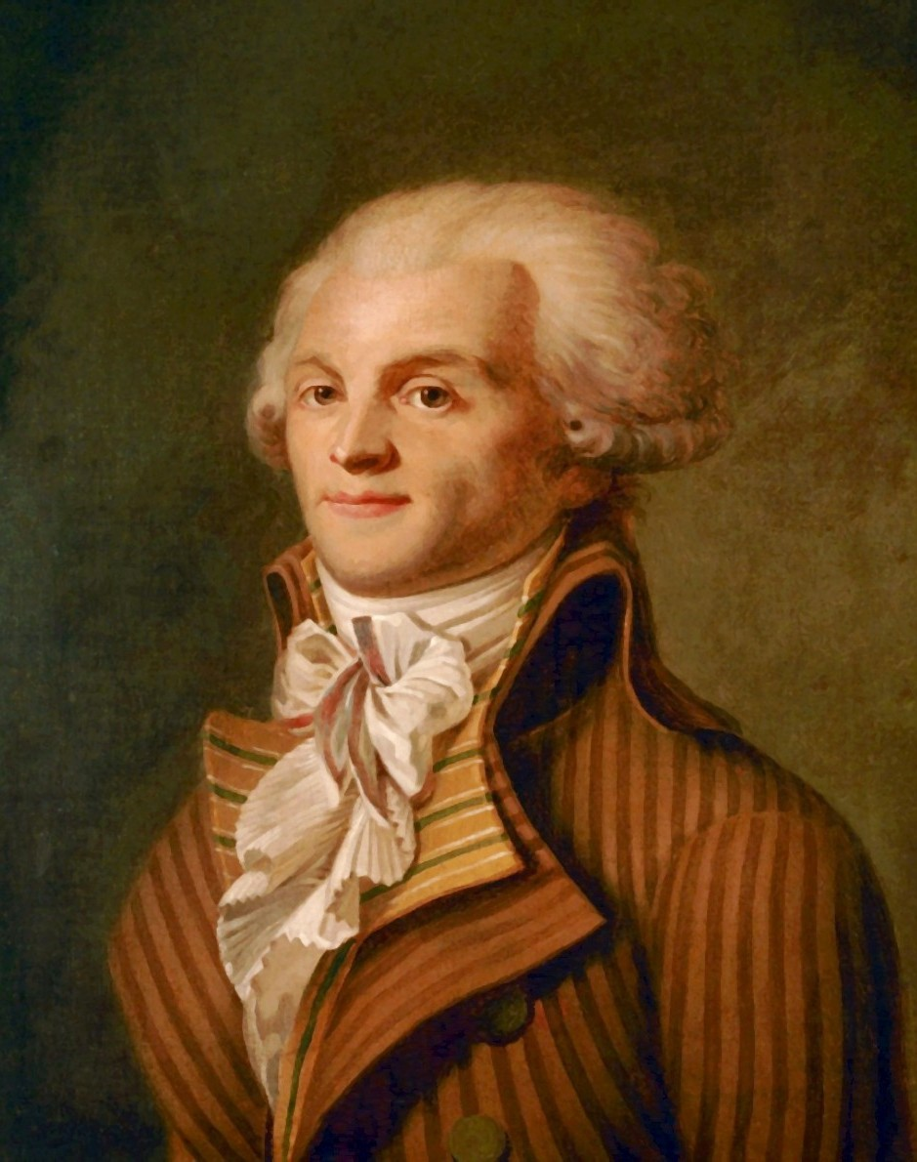
Robespierre
Modernized France
Metric system
Revolutionary calendar
Army more efficient
New schools & universities
People feared dictatorship: arrested and guillotined

Slide 38
The Directory
Middle class
Gave power to people with property
Vote
Elect members to government
Equality was over...
Many advances swept away

Slide 39
Video: http://www.youtube.com/watch?v=otnADq4Y0-A

Slide 40
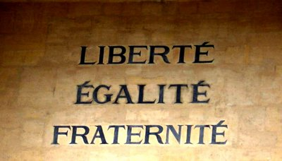
Why is it significant?
People revolted against Monarchy and established a republic
Established the flag, constitution, and National Anthem
The Republic = taste of freedom (short)
Became a model for future revolutions
Stepping stone to freedom, democracy, and rights that we have today

Slide 41
Monarchy

Slide 42
The Enlightenment

Slide 43
Causes of the French Revolution

Slide 44
The Beginning... of the French Revolution

Slide 48
The “Great Fear”

Slide 49
HOORAY!!!!!

Slide 53
1793-94: “Reign of Terror”

Slide 54
The Directory
Significance?

