Slide 1
The Government of Canada

Slide 2
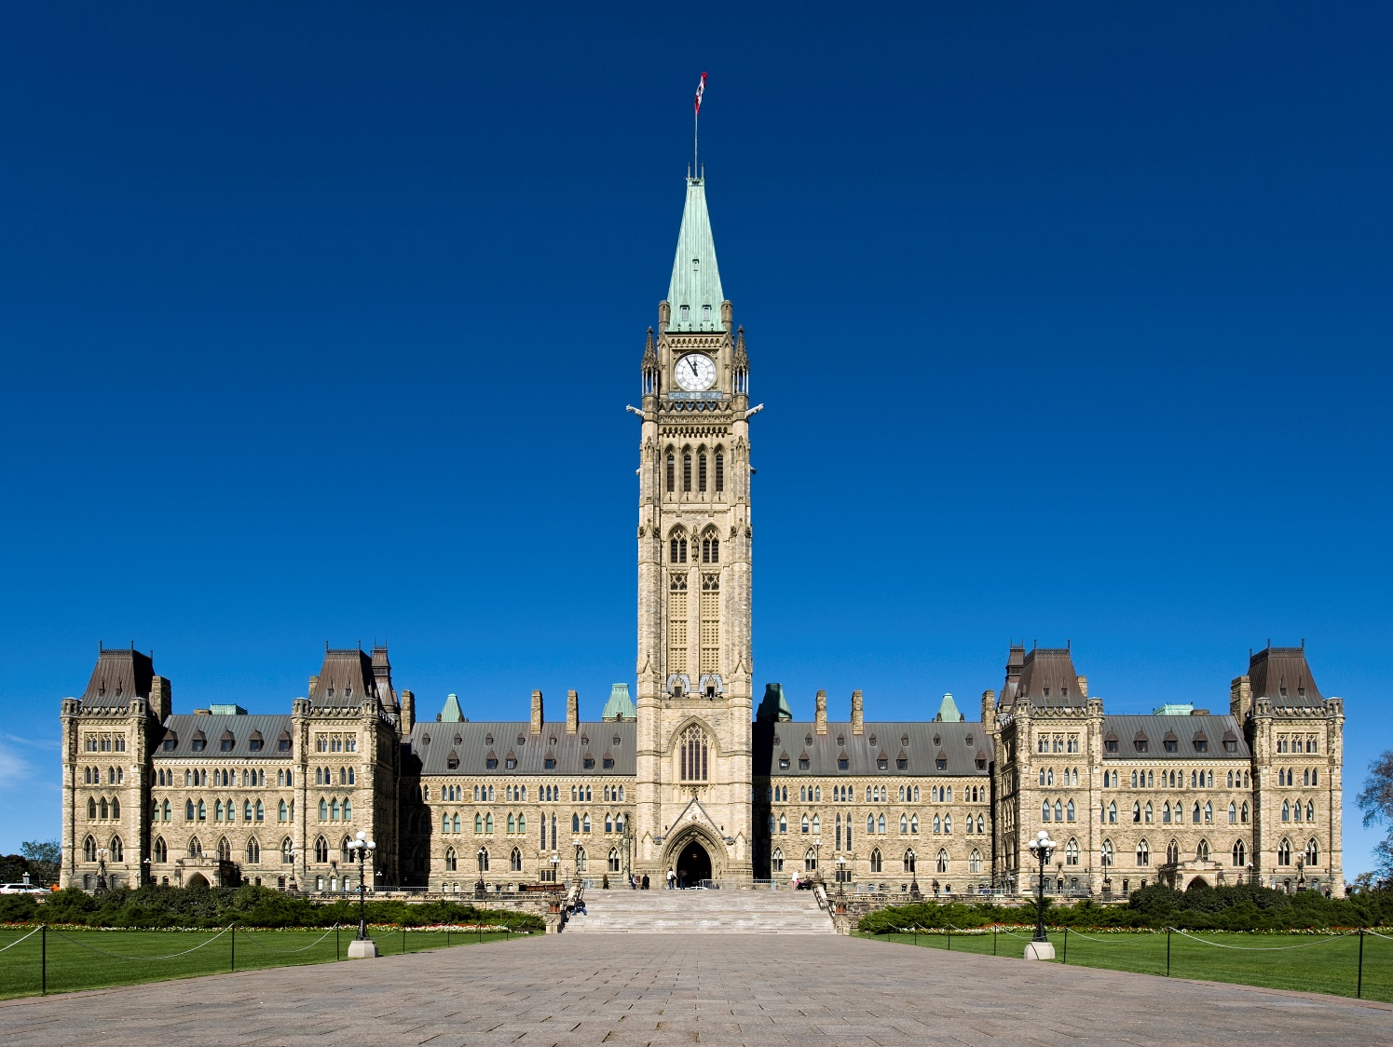
The Canadian Government
Who cares?

Slide 4
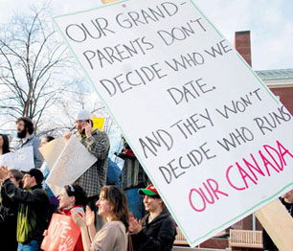
Close to 60% of Canadians aged 18-24 don’t vote Why do you think that is?
Watch: Rick Mercer on voting in Canada

Slide 5
As we will learn, the workings and policies of federal (national), provincial, and municipal government affect nearly all aspects of life
As long as young people are not voting, politicians will ignore the issues that matter the most
If you don’t like the system, there are ways to affect change!

Slide 6
Your Task
Complete the Pre-Test
Don’t worry, this will not be graded! It is to find out what you already know and what you need to learn

Slide 7
Your Task
Take Outlining Notes on the following information about Canada’s Government

Slide 8
Video
https://www.youtube.com/watch?v=zUW3oQ7gN1E

Slide 9
Canada can be described as a…
Representative Democracy
Constitutional Monarchy
We elect (vote for) MPs/MLAs to represent us
The Queen is our “Head of State,” and governs according to our constitution She is politically neutral and has mostly ceremonial duties.

Slide 10
Canada can be described as a…
Federal System of Government
We have three different levels of government: Federal, Provincial, and Municipal (they are all responsible for different things…)

Slide 11
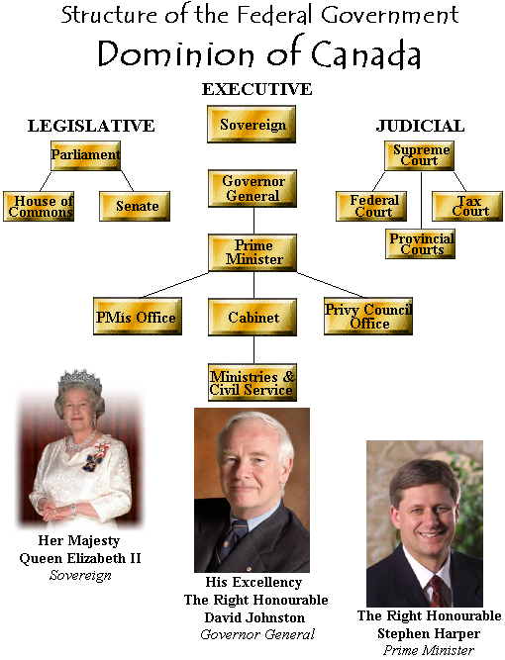
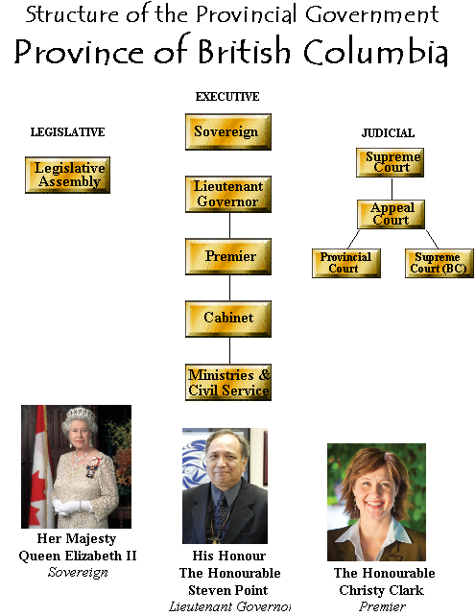
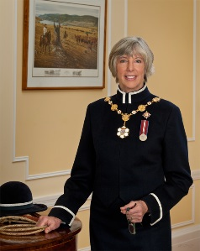
The Honourable Judith Guichon

Slide 12
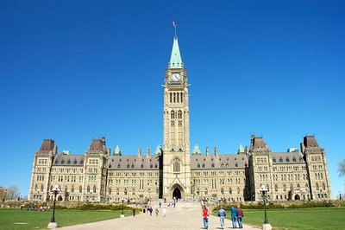
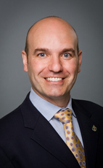
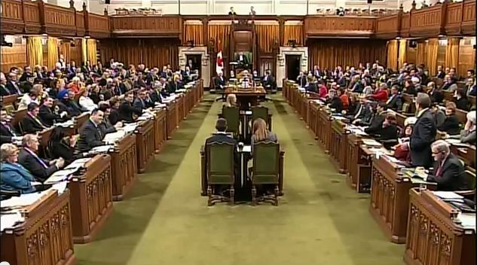
Members of Parliament
The people that each region of Canada elects to represent them in the House of Commons at the Parliament in Ottawa (where they make and debate laws)

Slide 13
Parliament
The political party that wins the most seats in the House of Commons becomes the Government
The party with the second most seats becomes the Official Opposition

Slide 14
Political Parties
An organization of people that wants to achieve similar goals and exercise of political power

Slide 15
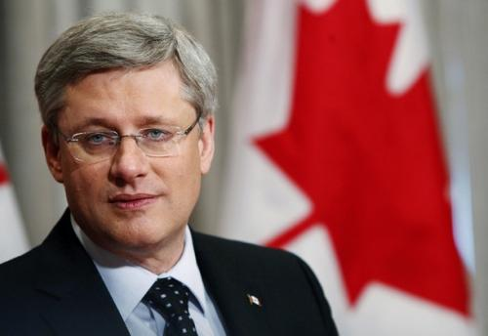
Canada’s Federal Political Parties
Led by
Stephen Harper
What they advocate for
Lower taxes
More jobs
Focus on family
Traditional values
Close relations with USA
More trade agreements
159/308

Slide 16
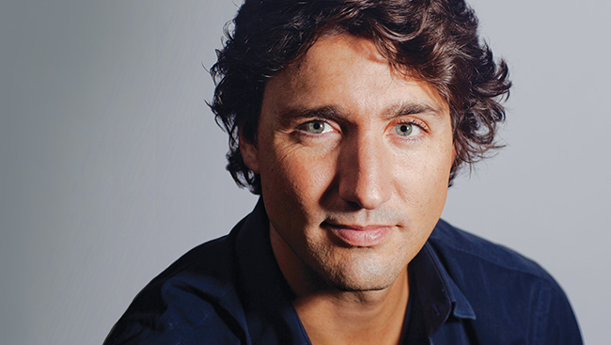
Canada’s Federal Political Parties
Led by
Justin Trudeau
What they advocate for
Invest in higher education
Renewable energy
Free trade agreements
Affordable housing
Reform marijuana policies
36/308

Slide 17
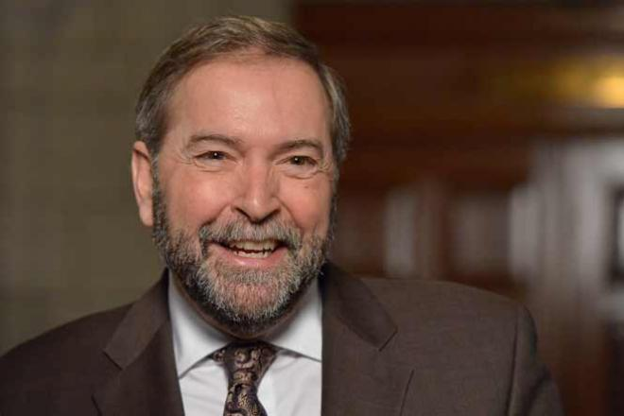
Canada’s Federal Political Parties
Led by
Thomas Mulcair
What they advocate for
Expand human rights
Diversity
Public health care
Raise minimum wage
Reduce poverty
Environmental protection
95/308

Slide 18
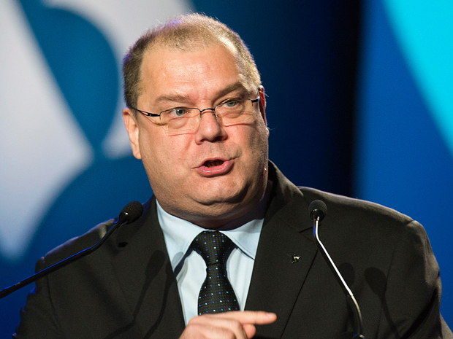
Canada’s Federal Political Parties
Led by
Mario Beaulieu
What they advocate for:
Interests of Quebec
Have opposed most recent wars
Legalization of assisted suicide
Decriminalization of marijuana
Abortion rights
Environmentalism
2/308

Slide 19
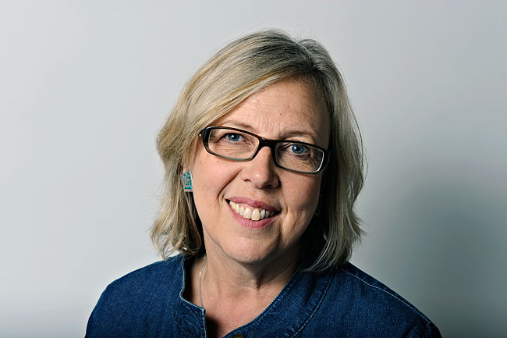
Canada’s Federal Political Parties
Led by
Elizabeth May
What they advocate for:
Environment***
Animal welfare
Renewable energy & sustainability
Respect for diversity
Social justice
2/308

Slide 20
Your Task
You can work individually or with those around you to complete the matching activity:
Match the image to the name, position, and party by writing (you can use the internet to help you)
Cut out the images and glue them to either federal, provincial, or municipal

Slide 21
What are we doing today?
Review
Activity: Who is Responsible?
Activity: Issues that Matter

Slide 22
Review
What does representative democracy mean?
We elect people to represent us in our government

Slide 23
Review
What does constitutional monarchy mean?
That we have a monarch (the queen) who rules according to a constitution (which gives us rights)

Slide 24
Review
What are the THREE levels of government in Canada?
Federal, Provincial, Municipal

Slide 25
Review
What do we call our Head of Government? (He leads the gov’t)
The Prime Minister

Slide 26
Review
What is our current Prime Minister?
Stephen Harper, Conservative

Slide 27
Review
Where our FEDERAL government is located
Ottawa

Slide 28
Review
Where our PROVINCIAL government is located
Victoria

Slide 29
Review
What we call someone who represents us at the parliament in Ottawa
A Member of Parliament (MP)

Slide 30
Review
What we call someone who represents us at the legislature in Victoria
A Member of the Legislative Assembly (MLA)

Slide 31
Review
Who is our Head of State?
The Queen (Elizabeth II)

Slide 32
Review
Who is our Head of State?
The Queen (Elizabeth II)

Slide 33
Review
Who represents the Queen in Canada (federally)
The Governor General (David Johnston)

Slide 34
Review
Who represents the Queen in BC (provincially)
The Lieutenant Governor (Judith Guichon)

Slide 35
Review
Name FOUR other political parties in Canada, and their leaders
Conservative (Stephen Harper), Liberal (Justin Trudeau), NDP (Thomas Mulcair), Green (Elizabeth May)

Slide 36
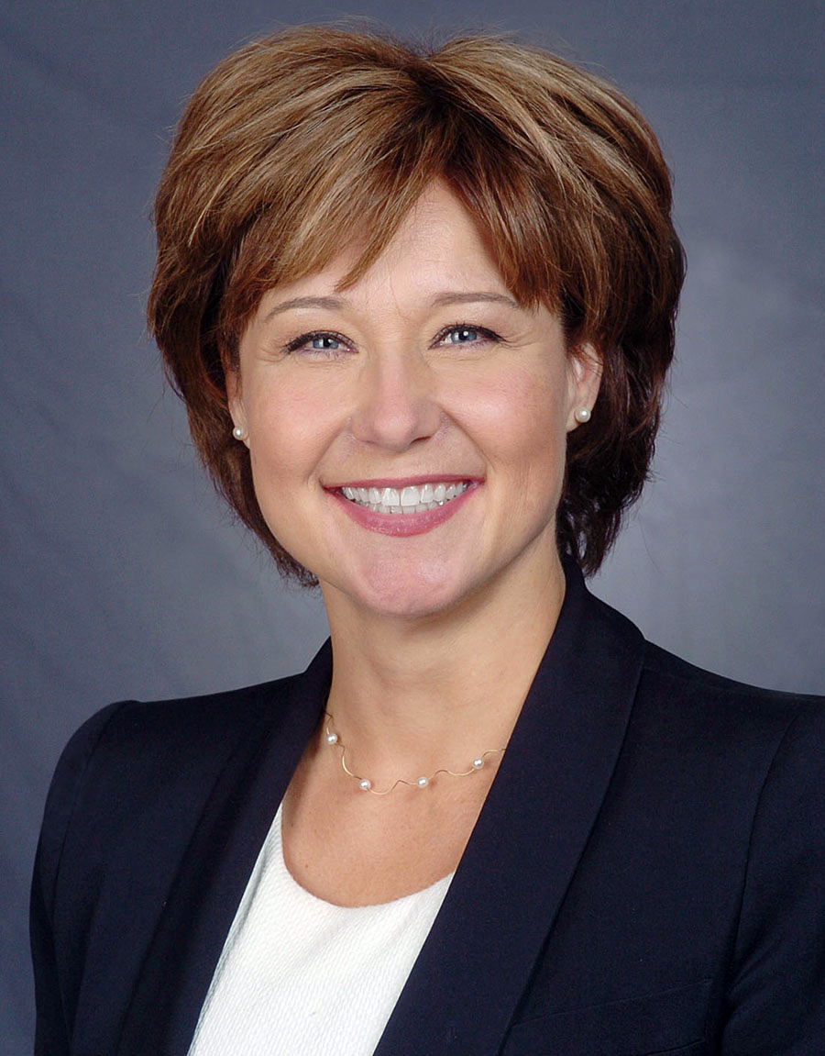
Who is this?

Slide 37
Who is this?
What does he do?

Slide 38
Learning Outcomes
By the end of this lesson you should be able to:
List the responsibilities of each level of government
Identify some issues that are important to you
Describe ways that you could affect change in relation to those issues

Slide 39
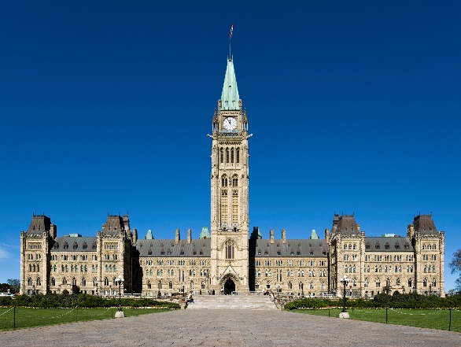
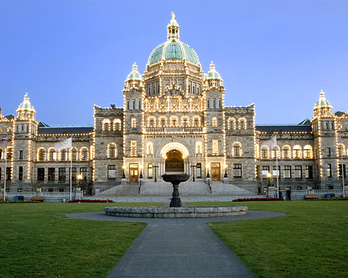
The Basics
Federal: We elect MPs (Members of Parliament) that represent us in the House of Commons in Ottawa.
Provincial: We elect MLAs (Members of the Legislative Assembly) that represent us at the Legislature in Victoria.
Municipal: We elect a mayor and town councillors to represent us at our town hall here in Burns Lake

Slide 40
Your Task
(Individually) Complete Who is Responsible? graphic organizer
Share with a partner
We will discuss as a class

Slide 41
Your Task
(Individually) On Issues That Matter, write down some current issues that matter to you
These are some ideas to get you thinking… come up with some of your own too!
Enbridge: Northern Gateway Pipeline Environment Euthanasia/Assisted suicide Women’s Rights
Increased surveillance/Privacy Driving Regulations
Drinking age Downloading of music/videos, etc.
Unemployment Cost of university
Hunting/fishing regulations Education

Slide 42
Your Task
Share your ideas/issues with a small group (3-4)
Write your group’s top two important issues down on sticky note, and add it to the board (where you think it belongs)

Slide 43
Your Task
In your group, discuss ways that you could address/change those issues or raise awareness about them.
Examples: write a letter to _______
start a petition

Slide 44
Discussion
Which issues are important to us?
Which level of government is “responsible” What could we do to affect change?

Slide 45
Your Task
Complete questions on
“Issues That Matter”

