Slide 1
What did we even learn last class?

Slide 2
What are we doing today?
What is a political ideology?
Activity: Agree/Disagree
Ideologies & Political Spectrum
Complete handout & survey

Slide 3
Learning Outcomes
By the end of this lesson you should be able to:
Define: communism, conservatism, fascism, liberalism, and socialism
Explain what it means to be “left wing” or “right wing”
Identify and evaluate your own political ideology

Slide 4
Political Ideology
A set of beliefs and values that guides one’s actions.
Your belief system about how the world works and what the role of government should be

Slide 5
Agree/Disagree?
Human beings are naturally selfish

Slide 6
Agree/Disagree?
Government is necessary

Slide 7
Agree/Disagree?
The main purpose of a government should be to protect the rights of the individual

Slide 8
Agree/Disagree?
It is necessary to give up some individual rights and freedoms for increased public security

Slide 9
Agree/Disagree?
The benefits of oil pipelines outweigh the environmental concerns

Slide 10
Agree/Disagree?
Using military force is the best way to defeat terrorism in the world

Slide 11
Agree/Disagree?
Capital punishment (death penalty) should be reintroduced to Canadian law

Slide 12
Agree/Disagree?
The drinking age should be eliminated

Slide 13
Communism
Extreme “left-wing” ideology based upon the revolutionary teachings of Karl Marx
Calls for the abolishment of private property, promotes collective ownership
Supports a planned economy & economic equality for all
Goods are owned in common and are available to all as needed
One political party is in control

Slide 14
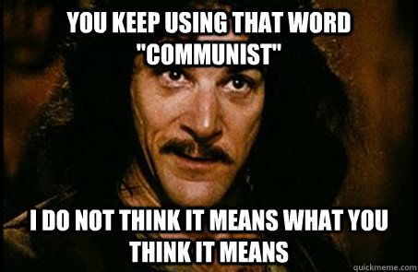

Slide 15
Socialism
The principle means of production, distribution, and exchange are in common ownership (co-operative)
Supports government intervention and regulation in the economy
When you think of socialism, think of things such as : farmer co-operatives, credit unions, labour unions, universal education or healthcare

Slide 16
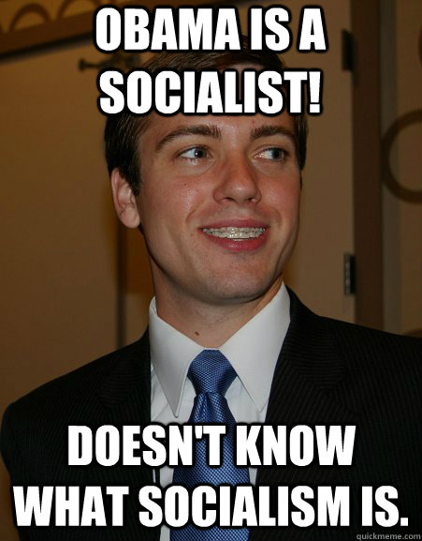

Slide 17
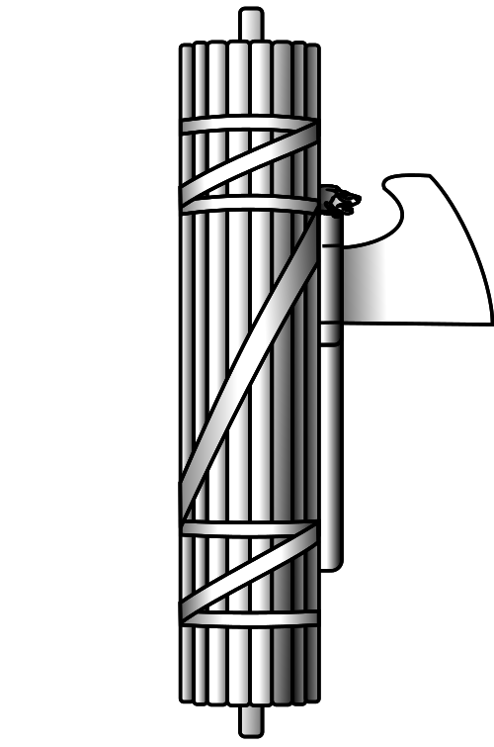
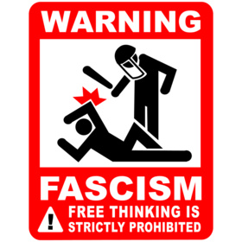
Fascism
Extreme “right wing” ideology where the existing social order is “protected” by the forcible suppression of the working class
No intellectual freedom, limited economic freedom, and strong government regulations

Slide 18
Liberalism
Strong belief in economic and intellectual freedom and promotes representative government, free-speech, abolition of class privilege and state protection of the individual
Think liberty: “freedom”

Slide 19
Conservatism
Strong belief in economic freedom and intellectual equality
Supports traditional values and beliefs and a governmental system where the existing institutions are maintained
Emphasizes free-enterprise and minimal government intervention

Slide 20
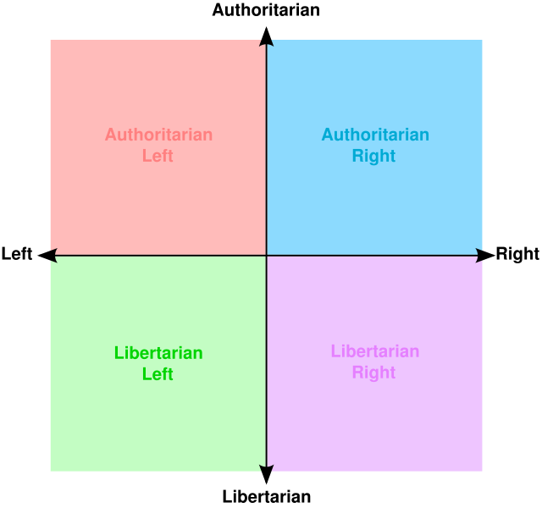
Political Spectrum
Way of organising political ideologies by comparing them to the beliefs of others
Continuum
Different models

Slide 21
Communism
Socialism
Liberalism
Conservatism
Fascism
LEFT WING
CENTRE
RIGHT WING

Slide 22
“Left/Right Wing”
Different ideas about the role of government, the economy, and social issues and freedoms
Left
Right

Slide 23
Left | Right
Social welfare / Social equality | Economic and Individual freedom
Progressive values | Traditional values
Anti-globalization/Free trade | Pro-globalization/Free trade
Greater regulations | Fewer regulations
Government can solve problems | Individual can solve problems
More gov’t intervention | Less/no gov’t intervention

Slide 24
AUTHORITARIAN
State Communism
Fascism
Conservatism
LEFT WING
RIGHT WING
Social democracy
Neo-liberalism
Anarchism
LIBERTARIAN

Slide 25
Authoritarian – Government requires a strict obedience to the authority of the state
Libertarian – The rights of the individual are favoured over the state. In some cases government is believed to hinder individual freedoms.

Slide 26
Left-right political spectrum
Favours privatisation of some public services, lessened state intervention in social and economic policy and greater personal autonomy.
Favours nationalisation of public services, large state intervention in social and economic policy and greater equality.
Socialism
Liberalism
Conservatism
LEFT WING
CENTRE
RIGHT WING

Slide 27
Left-right political spectrum
Favours less state intervention but some regulation from the government on key policies
Socialism
Liberalism
Conservatism
LEFT WING
CENTRE
RIGHT WING

Slide 28
Now imagine that you are the Prime minister. What sort of government would you run?
You have to consider the two big areas of government.
Social and economic policies.

Slide 29
AUTHORITARIAN
Economic
LEFT WING
RIGHT WING
Social
LIBERTARIAN

Slide 30
AUTHORITARIAN
Economic and fiscal policy is tightly controlled by the government.
Economic and fiscal deregulated to encourage free enterprise
Economic
LEFT WING
RIGHT WING
Social
LIBERTARIAN

Slide 31
Society is strictly controlled by the government making laws about how people can live.
AUTHORITARIAN
Economic
LEFT WING
RIGHT WING
Society is a collection of small self-regulatory communities that have no state input
Social
LIBERTARIAN

Slide 32
Policy | Left wing | Centre | Right Wing
CRIME | Solve underlying social problems that cause crime | “Tough on crime; Tough on causes of crime” | Tough on criminals
SOCIETY | Equality in society | Equality of opportunity | Inequality exists
TAX | High levels to make society equal | Balance of taxation- based on fairness | Low taxation
ECONOMY | Intervention in economy | Mixture – Market driven when possible; State when necessary | Laissez-faire
SERVICES | Public – e.g. NHS | Mixture of Public and Private | Private where necessary for efficiency

