Slide 1
TODAY…
OUR GOALS | YOUR PLAN
Story & Think/pair/share | Listen quietly to the story Think about it, share with partner and participate in discussion
Watch two videos about Canada’s Democracy and the Constitution | Watch/listen quietly and take notes on the provided note sheet
Political Party Jigsaw | Work cooperatively, take notes, report back to your group to share info

Slide 2
Learning Outcomes
Identify what kind of a government system we have in Canada
Describe the rights and freedoms that we have as Canadian citizens
Outline the key information/policies of the five major political parties in Canada

Slide 3
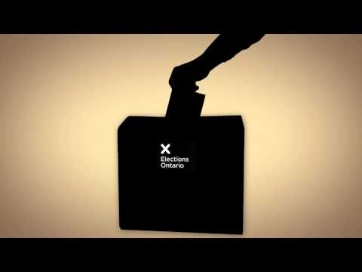

Slide 4
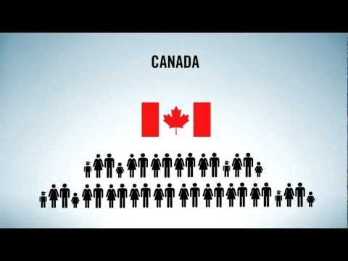

Slide 5
Canada’s Constitution & Charter of Rights & Freedoms
Much of our Constitution is based on the idea that government power needs to be constrained, and the rights of individuals protected.
We are guaranteed:
Rule of Law
limits power of officials
Freedom
protects people with unpopular beliefs
Democracy
so gov’t doesn’t stay in power forever…
Minority Rights
prevents discrimination

Slide 6
Freedom of expression
Freedom of thought
Freedom of the press
Freedom of religion
Freedom of
association

Slide 7
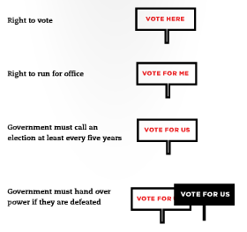

Slide 8
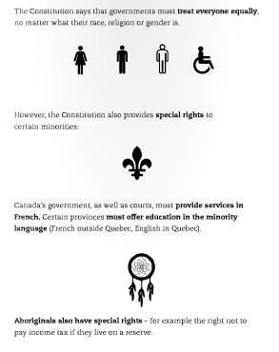
Equal treatment regardless of race, religion, or gender.
Special rights to certain minorities (e.g. Aboriginal rights)

Slide 9
Canada’s Federal Political Parties

Slide 10
Your Task
Political Party Jigsaw
The groups you are in now are your home groups
Number off 1 to __
Move to meet with the other “1” students, etc.
Now you are in your research groups (you should all have the same number)

Slide 11
Part 1: Research Group
Read through the information provided
2. Discuss what the most important points are
3. Write them down on your graphic organizer

Slide 12
Part 2: Home Group
Each group member will take turns sharing their information with their group (write it down…)
Now you should have a completed assignment! Yay teamwork! ;)

Slide 13
Ticket Out the Door…
Directions: Answer the following questions on a piece of paper; hand it to me before you leave class
Which political party do you think that your beliefs align best with? Why?
Which party would you be most likely to vote for if an election were held today?

