Slide 1
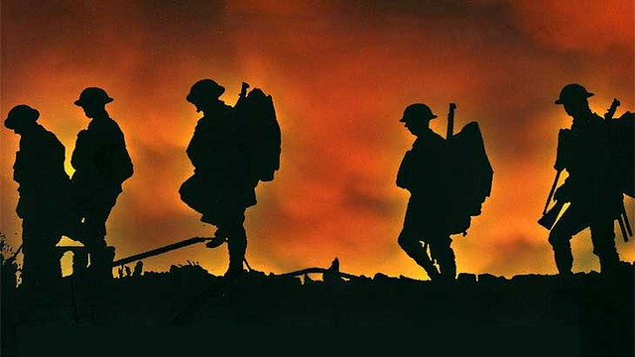
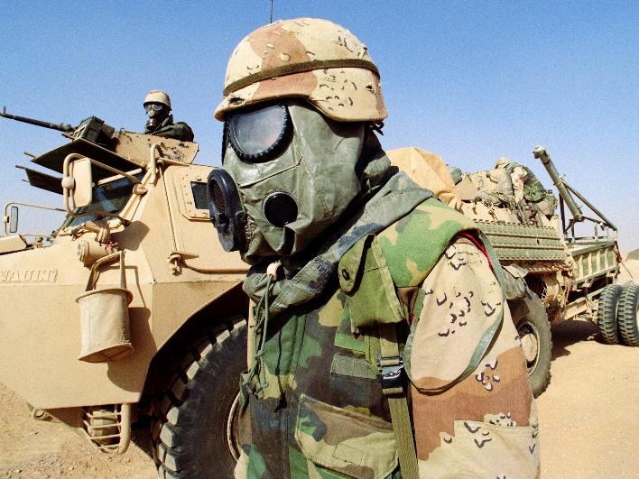
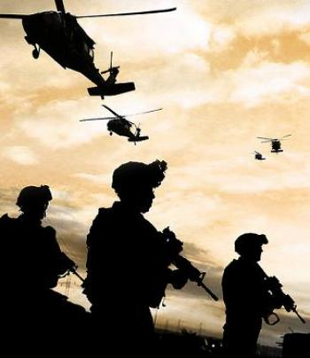
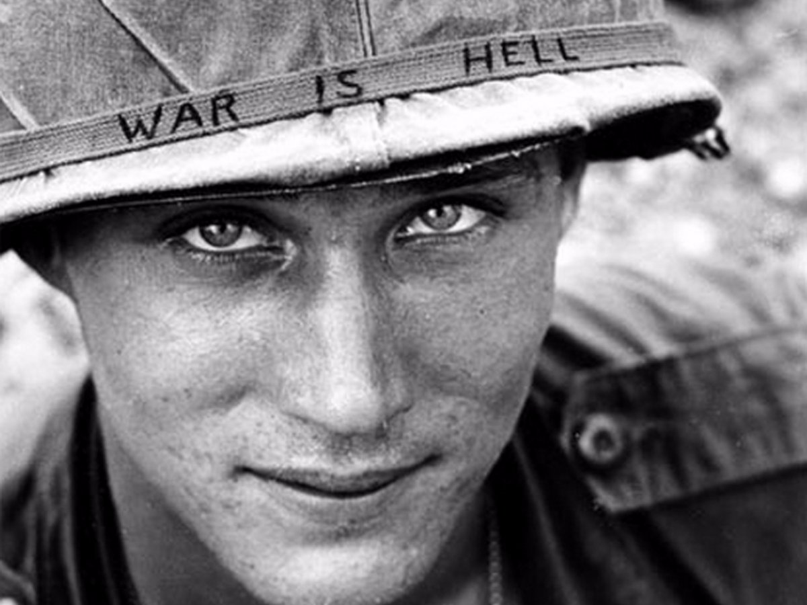
What is the cost of war?

Slide 2
Characterization
ELOs
I understand the difference between Direct and Indirect characterization
I can list the 5 ways an author indirectly reveals characters (STEAL)
QUIZ ON THESE TOMORROW

Slide 3
Characterization
Watch video: https://www.youtube.com/watch?v=IRW6yVOHCQc
Fill in chart with the words for STEAL

Slide 4
What is characterization?
How the author reveals the personality and traits of the character

Slide 5
Characterization
What do each of these mean?
Direct
Indirect
“TELLS”: the author makes direct statements about a character’s personality or traits.
“SHOWS”: the author reveals information about a character through their thoughts, actions, what other characters say, etc.

Slide 6
Indirect Characterization
What are the 5 ways an author can reveal a character’s personality/traits, INDIRECTLY?
S
T
E
A
L
SPEECH
THOUGHTS
EFFECT on other characters
ACTIONS
LOOKS

Slide 7
Direct/Indirect?
“Hey, we can have lots of fun at camp this summer! I love being outside!”
Julie held up six different outfits in front of the mirror and pondered which would go best with her navy blue shoes, pastel eye shadow and the diamond earrings she’d already procured from her overflowing vanity.
The old mechanic hated modern electronics, preferring the good old days when all he needed was a stack of manuals and a good set of tools.
Julie was very superficial and cared way too much about how she looked. Some days she spent hours in front of the mirror.

Slide 8
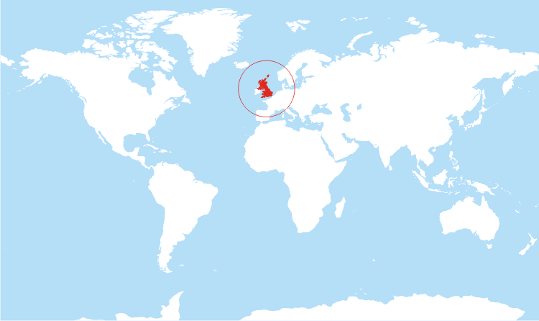
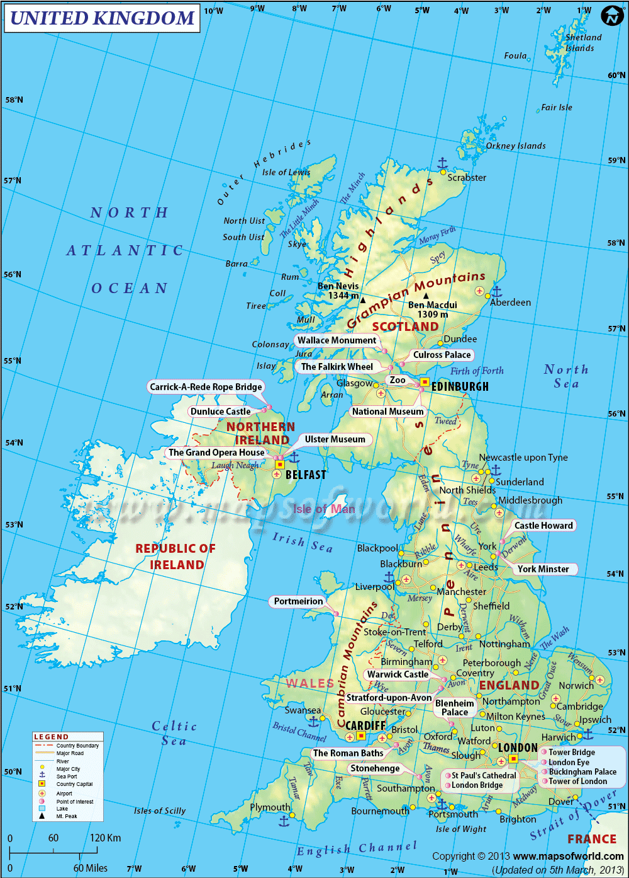
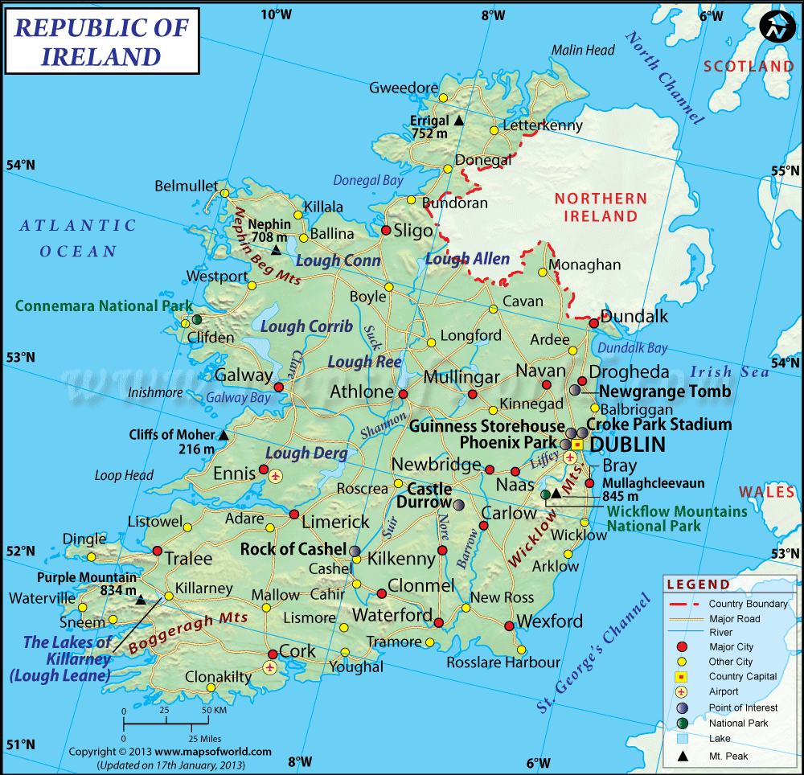

Slide 9
Your Task: HIGHLIGHT anything that shows us about the sniper’s personality or traits (STEAL)
https://www.youtube.com/watch?v=nTE59C7Y6fI

Slide 10
Characterization in:
YOUR TASK:
Find & highlight parts in the story where the sniper’s personality/traits are revealed
Write those down in the appropriate box
Explain what the thoughts, actions, etc. of the sniper REVEAL about them
ELOs:
I can list character traits/adjectives to describe the character in the text
I can find supporting evidence from the text to support my choice of adjectives/traits

Slide 11
Characterization in:
TASK: Use the information from your STEAL chart to write a properly formatted paragraph about the characterization of the sniper in this short story.
ELO:
I can write a properly formatted paragraph to discuss characterization

Slide 12
YOUR TASK
Complete the Questions about The Sniper
ELOs:
I can read text and make inferences
I can address the prompt or question
I can define and identify irony

Slide 13
What does it tell us about the cost of war?
War reduces human beings to objects
They have no names or faces. They are targets to be shot at from a distance.
War knows no boundaries (age, sex, location, family ties)
IRA sniper is a young man, informer is an old woman. Fighting takes place in the middle of a city after sundown. IRA sniper kills his own brother.
ELO:
I can identify the main idea(s) or message(s) that the author wants readers to think about.

